Slide 1

The Onslaught of
Exotic Invertebrates
in Oregon
James R. LaBonte
Oregon Dept. of Agriculture
Columbia Gorge Exotic Species and Invasive Pest Workshop
Stevenson, WA March 19, 2015

Slide 2


When in
doubt,
keep it out!
Exclusion
Invasive
Species

Slide 3

Strong Regulations

Slide 4
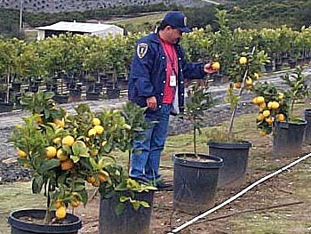

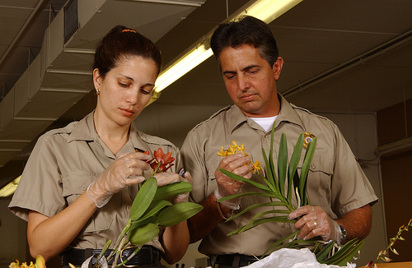
Strong Enforcement
alic.arid.arizona.edu
northjersey.com
blogs.usda.gov

Slide 5

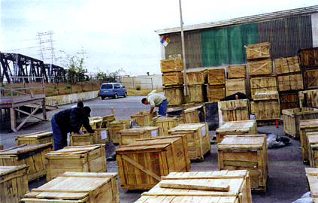


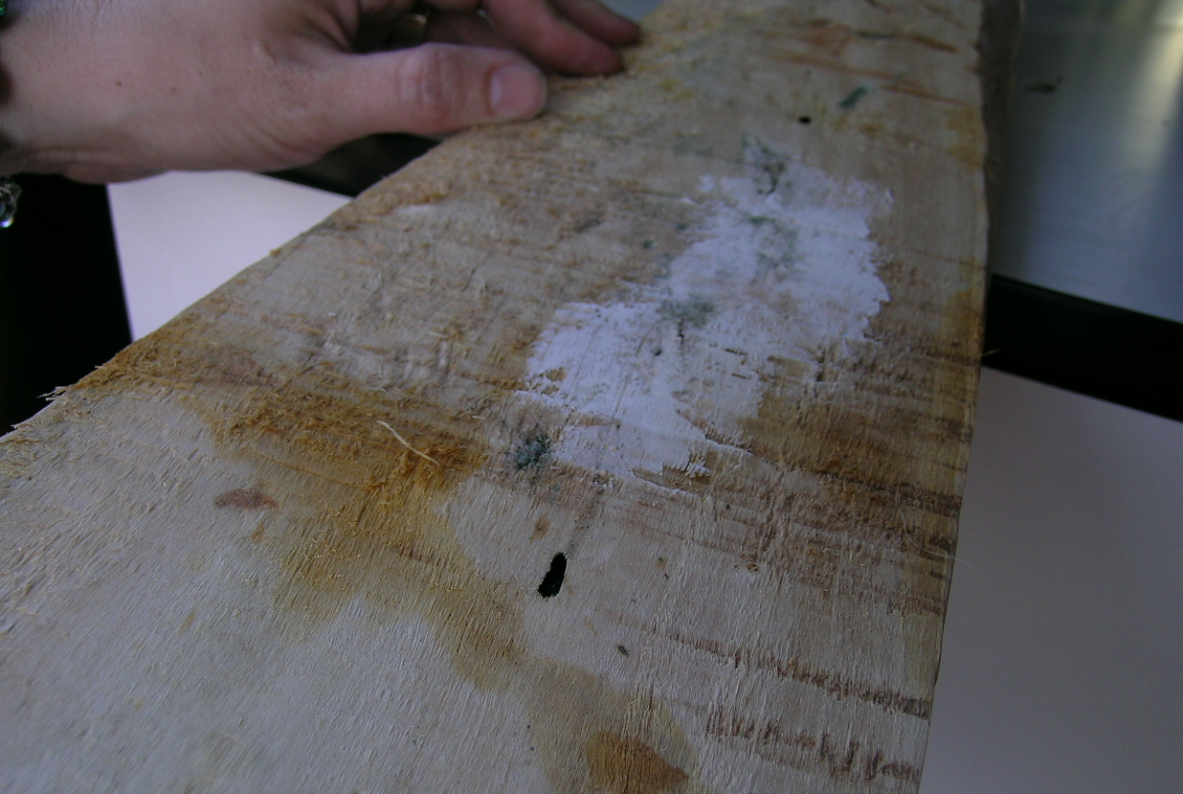
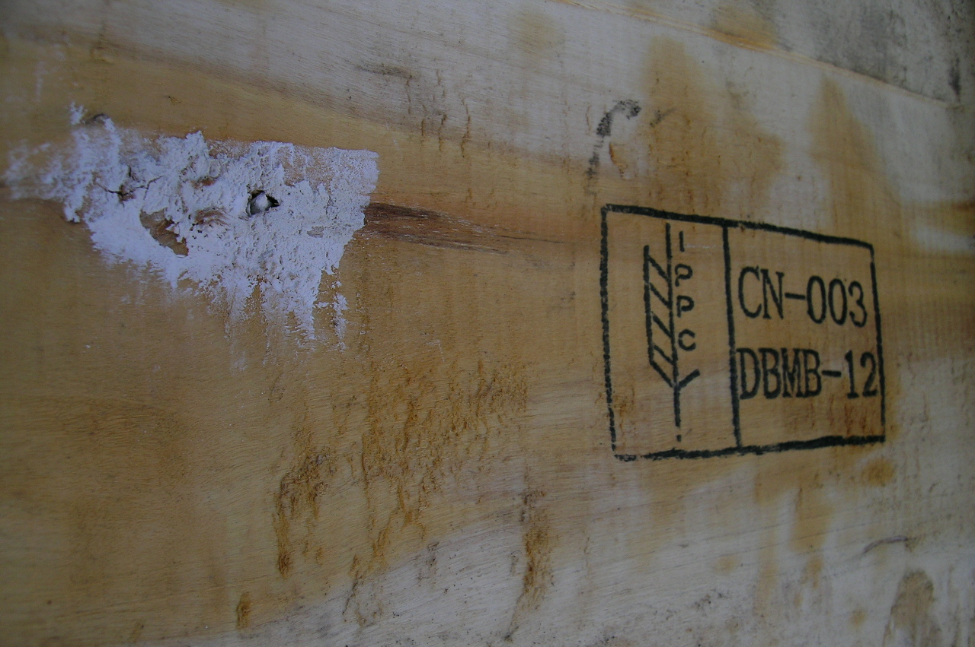
ISPM-15 “treated” crates of Chinese iron castings,
at receiving business, Portland, September 2006

Slide 6
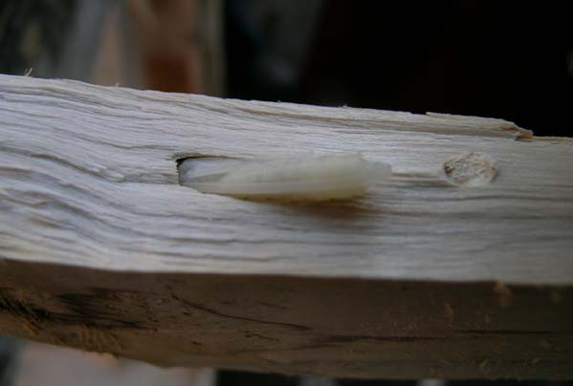
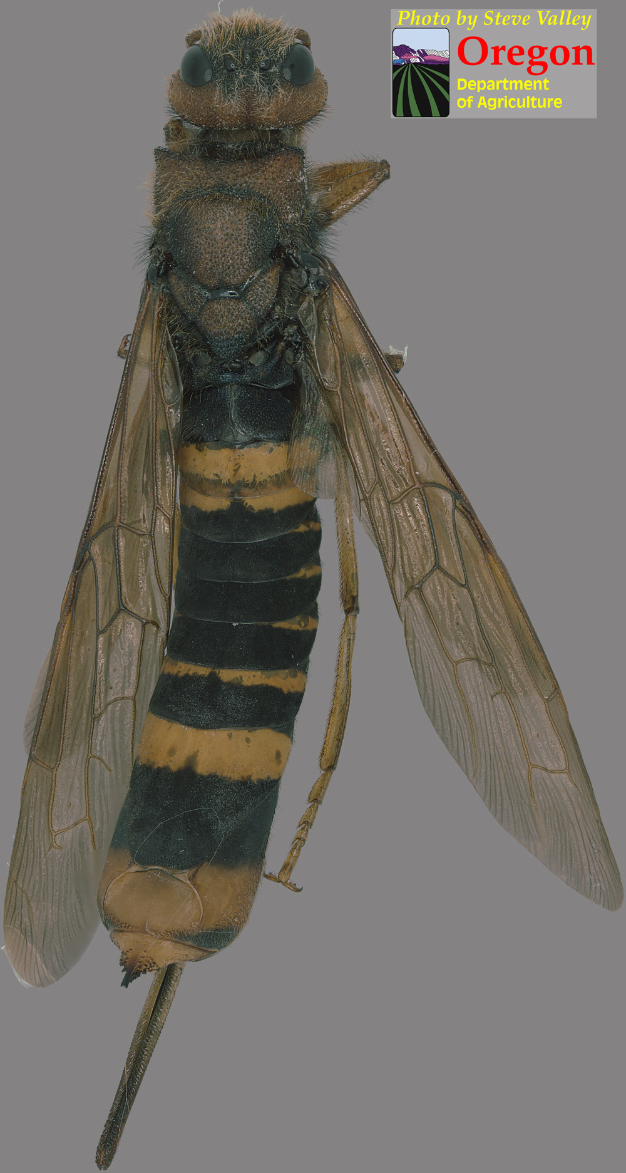
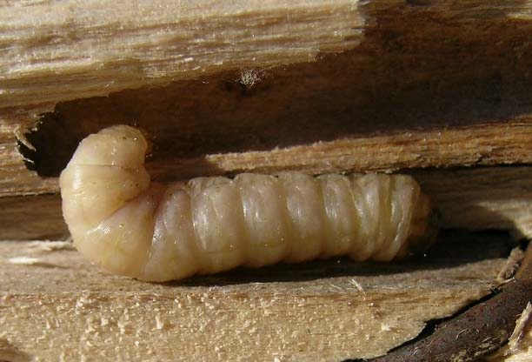
Live pupa of horn-tail wasp
Adult, found alive,
of horn-tail wasp,
Tremex fuscicornis
Live larva of clear-wing moth

Slide 7
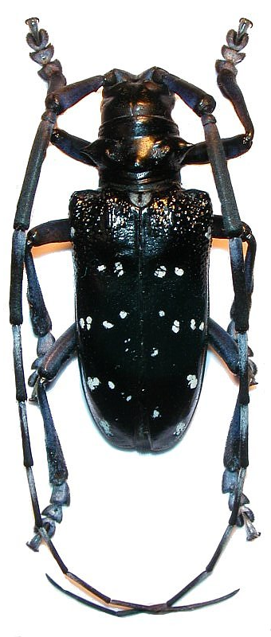
Live Plant Imports: #1 Pathway
In 2007, the U.S. imported over 3 BILLION
live plants!
In 2010, USDA live plant inspectors had an
average workload of 43,000,000 (milion) plants
per inspector!!!!!!!!!!!!!
Citrus longhorned beetle
biolib.cz
*Above information from Liebhold et al. 2012. Live plant imports: the major pathway for forest
insect and pathogen invasions of the US. Front. Ecol. Eviron. 10(3): 135-143.

Slide 8
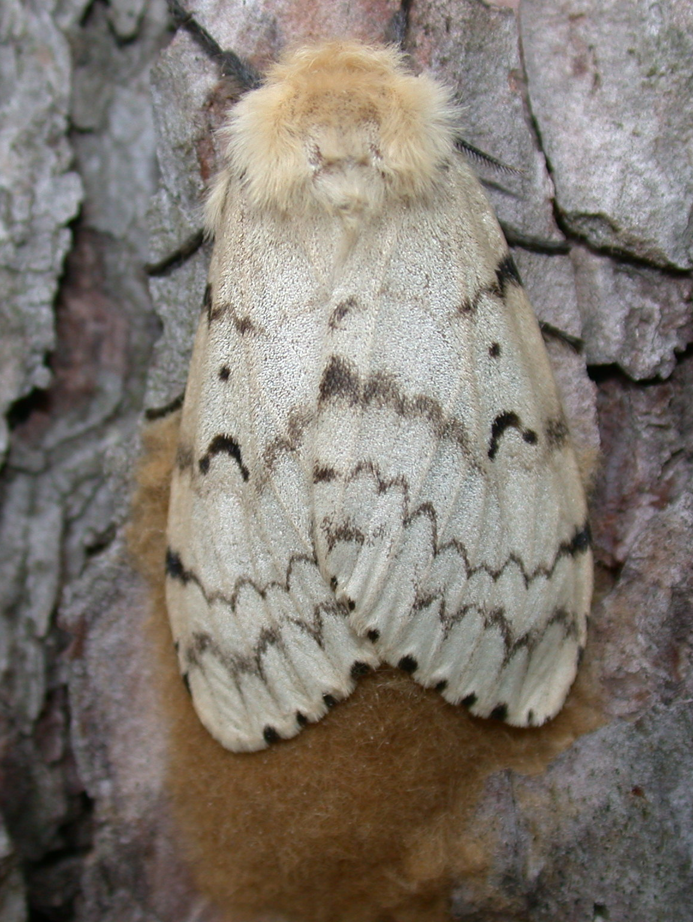
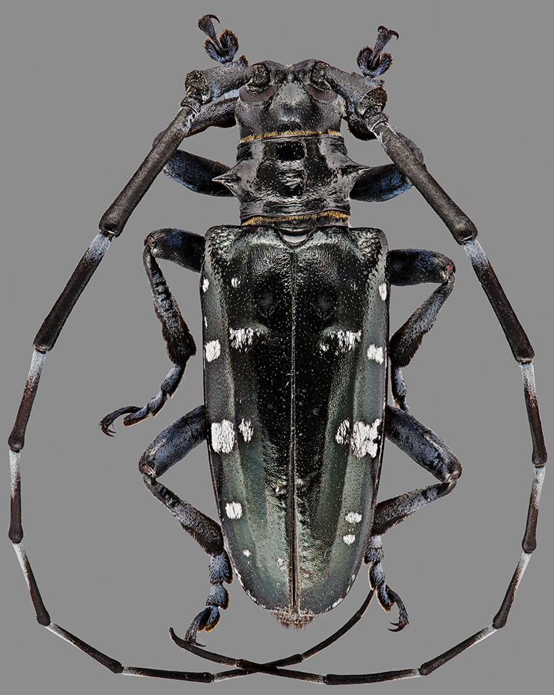
High Profile Exotic Pests
Gypsy moth
Asian long-
horned beetle
uwex.edu

Slide 9

Surveillance for and Detection
of Exotic Species is Costly

Slide 10

Technology for surveillance and
detection of exotic species is primitive
“Jim! I’m working
with stone knives
and
bearskins here!”

Slide 11
Lag time between
introduction and
detection
INTRODUCTION
ESTABLISHMENT
DISPERSAL
POPULATIONS INCREASE
DETECTABLE POPULATIONS

Slide 12
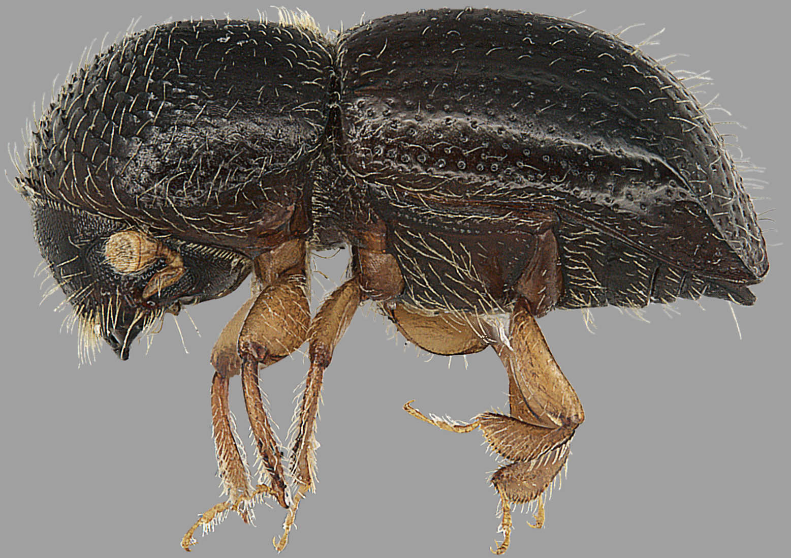
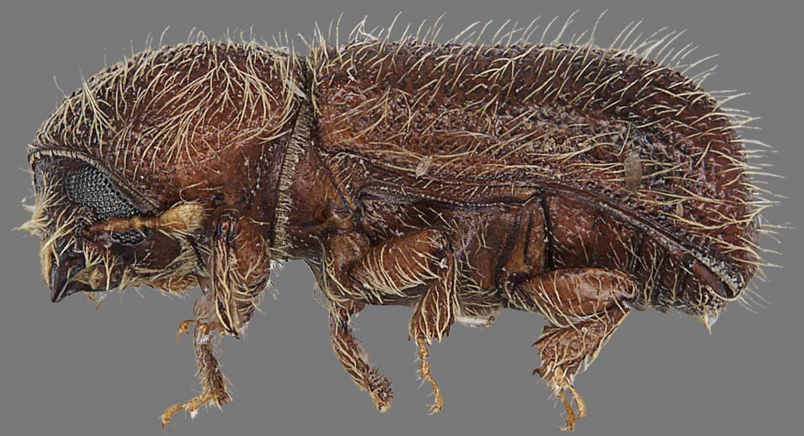
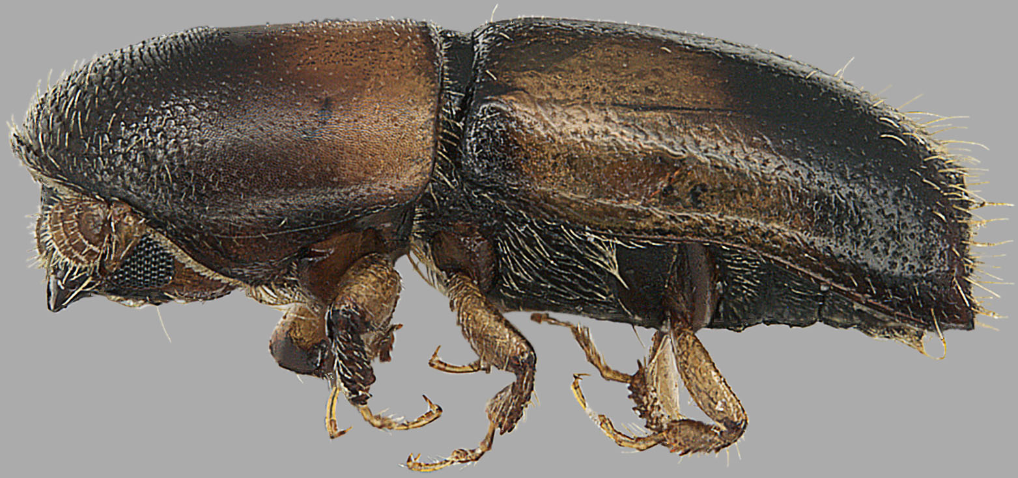
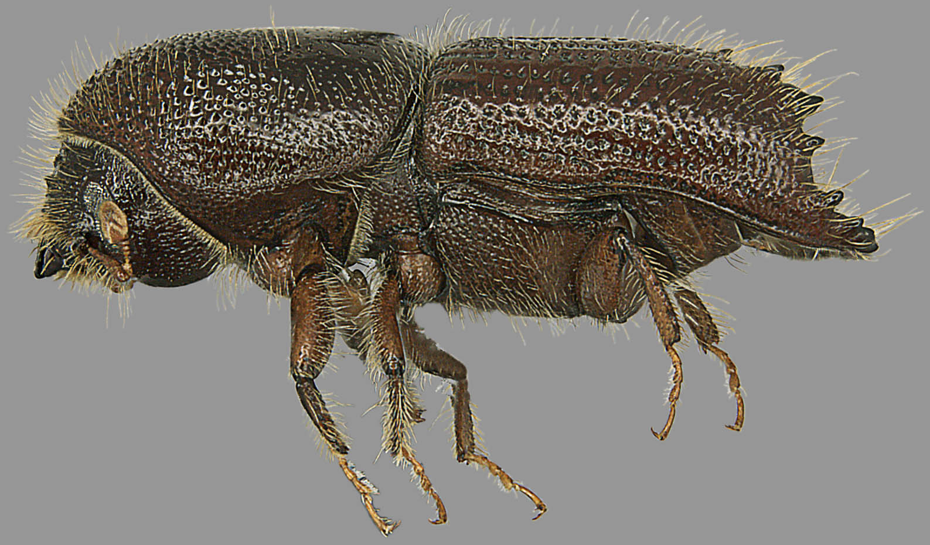
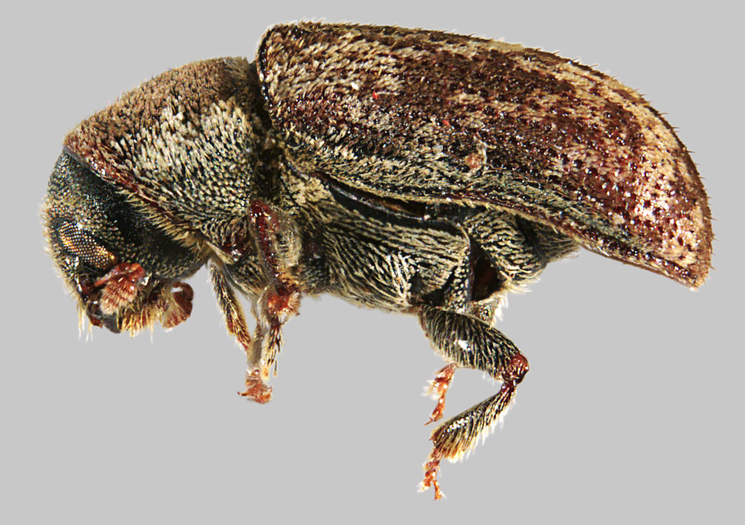
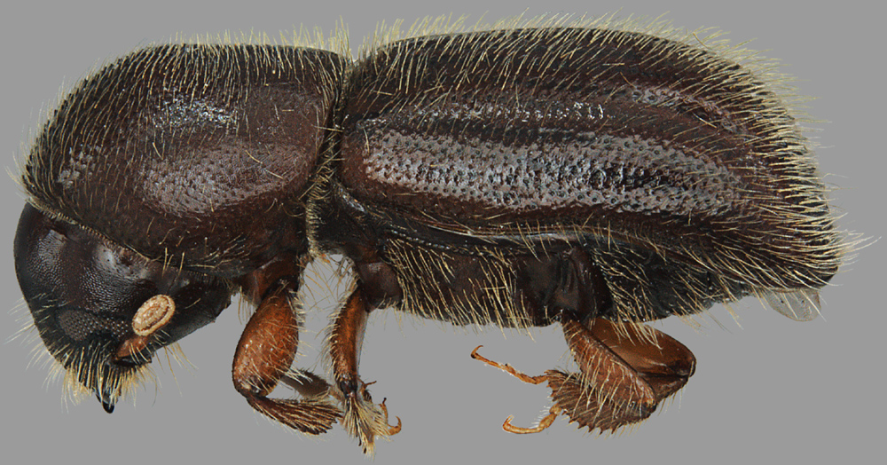
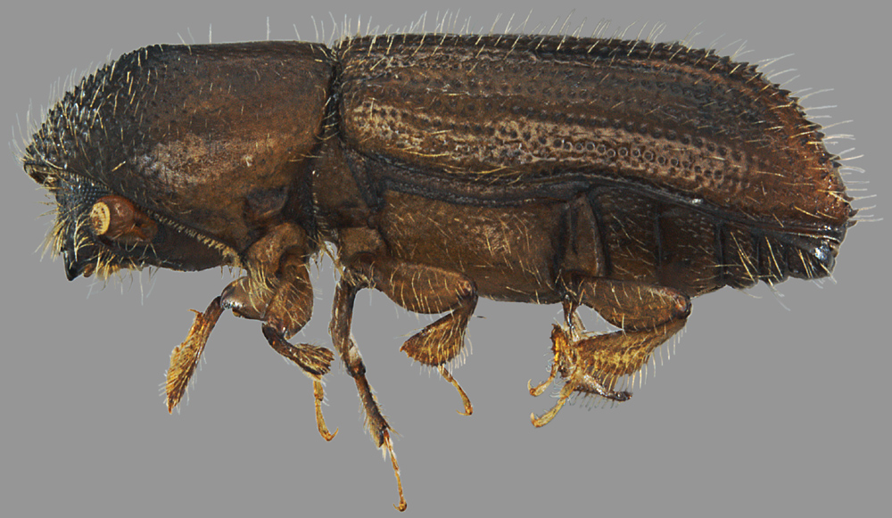
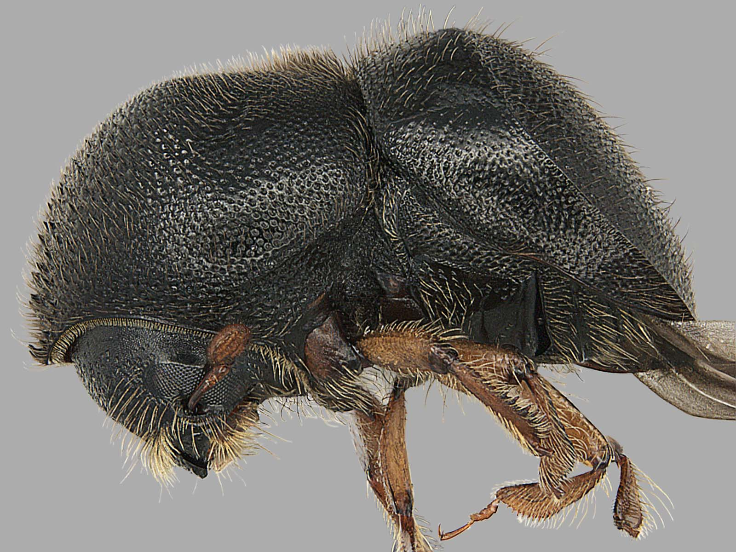
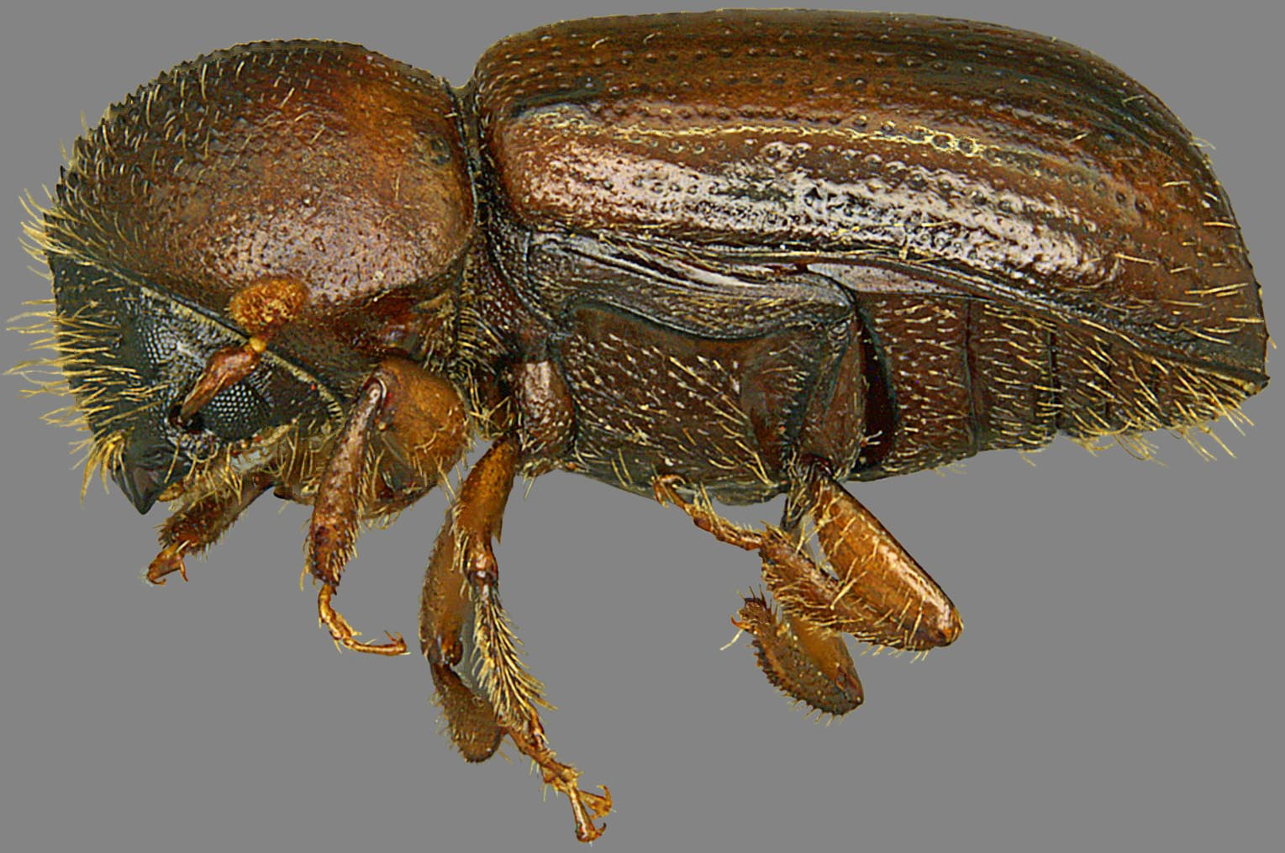
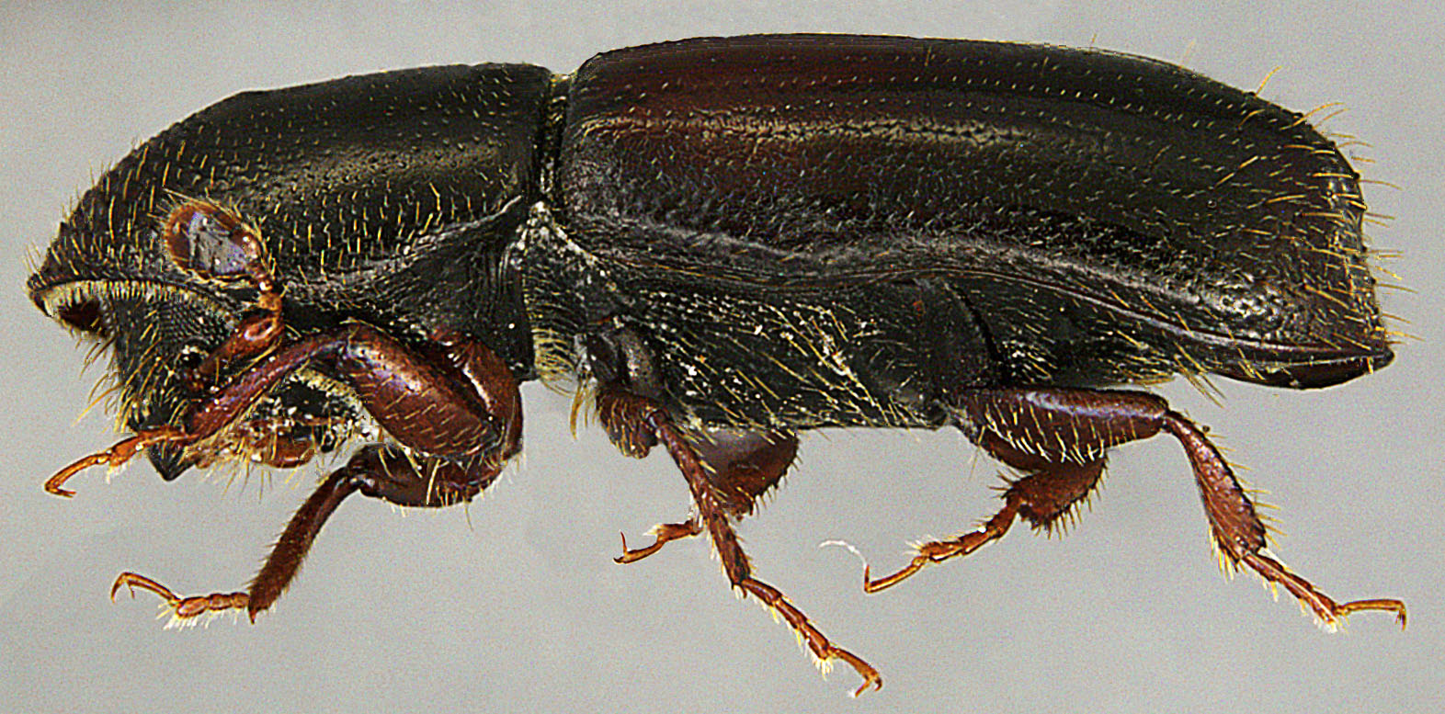
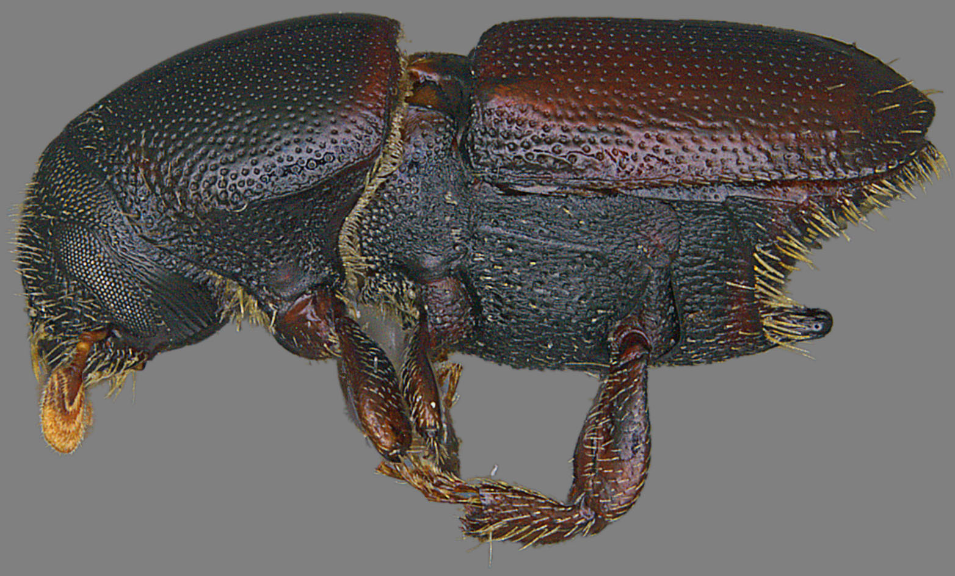
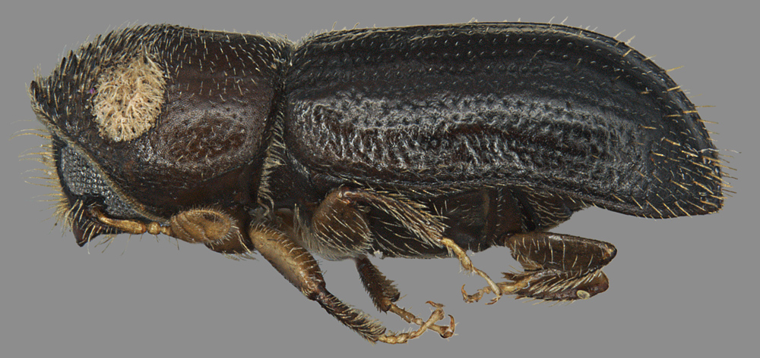
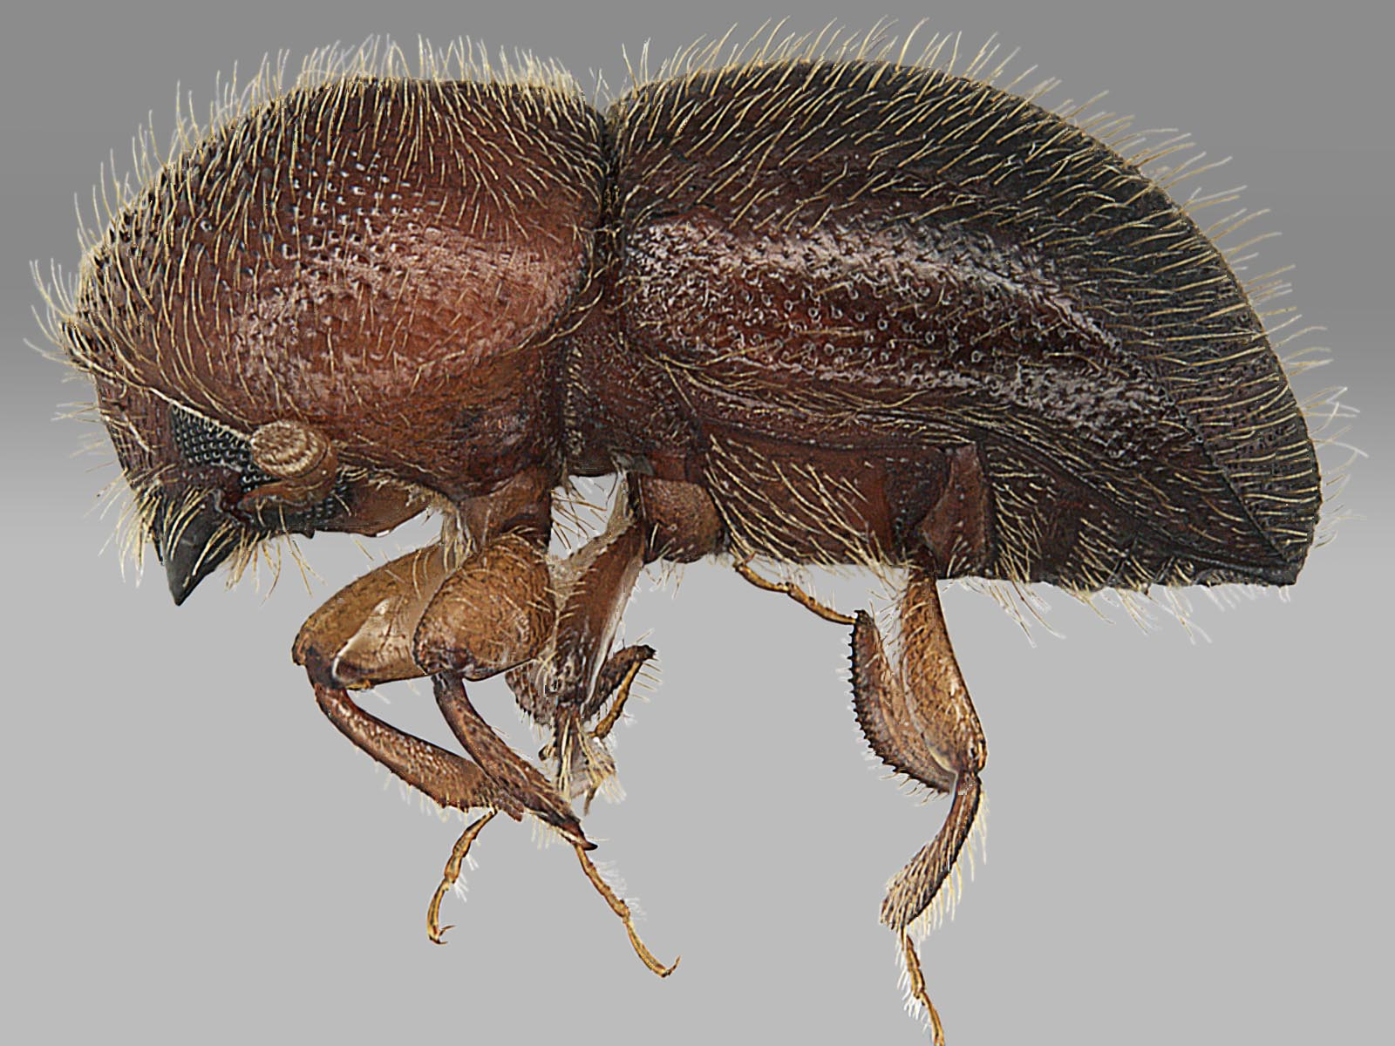
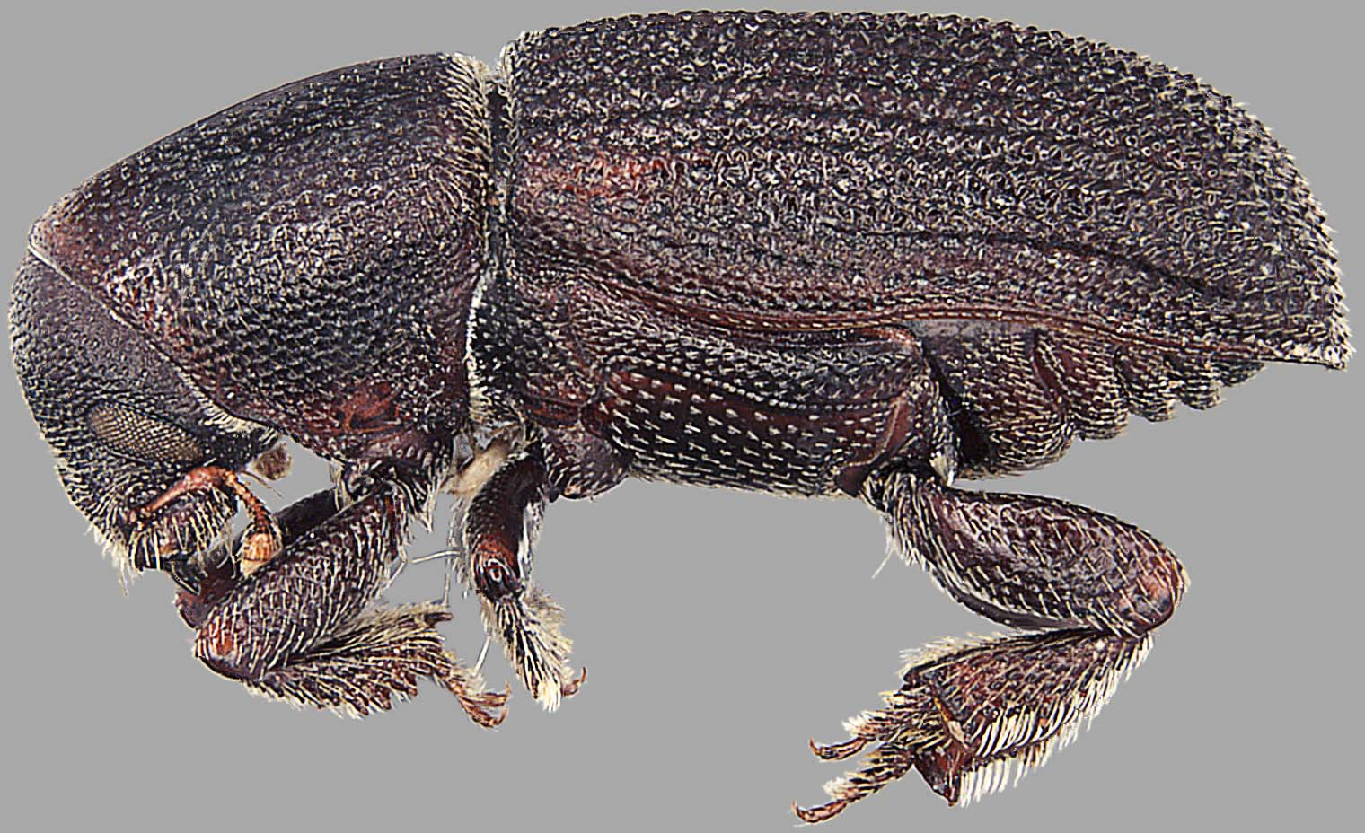
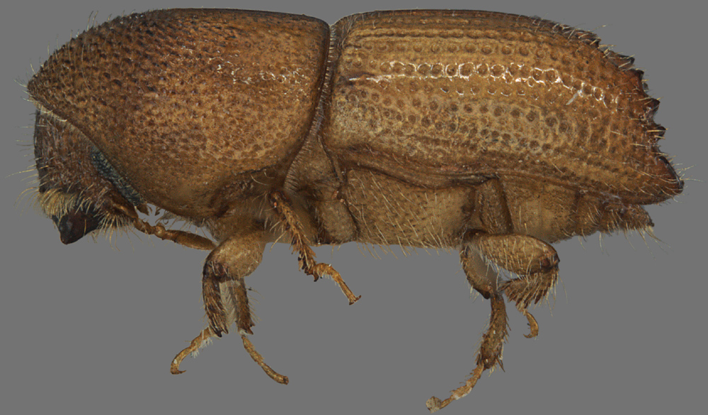
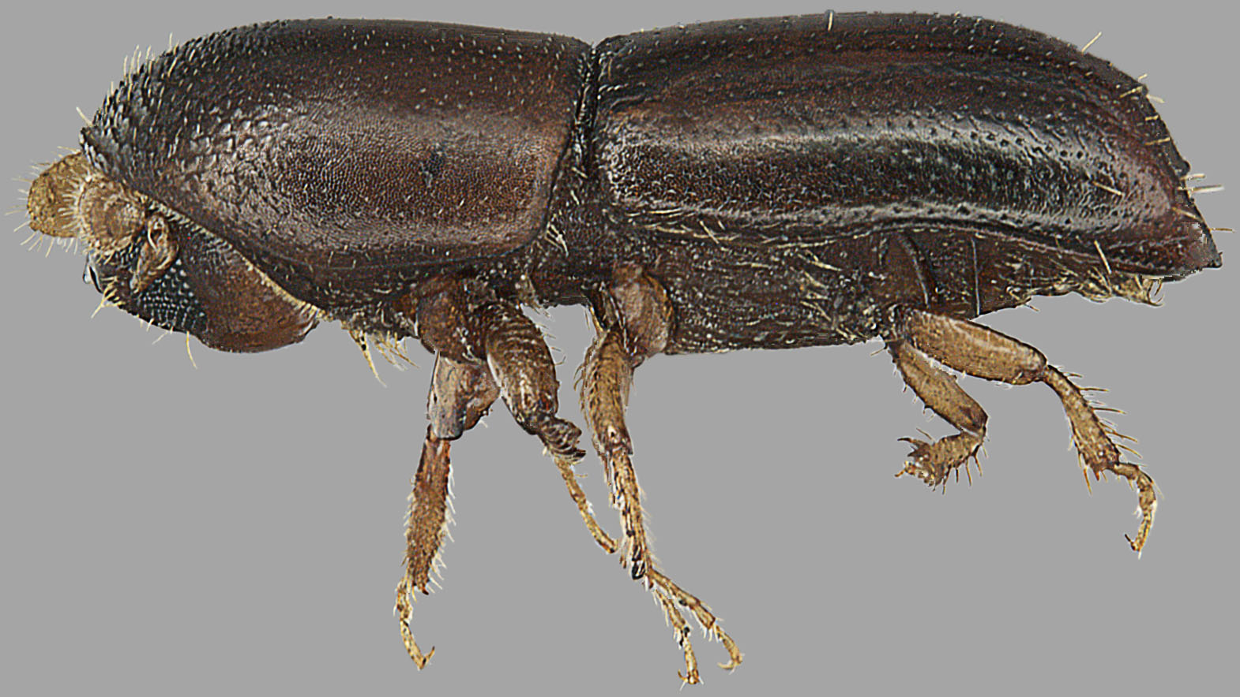
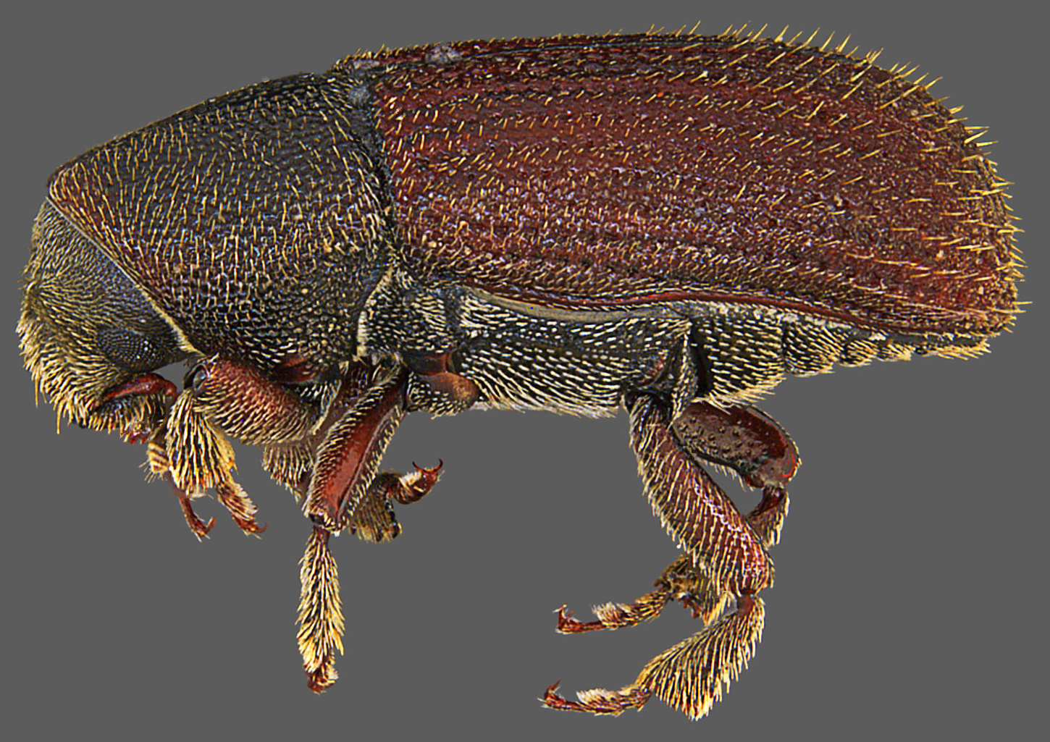
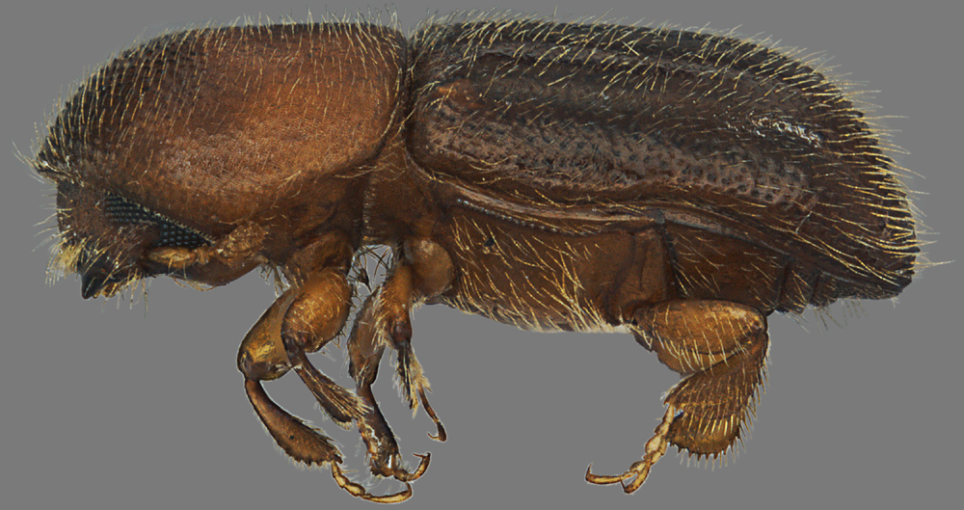
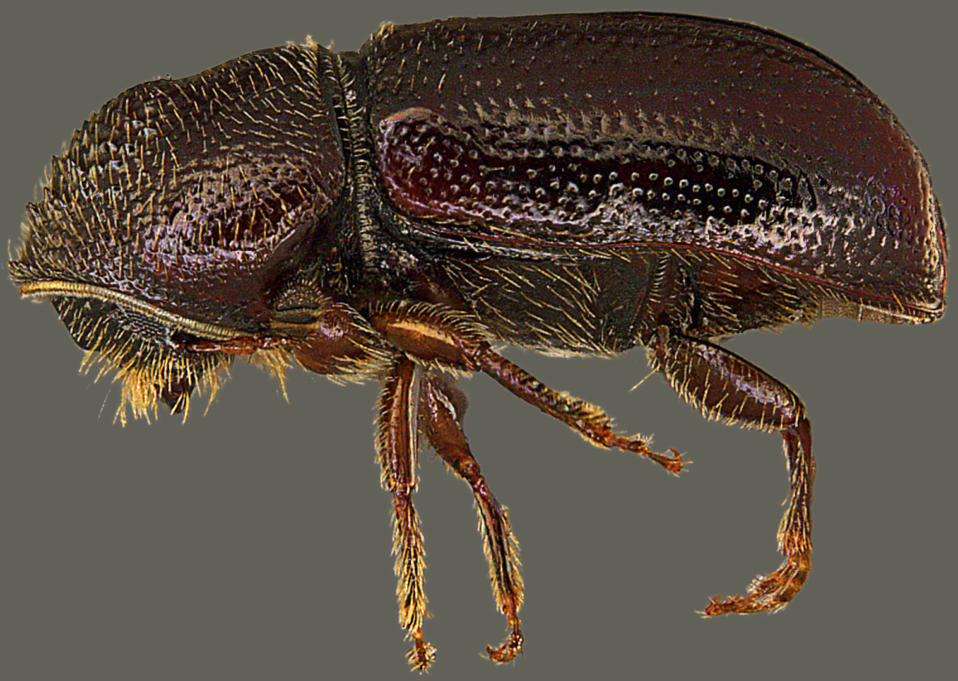
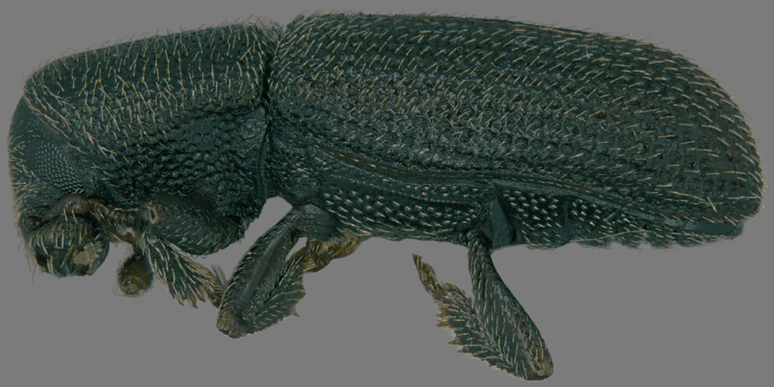
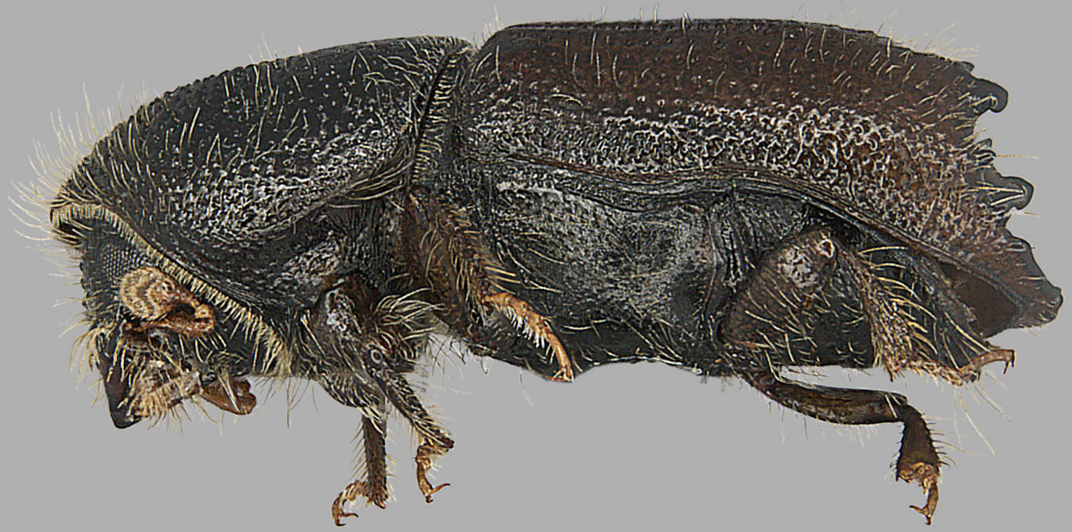
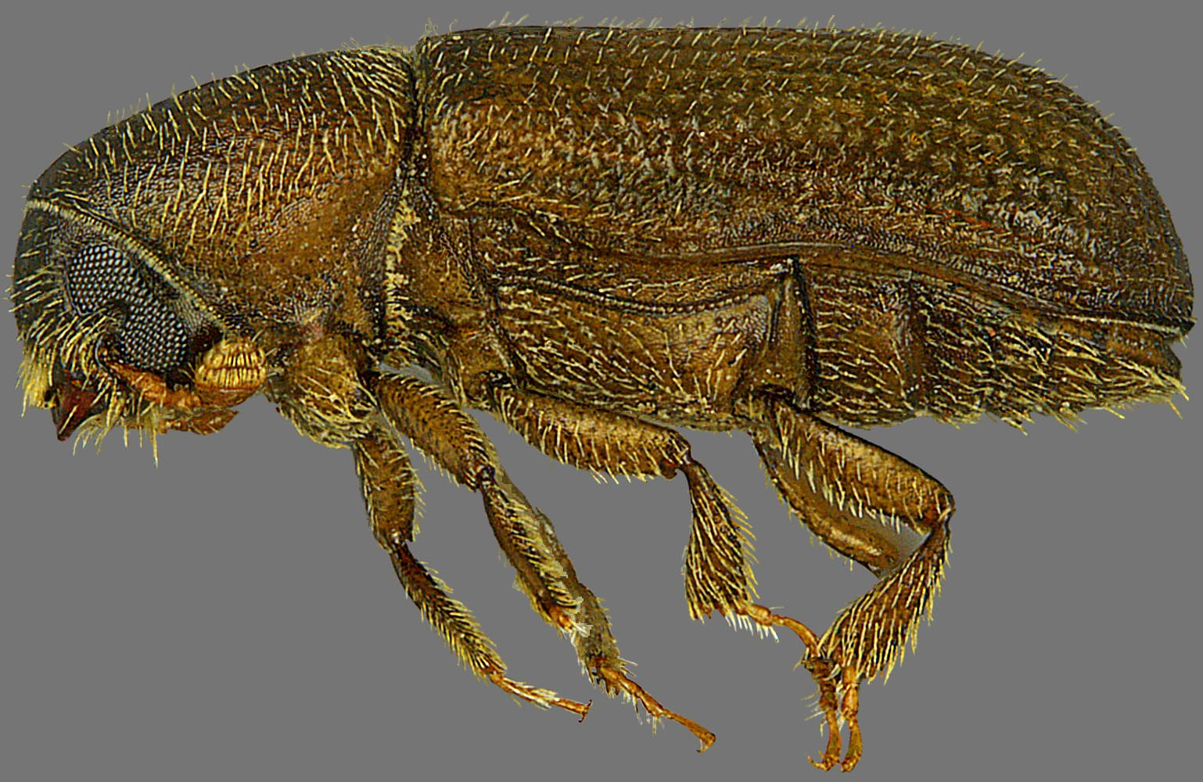
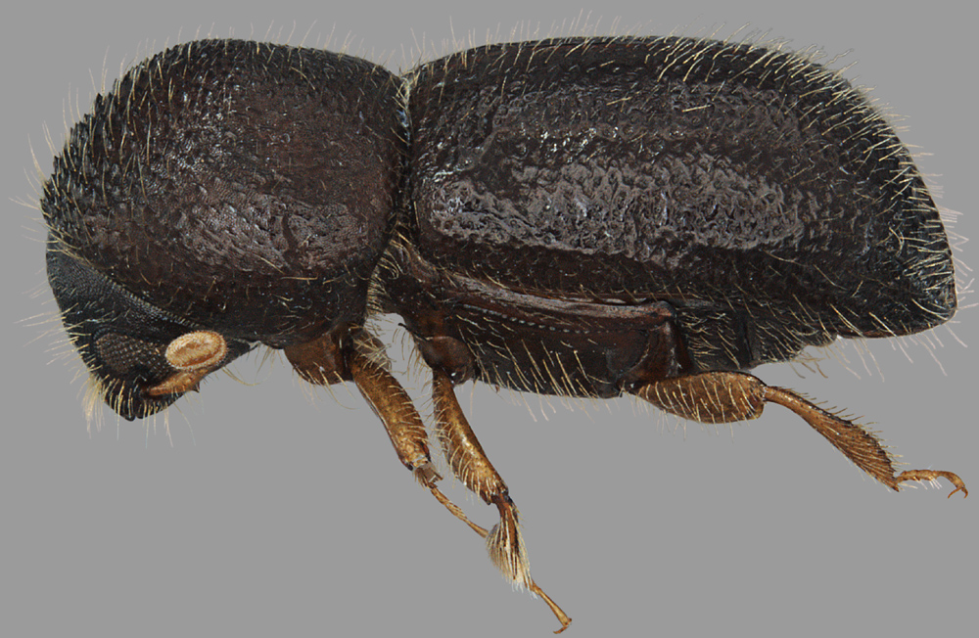
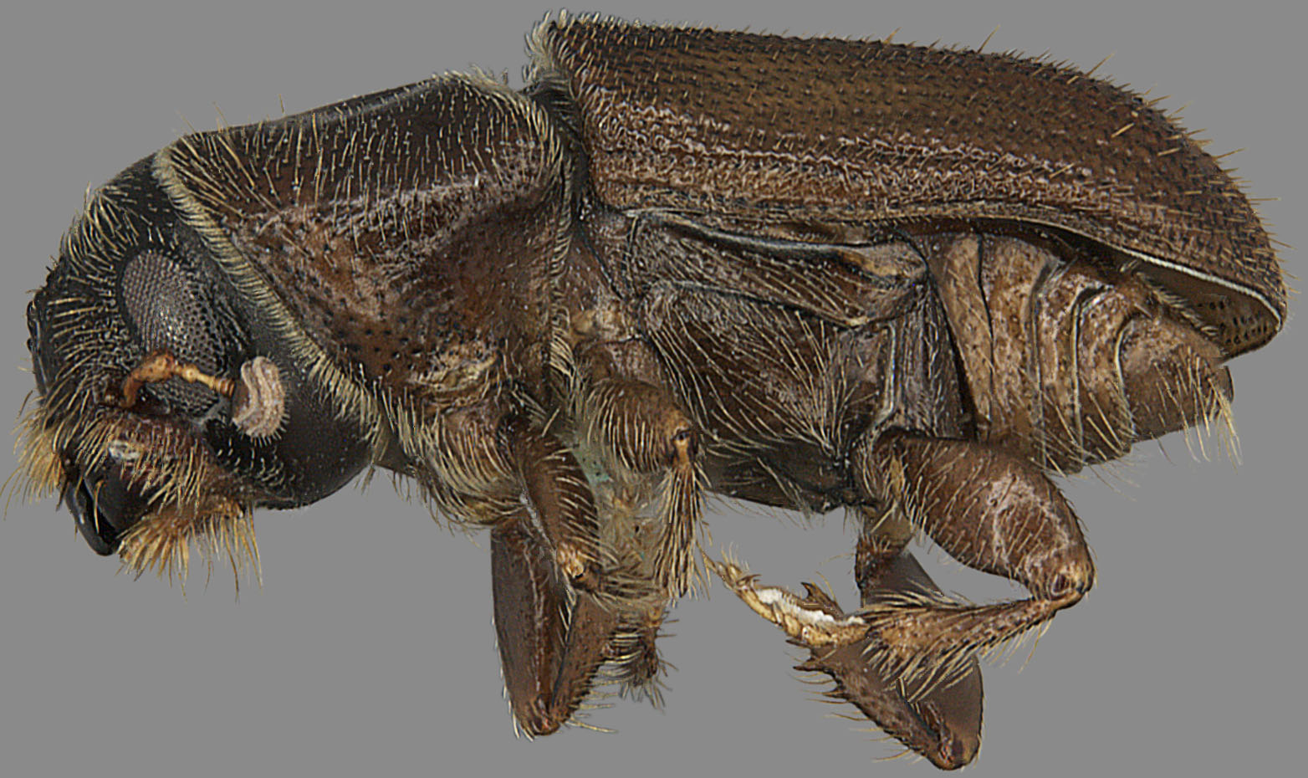
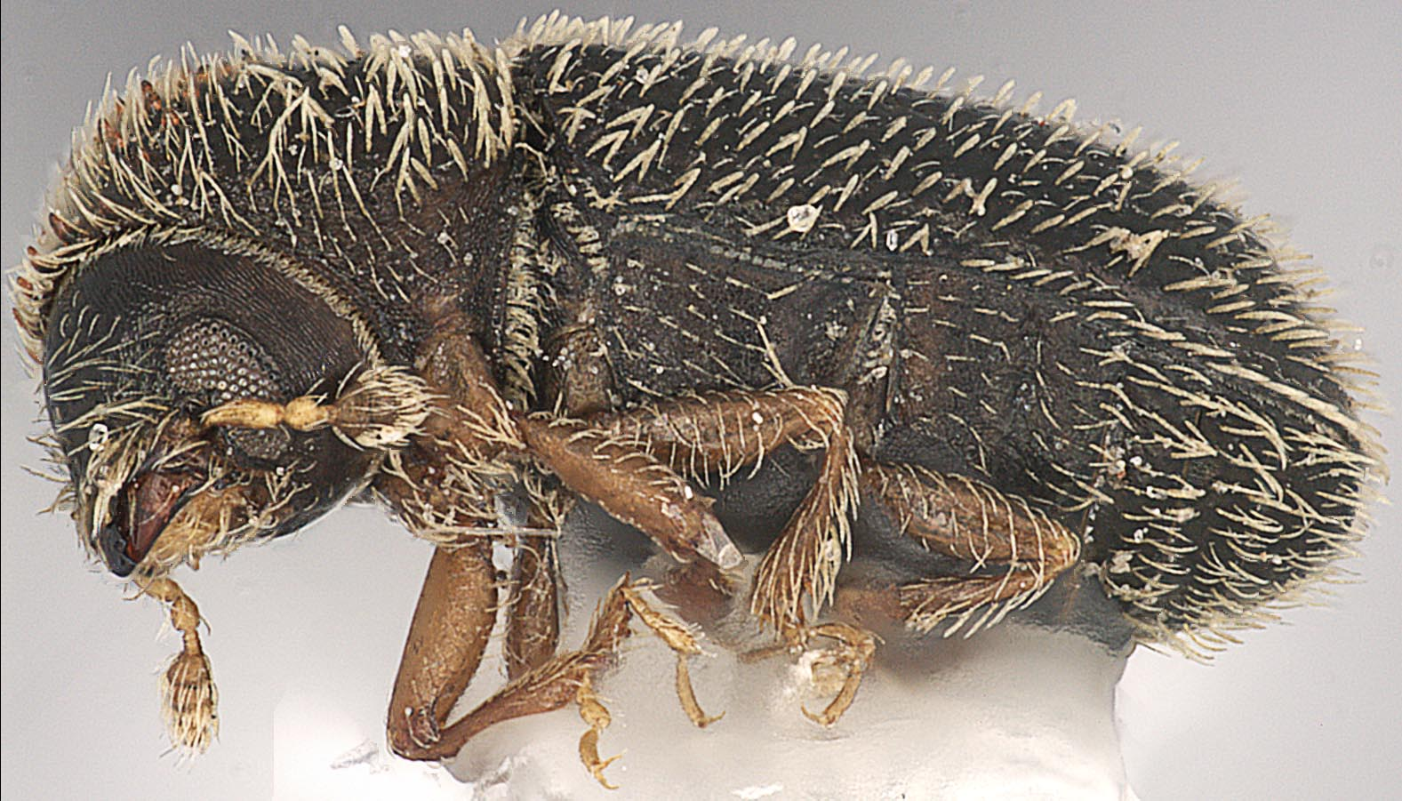
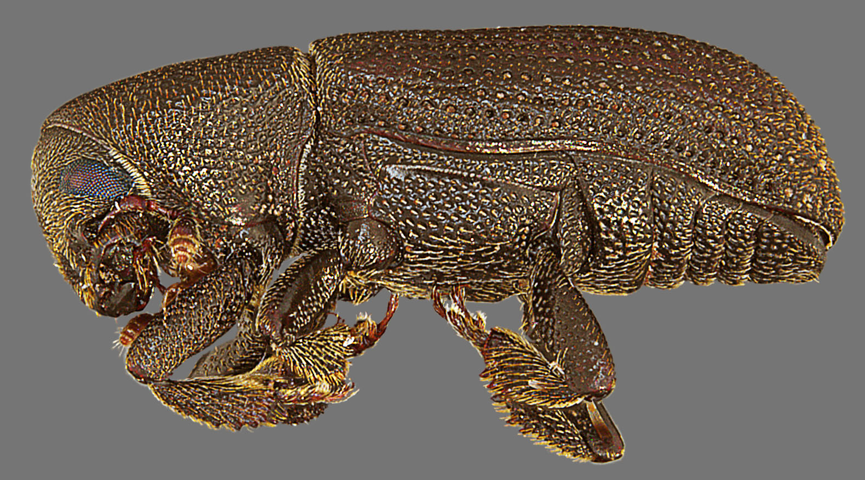
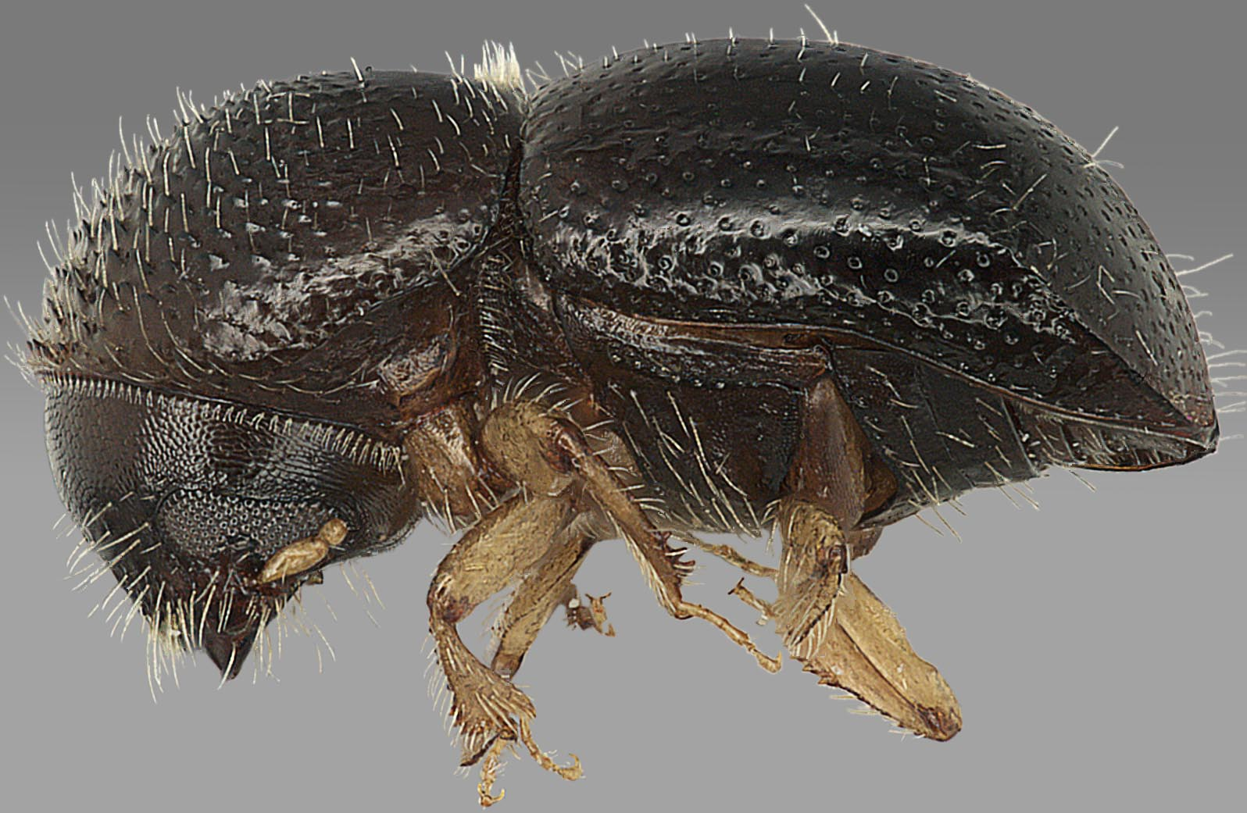
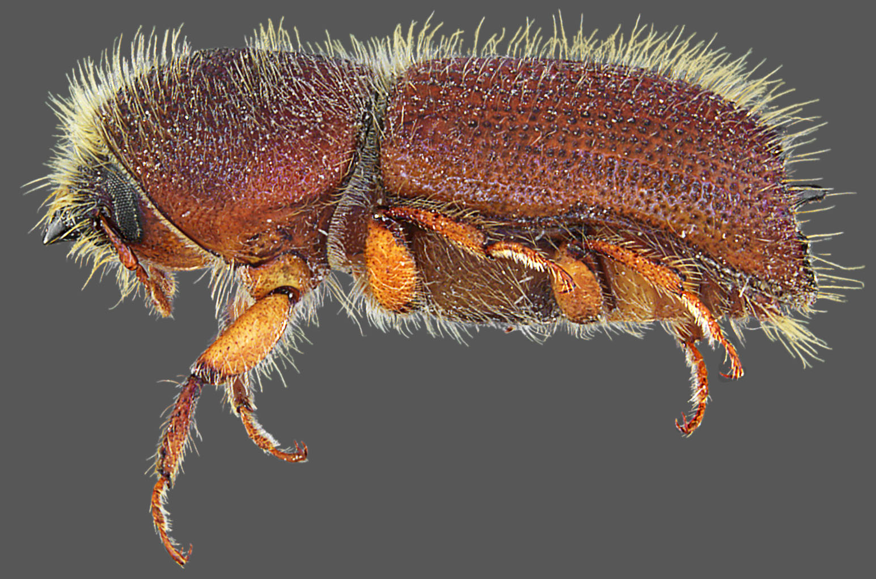
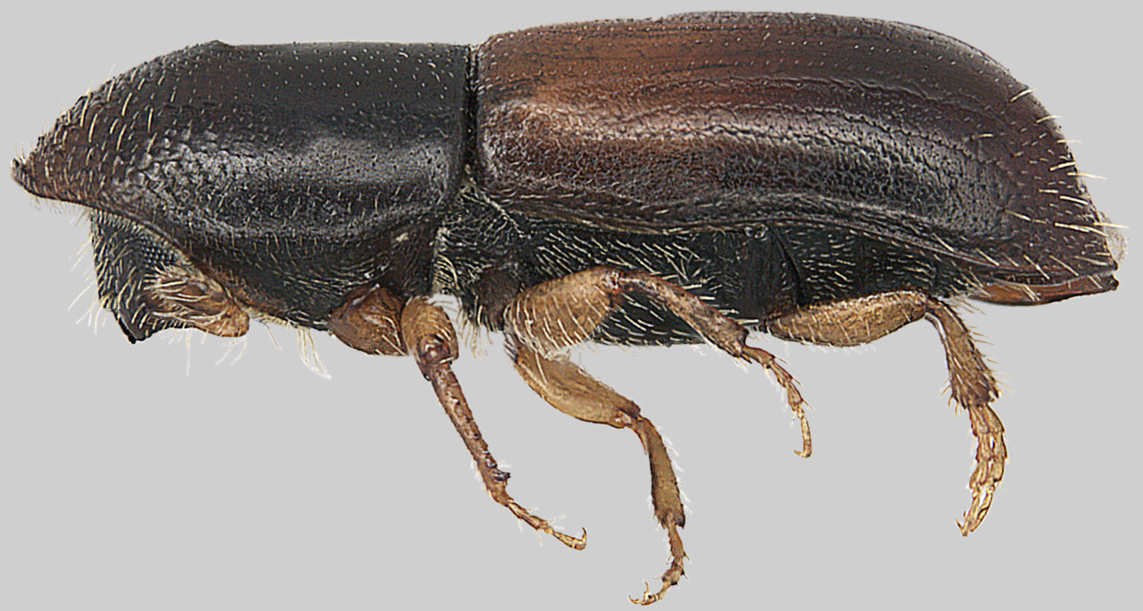
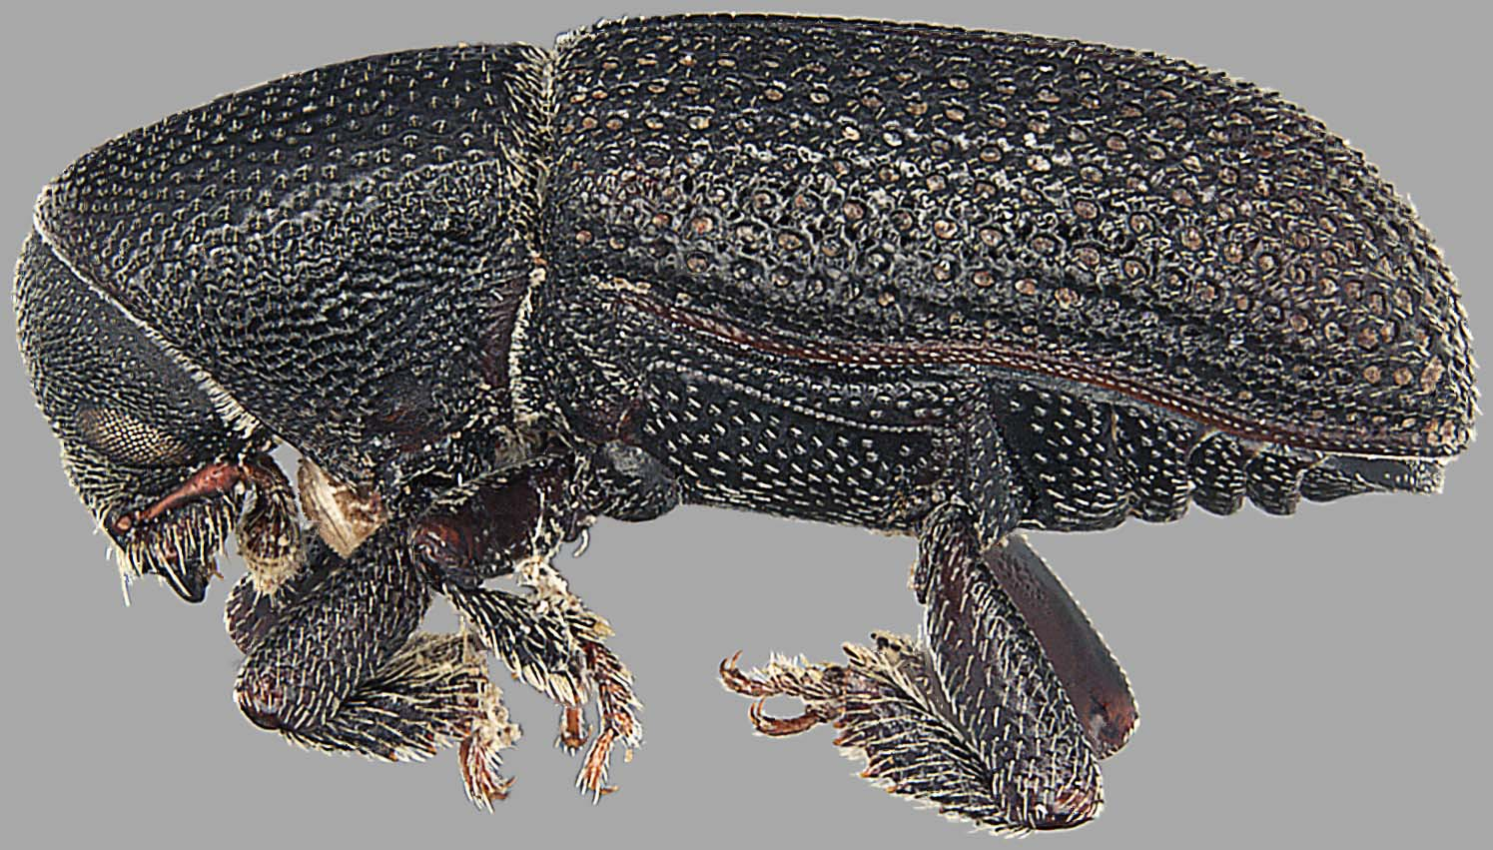
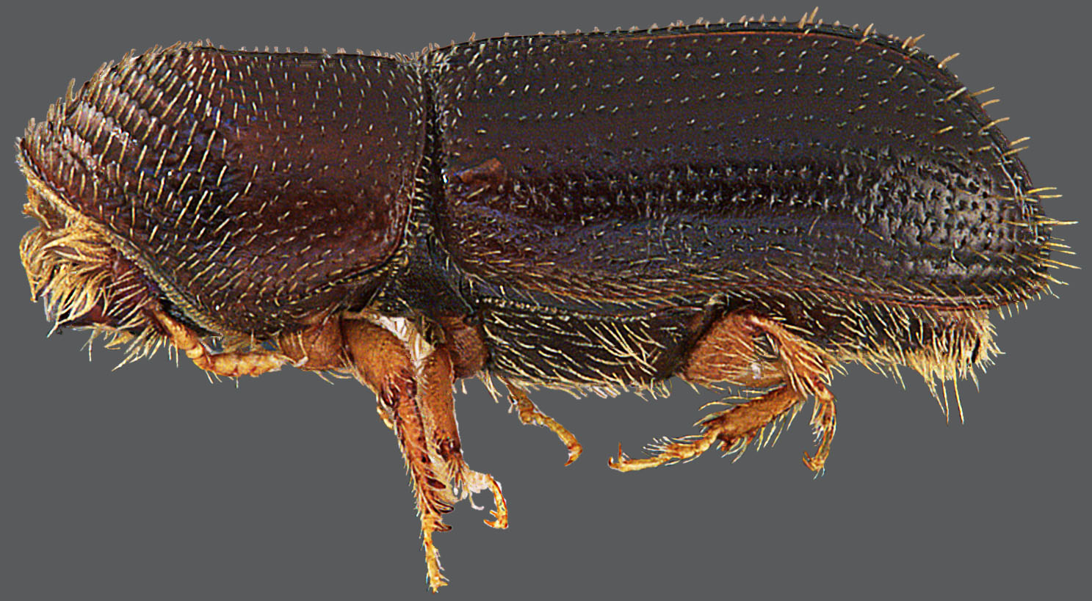
Many targets are not
identifiable except by
experts (of which there
are fewer all time!)
Notes:
Right

Slide 13
U.S. identification capabilities are inadequate
Below
Critical
Mass
availability of taxonomists
regulatory need for taxonomists
(paralleling increased global trade)
Industrial
revolution
1970’s
2015
Notes:
Left

Slide 14
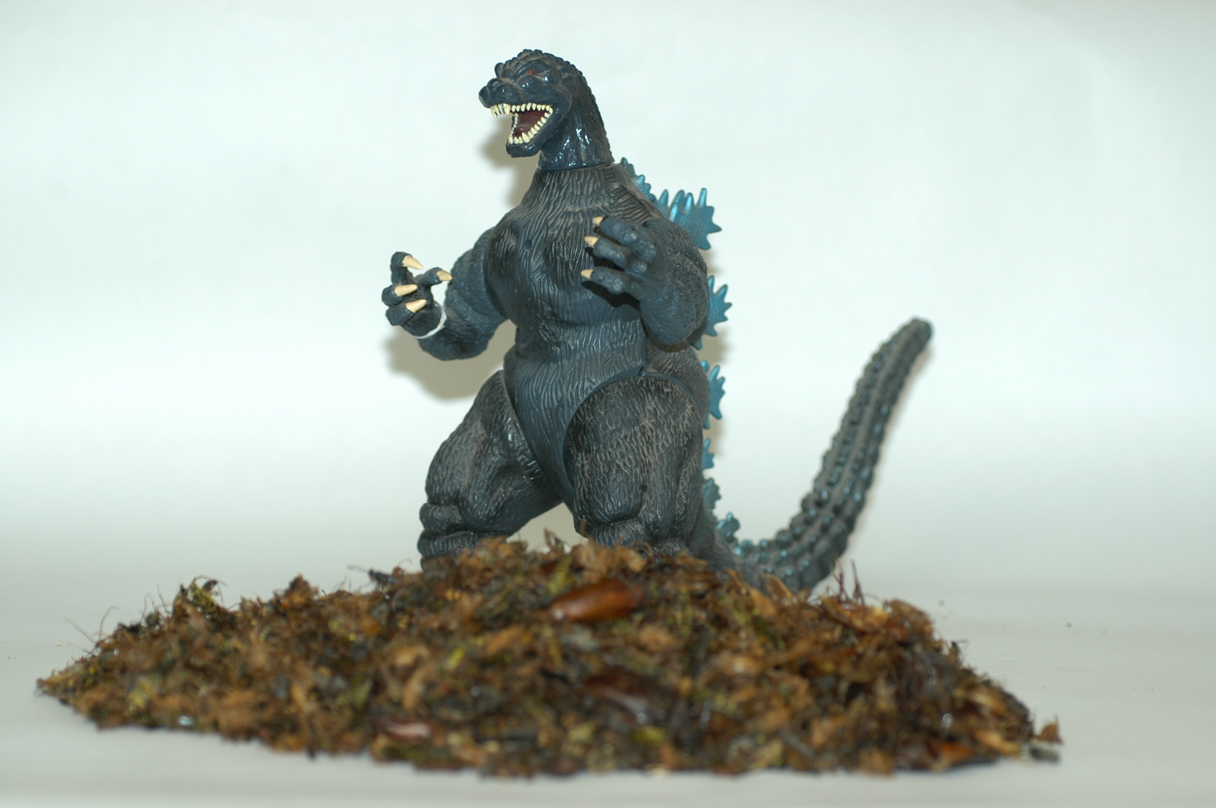
A Single Year’s Survey Catch - Daunting!!!
> 50,000
specimens!

Slide 15

Most exotic species sneak in undetected

Slide 16
The Result: A Tsunamai of Exotic Species
~ 25,000 terrestrial invertebrate species in Oregon
~ 1,000 species of exotic terrestrial invertebrates
in Oregon, so…
~ 5% of terrestrial invertebrate
species in Oregon are exotic
Most of these have
gone unnoticed

Slide 17
New Exotic Invertebrate Species Found
Established in Oregon 2007-2014
Scientific name | Common name |  | Scientific name | Common name
Aceria spartii | bud mite |  | Hylotrupes bajulus | old house borer
Acleris forsskaleana | Maple leaftier |  | Limonia distans | crane fly
Aculus ballei | linden mite |  | Meconema thalassinum | drumming katydid
Aegopinella nitidula | Waxy glass-snail |  | Monosoma pulveratum | green alder sawfly
Aelothrips albicinctus | a thrips |  | Myrmica speciodes | ant
Aleyrodes proletella | cabbage whitefly |  | Nebria brevicollis | European gazelle beetle
Arocatus melanocephalus | elm seed bug |  | Onthophagus taurus | bullhorned dung beetle
Athysanus argentarius | leafhopper |  | Orchestes alni | European elm flea weevil
Bactericera maculipennis | a jumping louse |  | Pandemis cerasana | barred fruit-tree tortrix
Balanococcus diminutus | Phormium mealybug |  | Pasiphila retangulata | green pug moth
Blaniulus guttulatus | Spotted snake millipede |  | Philopedon plagiatum | weevil
Cacopsylla fatsiae | Fatsia psyllid |  | Phytomyza hellebori | hellebore leafminer
Caliscelis bonelli | piglet bug |  | Pityophthorus juglandis | Walnut twig beetle
Carabus granulatus | a ground beetle |  | Planococcus citri | Citrus mealybug
Cartodere bifasciata | a minute brown fungus beetle |  | Platycleis tessellata | tessellated shieldback
Catocala amatrix | sweetheart underwing |  | Ponera testacea | ant
Catocala neogama | bride underwing |  | Pseudaulacaspis cockerelli | False oleander scale
Cepaea nemoralis | Banded wood snail |  | Psylliodes affinis | Bittersweet flea beetle
Cephalonomia gallicola | bethylid wasp |  | Psyllopsis fraxinicola | psyllid
Crisicoccus probably azaleae | Azalea mealybug |  | Rhyncophytoptus new sp. 1 | Eriophyidae
Cydia coniferana | Conifer bark-feedng tortrix |  | Rhyncophytoptus new sp. 2 | Eriophyidae
Diaphnocoris chlorionis | Honeylocust plant bug |  | Schevtchenkella dentata | rust mite
Drosophila hydei | a vinegar fly |  | Scolytus schevyrewi | Banded elm bark beetle
Drosophila suzukii | spotted wing drosophila |  | Scythris limbella | a Eurasian moth
Eriopeltis lichtensteini | scale |  | Simplocaria semistriata | moss beetle
Eriophyes canestrini | boxwood bud mite |  | Siphoninus phillyreae | ash whitefly
Ferrisia gilli | Gill's mealybug |  | Smynthurodes betae | bean root aphid
Glycaspis brimblecombei | Eucalyptus redgum lerp psyllid |  | Stephanitis pyriodes | Azalea lace bug
Hemiberlesia lataniae | An undescribed scale |  | Stigmaeopsis sp. | Bamboo spider mite
Hexacola neoscatellae | a parasitoid wasp |  | Succinea concordialis | Amber snail
Holoparamecus caularum | handsome fungus beetle |  | Syricoris lacunana | dark strawberry totrix
Homadaula anisocentra | mimosa webworm |  | Tinocallis kawaluokalani | Crape myrtle aphid
Humerobates rostrolamellatus | a moss mite |  | Trioza alacris | jumping louse

Slide 18

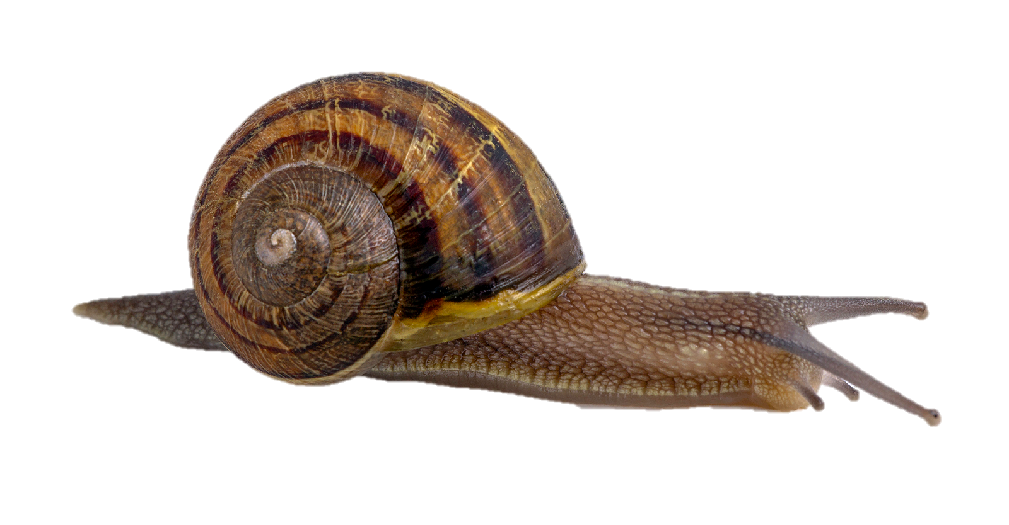
Legacy Species: A “Gift” From
One Generation To The Next

Slide 19
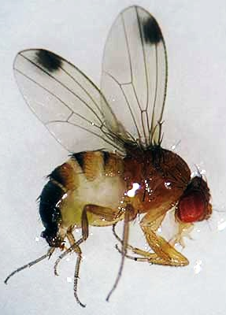
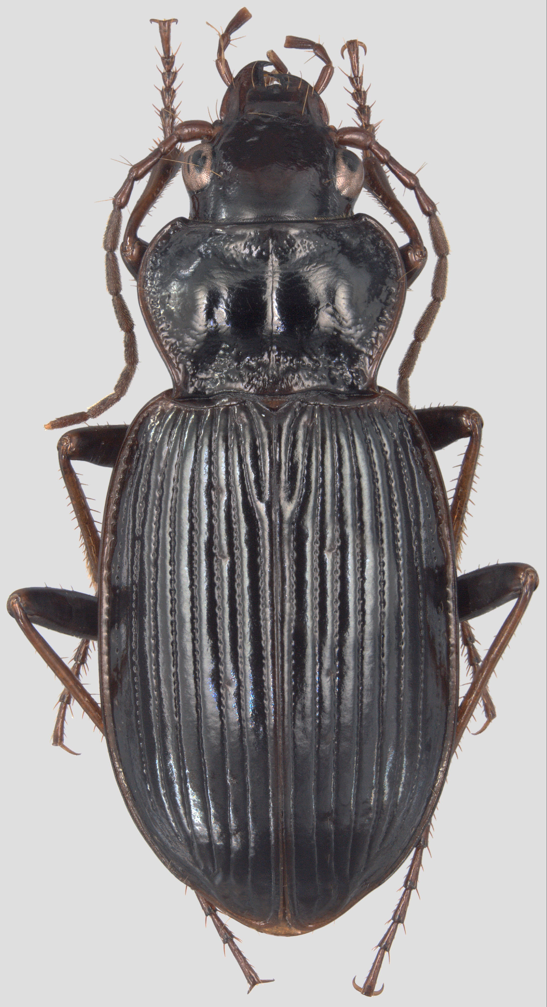
Undeniable “New Kids On The Block”
Spotted wing Drosophila
Azalea lace bug
European gazelle beetle
labs.russell.wisc.edu

Slide 20
New Exotic Invertebrate Species
Found Established in Oregon 2007 - 2014
Year No. Species
2007 12
2008 11
2009 8
11
5
2012 10
2013 3
2014 6
---------------
66
An average of
8.25 species/yr
or
> 1 every two months!

Slide 21
Rate of Detection of New Oregon Exotics

Slide 22
Where Do They Come From?
Origins %
Europe 58
Asia 15
Other U.S. Regions 12
Australia/New Zealand 6
South America 1
Unknown 8
verydemotivational.com

Slide 23
Where Are They New To?
Region %
North America 9
Western North America/U.S. 17
United States 3
Pacific Northwest 9
Oregon 60
Western Oregon 2
microlepidoptera.nl

Slide 24
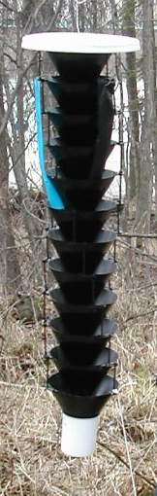
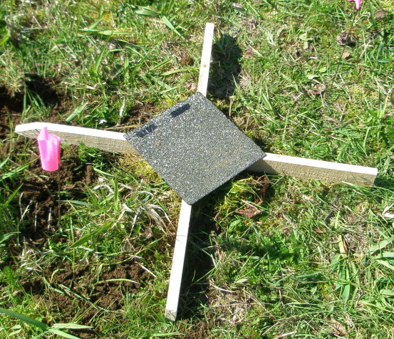
How Are They Found?
Detection Method %
Survey 70
Submitted Sample 28
Public Detection 2

Slide 25


How Did They Get Here?
Pathway %
Associated With Live Plants 55
Probable Hitchhikers 33
Raw Wood 8
Miscellaneous or Unknown 4

Slide 26

Major Exotic Pests
Detected 2007-2014
It’s a crap shoot
every time!
Aleyrodes protella Cabbage whitefly
Drosophila suzukii Spotted wing Drosophila
Ferrisia gilli Gill’s mealybug
Hylotrupes bajulus Old-house borer
Pandemis cerasana Barred fruit-tree tortrix
Pityophthorus juglandis Walnut twig beetle
Scolytus schevyrewi Banded elm bark beetle
Stephanitis pyrioides Azalea lace bug
Average detection rate: 8.25 species/year
Proportion of major pests detected: 1 in 8
Thus, on average, every
year Oregon could
have a MAJOR pest
detected…

Slide 27
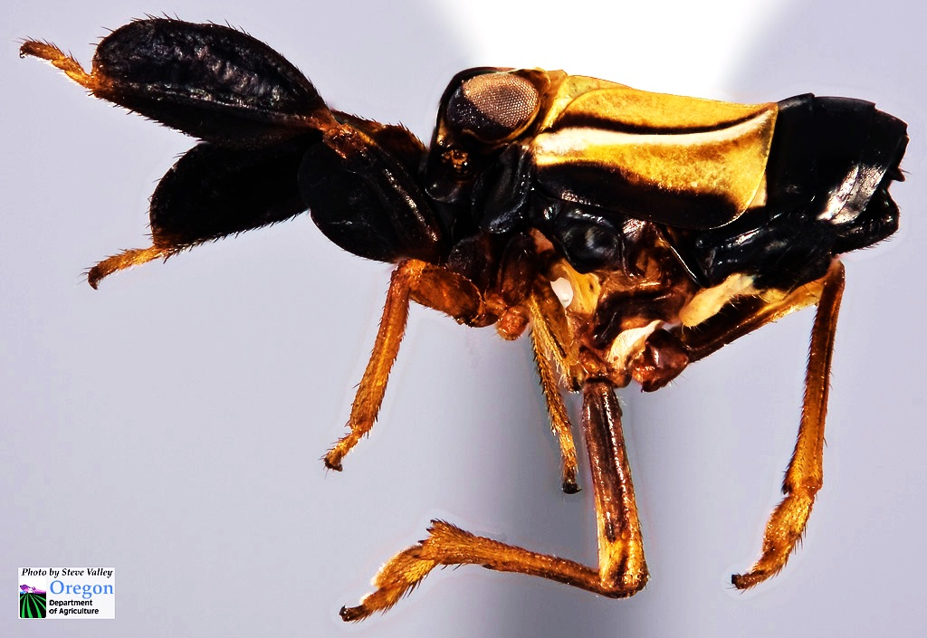
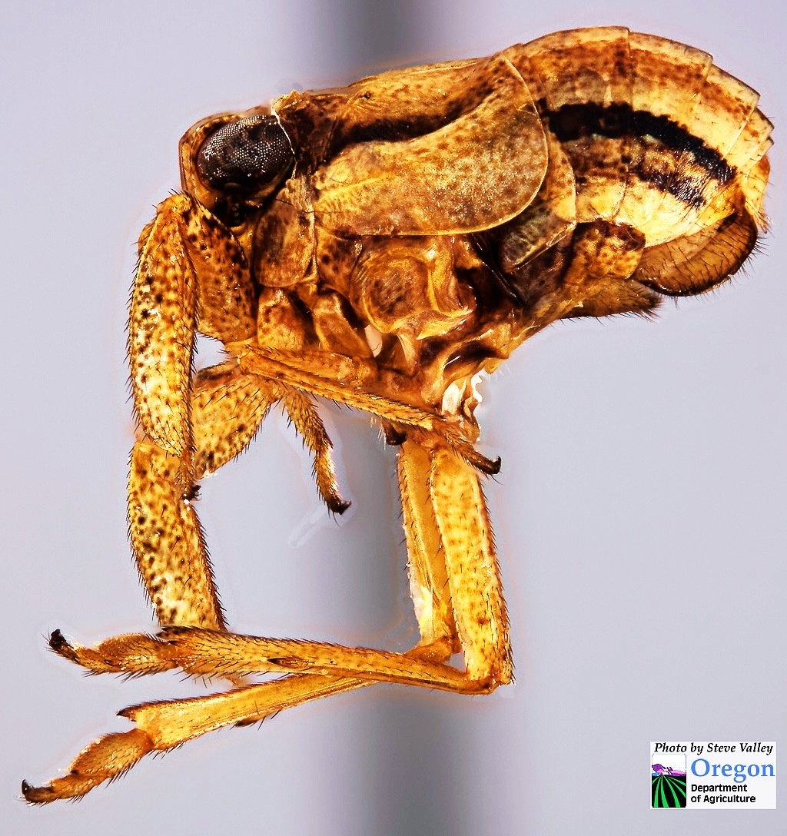
Caliscelis bonelli, a piglet bug
male
female

Slide 28

Nebria brevicollis
the European
Gazelle Beetle

Slide 29




Truck stop
Blueberry field
Garden
Second growth mixed forest

Slide 30




Marys Peak, noble fir stand
Marys Peak, noble fir stand, NW slope
Marys Peak, old growth noble fir stand, N slope
Marys Peak grass bald

Slide 31








Competitor for
limiting resources
with indigenous
forest species
or
predator thereof
??????????????

Slide 32

Only one of >400 species of gazelle beetle known to do this!
David Maddison
Oregon State University

Slide 33




= 20 km
= Fender’s blue
= Oregon
silverspot
=
=
=
=

Slide 34
Azalea Lace Bug
(Stephanitis pyriodes)

Slide 35

Distribution of
Azalea Lace Bug in
the Continental U.S.
2008
Prior to
2008
2009

Slide 36

I vant to suck
your
chlorophyll!

Slide 37


Slide 38


Slide 39
Novel Hosts
Based on Garden & Nursery Observations
and Host Plant Trials (ODA)
3 New Host Families: 14 New Host Genera
Betulaceae Agapetes Epigaea Caprifoliaceae Andromeda Gaultheria
Rosaceae Chamaedaphne Kalmiopsis
Corylus Phylliopsis
Cotoneaster Prunus
Crategus Vaccinium
Daboecia Viburnum
30 New Host Species

Slide 40



Walnut twig beetle, Pityophthorus juglandis
Adult walnut twig beetle
Thousand cankers disease vectored
by walnut twig beetle
Walnut dying of thousand
cankers disease

Slide 41

Distribution of WTB/TCD
Eastern black
walnut range
WTB
native
range?
threatsummary.forestrythreats.org

Slide 42






















What’s next?
?
?
?

Slide 43

Spotted Lanternfly, Lycorma delicutala
Pennsylvania Dept. of Agriculture

