Slide 1

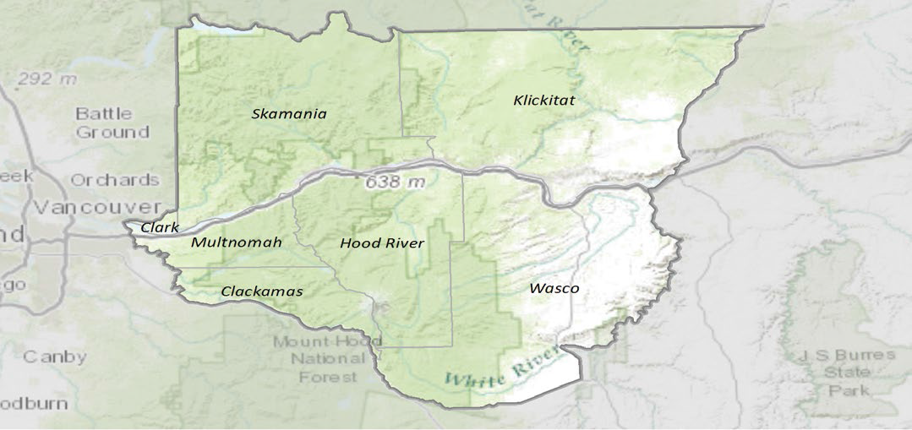
Columbia Gorge Cooperative Weed Management Area
Partners from over 25, non profit, local, state and federal organizations
The CWMA provides a means to effectively coordinate actions to address invasive weeds on lands within its jurisdiction.
Notes:
The CWMA designated the plants.

Slide 2

The CG-CWMA seeks to prevent the introduction and control the spread of the most harmful invasive plant species by facilitating cooperative management amongst willing land owners and managers.
The Columbia Gorge Cooperative Weed Management Area (CWMA) is a voluntary network of public and private interests in Northwestern Oregon and Southwestern Washington that are concerned with management of invasive plants.

Slide 3

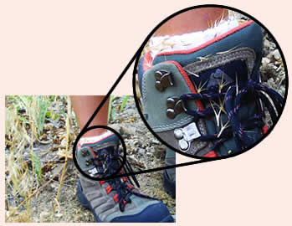
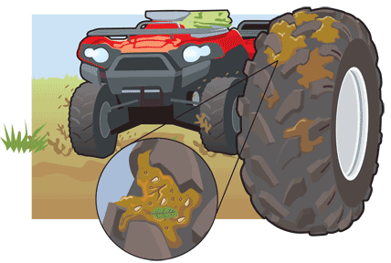
Activities that Spread Weeds
Motorized Travel
Driving
Boating
ORV use
Disturbance
Construction
Fire
Natural Events
Recreation
Hiking
Fishing
Horseback riding

Slide 4
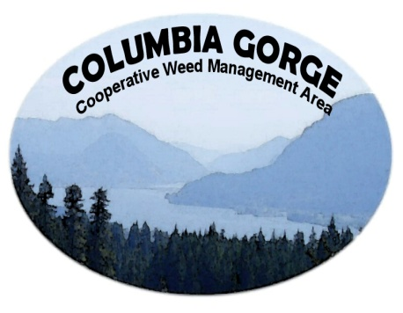
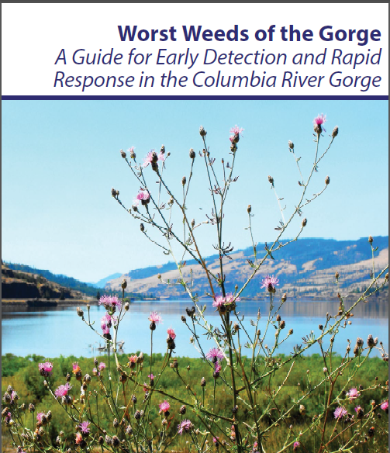

Slide 5

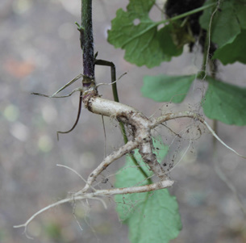
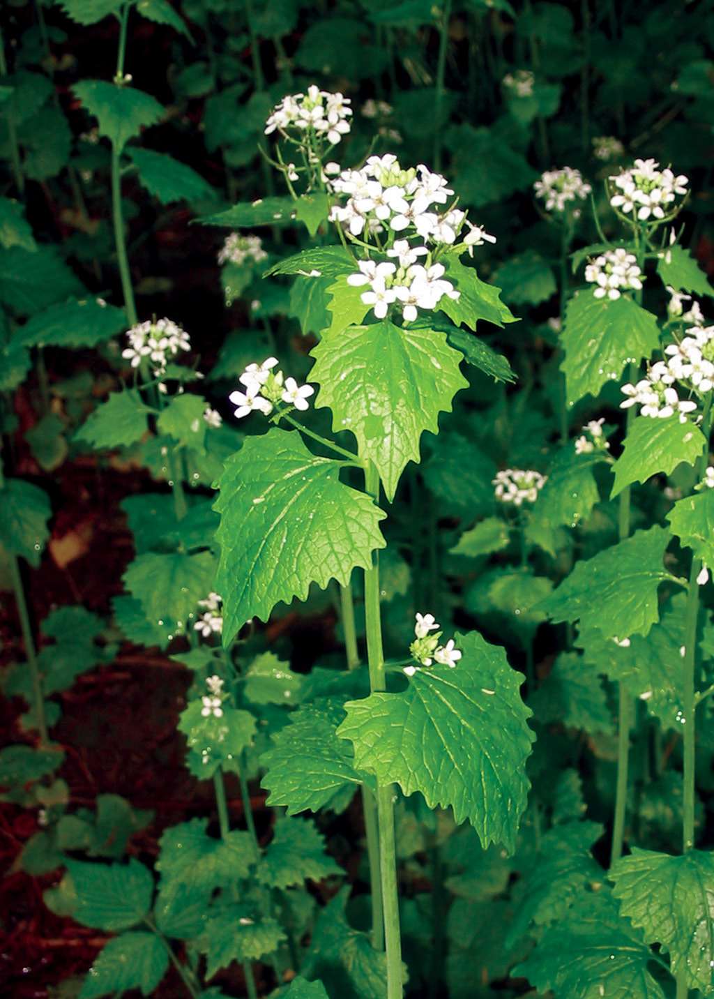
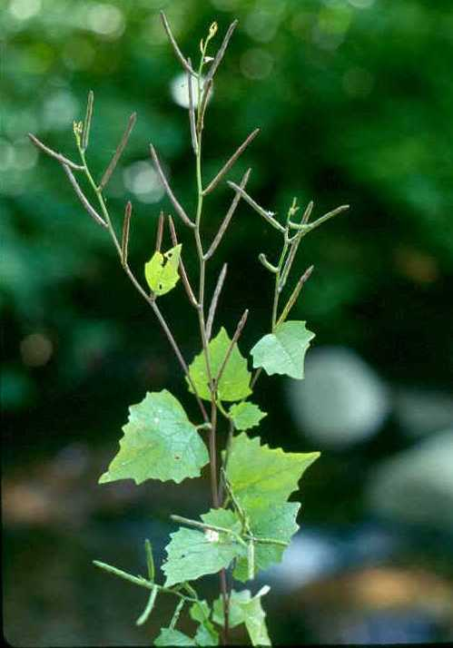
Garlic Mustard
Alliaria petiolata
Biennial or winter annual. Rosettes form by late spring in first year, blooms April to June second year. Typically 1 to 3 feet tall,up to 5 feet.
Distinct “S” or “L”-shaped curve at top of root.
Produces allelopathic chemicals that inhibit growth of other plants and microbes.
Pungent garlic odor when pulled or leaves crushed.
Small, white 4 petaled flowers appear in early spring.
Able to self-pollinate, seeds are easily spread to natural areas
Plant tolerates full sun, as well as full shade

Slide 6

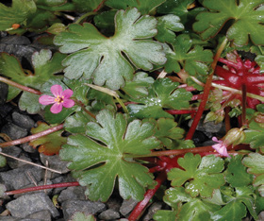
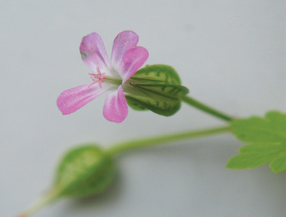
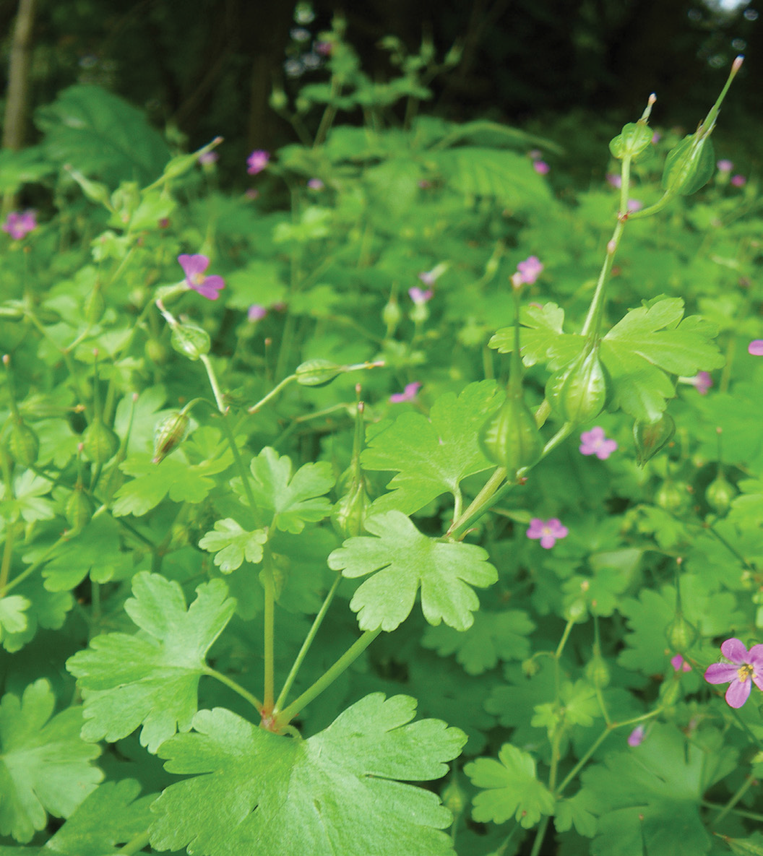
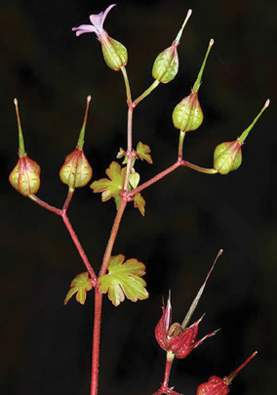
Shiny Geranium
Geranium lucidum
sepals
Low-growing, winter annual to annual.
Shiny green, round to kidney-shaped leaves 5 to 7 lobes and grow on
red, hairless stems. At the end of the summer, leaves become red and waxy.
Blooms spring to late July. Long, straight, pointed beak. Small, oval seeds are hairless and reddish with a black projection
Notes: Also known as “shining crane’s bill.”
Resembles the Common dovefoot geranium (Geranium molle). Dovefoot geranium’s petals are deeply notched and are very fuzzy. The sepals of dovefoot geranium are smooth and fuzzy and the stems are less red than shiny geranium.
Small, pink to purple flowers with five petals grow in pairs on little stems. Sepals around the base of the flower are keeled with noticeable cross-ribs, a key identification trait.
This shallow-rooted plant spreads by a forcefully ejected seed, helping it spread up as well as out from parent plants. With this method, it quickly dominates the landscape.

Slide 7

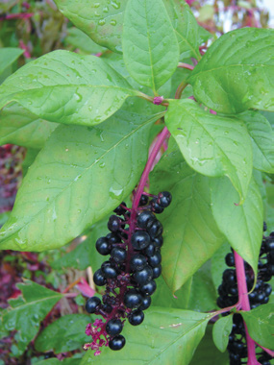
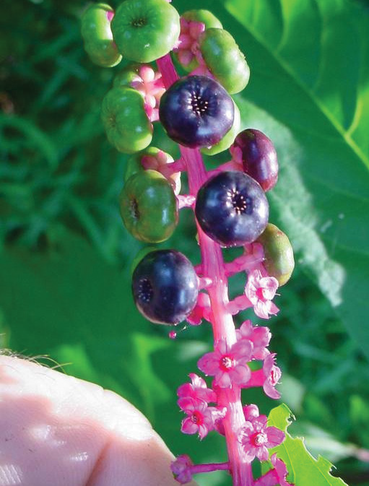
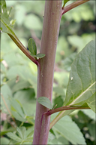
Pokeweed
Phytolacca americana
Perennial , 2 to 8 feet tall. Smooth, stout, purplish stem that branches extensively. Egg-shaped, alternate leaves on stem with smooth edges, up to 12 inches long and 4 inches wide.
Flowers are white or green. Form in elongated clusters that hang from branches in early summer.
Hanging clusters of deep purple berries. Fruits present mid-summer to late fall.
The large taproot can grow to the size of a bowling ball.
Resprouts from any remaining root fragments.
Notes: Every part of pokeweed is poisonous with the root and leaves being the most toxic. The plant’s berries have been shown to cause vomiting, spasms, and even death in humans.

Slide 8

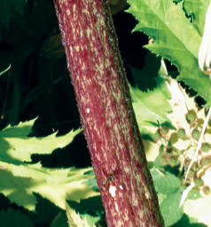
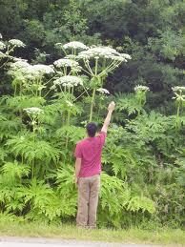
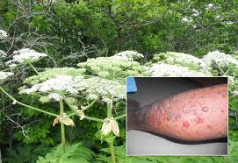
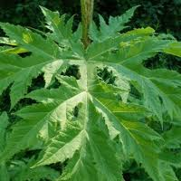
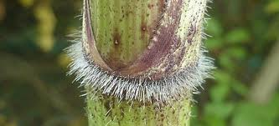
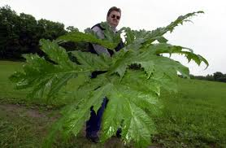
Giant Hogweed
Heracleum mantegazzianum
Perennial 10 to 17 feet tall.
Leaves are 3 to 5 feet wide, with 3 leaflets per leaf.
Leaflets are deeply incised and lower surface is scaly.
Stalks 2 to 4 inches in diameter are hollow with raised, purple blotches and erect hairs. Stalk and flowerhead develop after 2 to 4 years then plant dies back.
Flowerhead made up of numerous, white flowers, umbrella-like, up to 2 feet in diameter, blooms mid-May through July. Seeds are flat, oval, tan with brown lines, about 3/8” long. Each plant can produce up to 50,000 seeds.
Readily colonizes streambanks, fields, and forest understories where it replaces native vegetation and prevents new trees from growing
This plant is a public health hazard!! Skin that has come in contact with the plant’s sap will burn and blister when exposed to sunlight.
Native cow parsnip, a giant hogweed look-a-like, typically only grows up to 6 feet tall with a flowerhead of less than 1 foot in diameter and much smaller, less incised leaves.

Slide 9

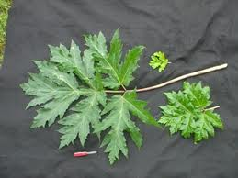
How to Report
Step 1: Collect information about your sighting
If you suspect that you have found any of the weeds included
in this ID guide, please record the following information so
we can follow up on your report:
1. Take a picture of the plant: Include something to
show scale (a ruler or a common object like a quarter) and
close-ups of distinctive features of the plant. Take your
time to make sure the photo is in focus.
2. Collect a written description of the plant: Are the
stems or leaves hairy, smooth, or waxy? Note color, shape,
and size of flowers and leaves.
3. Collect location information: GPS coordinates are the
best; written directions to the site work, too. The closest
address, intersection or mile marker, or how far past a trail
or bridge crossing, as well as nearby landmarks are most
helpful.
4. Collect infestation size: How many feet wide and how
many feet long is the weed patch? You may also estimate
the number of plants at the site.

Slide 10
WHERE TO REPORT
ONLINE
Oregon Invasive Species Hotline www.oregoninvasiveshotline.org
*indicated on boot brushes
EDDMaps www.eddmaps.org/
bbBBBYes.org/map
ves.org/map
Phone: If you do not have access to the internet, the
second way to report an EDRR sighting is by phone. To
report an infestation in either Oregon or Washington,
please call 1-877-9-INFEST (1-877-946-3378).

Slide 11
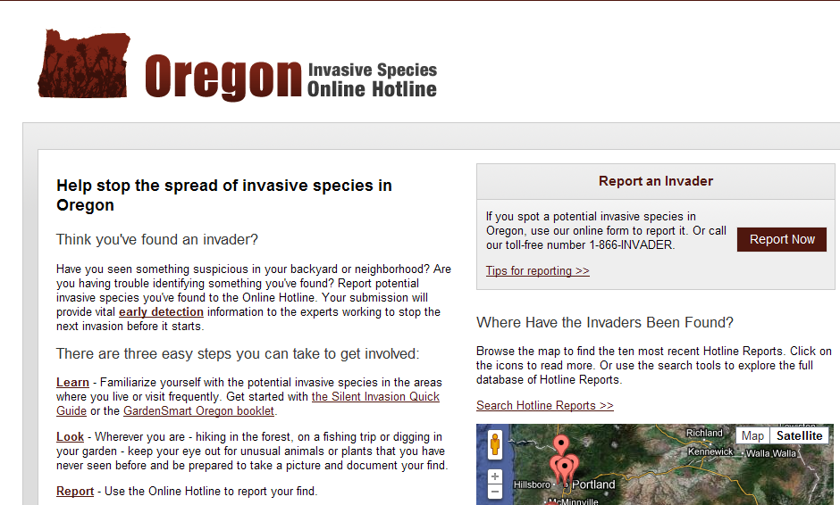
www.oregoninvasiveshotline.org
Visit www.oregoninvasiveshotline.org and click on the “report now” button and fill out the form.

Slide 12
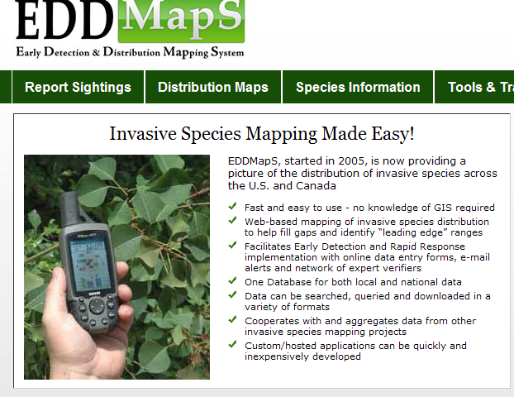
www.eddmaps.org/

Slide 13
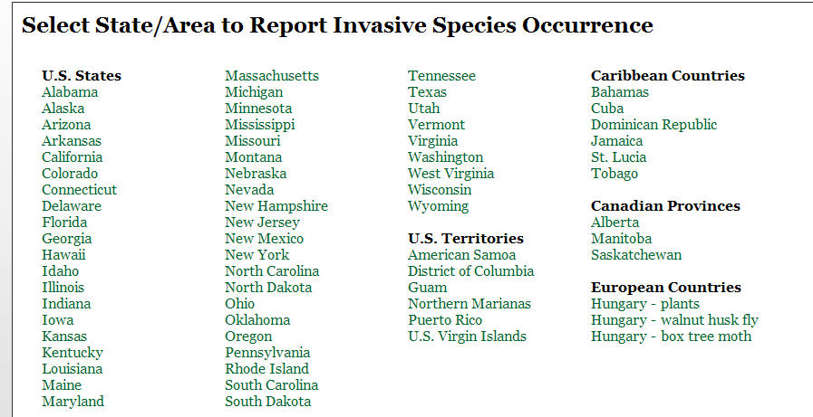
www.eddmaps.org/

Slide 14

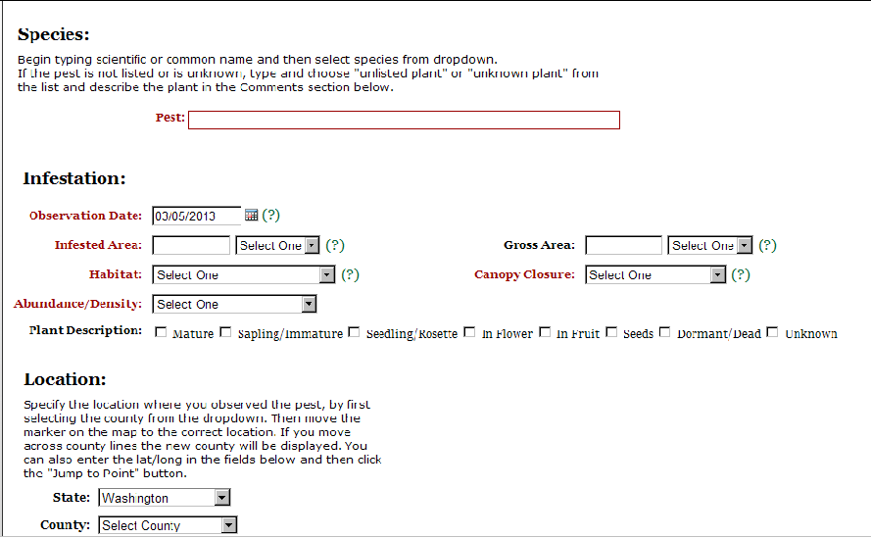
www.eddmaps.org/

Slide 15
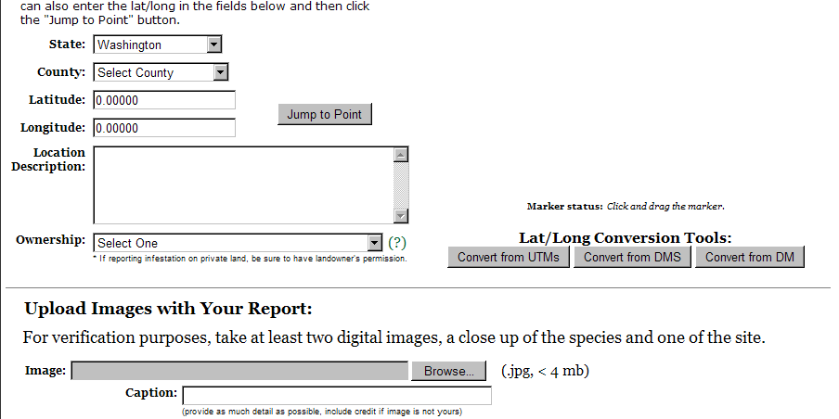
www.eddmaps.org/

Slide 16

www.eddmaps.org/

Slide 17


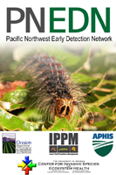
SMART PHONE APPS!!!
The Pacific Northwest Early Detection Network (PNEDN) app brings the power of EDDMapS to your smartphone. Now you can submit invasive species observations directly with your smartphone from the field.

Slide 18
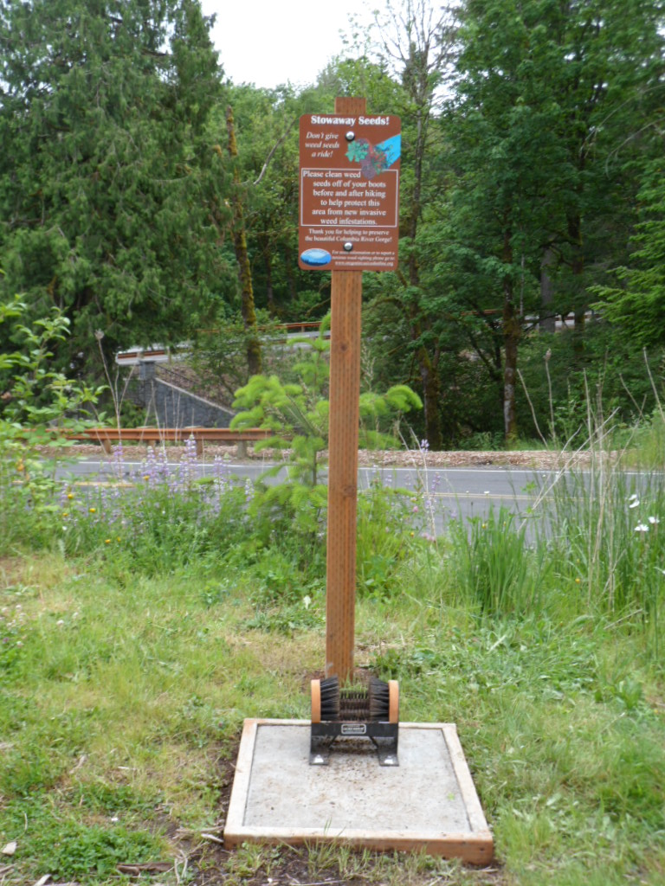
Check boots, equipment and pets
Watch for weeds and don’t spread ‘em: Take care not to spread invasive plant seeds and materials as you hike, bike, or boat!
Brush off your boots, bike, and dog before and after using the trail or natural area. If you get in water, clean and dry your boat and gear before going to a new place.
Look for boot brushes like this one at trailheads throughout the Gorge!

Slide 19
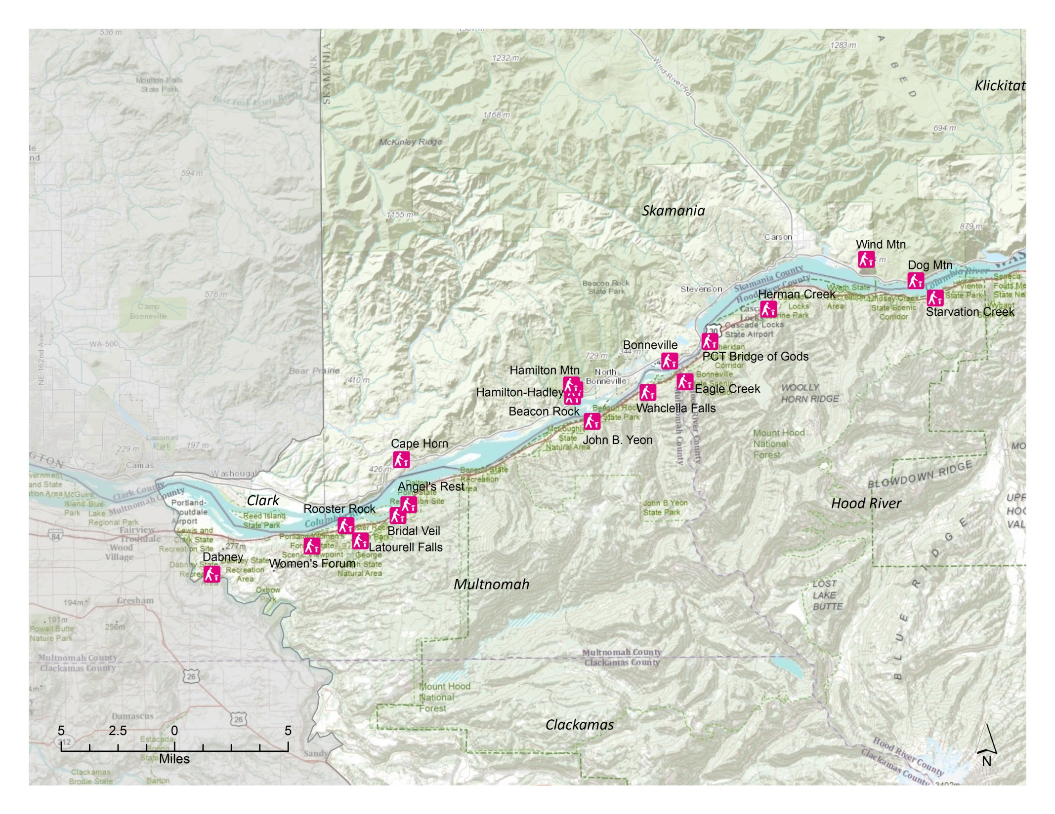
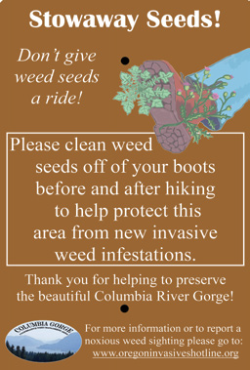
Western Boot Brush Sites

Slide 20
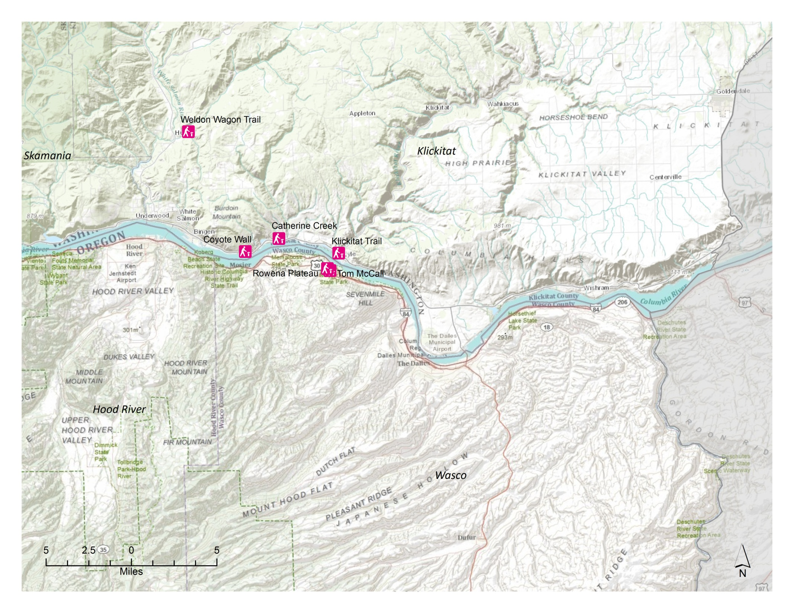
Eastern Boot Brush Sites

Slide 21

Wind Mountain

Slide 22
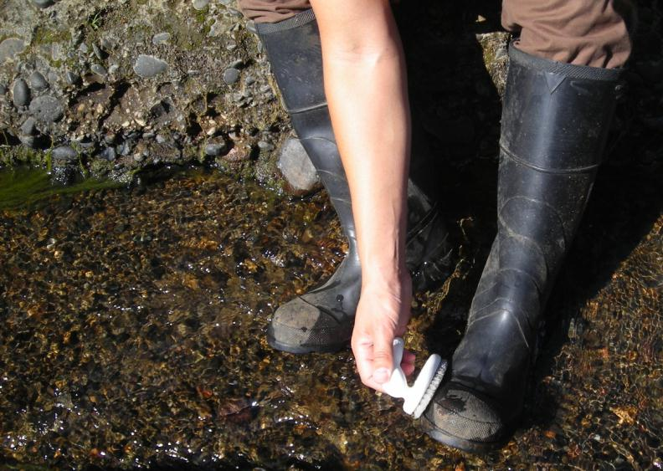
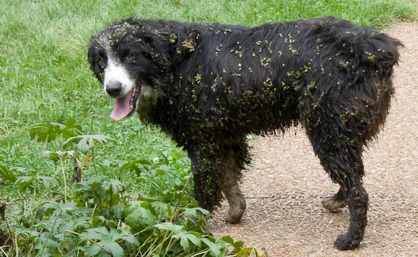
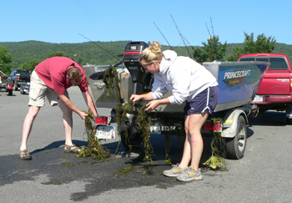
Remember to check your pets too!
Prevention. Don’t introduce the weed in the first place!

Slide 23



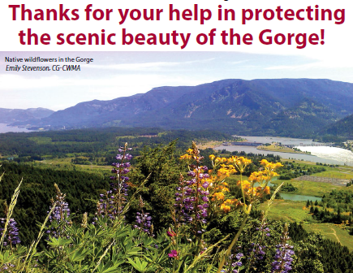




Partners

