Slide 1
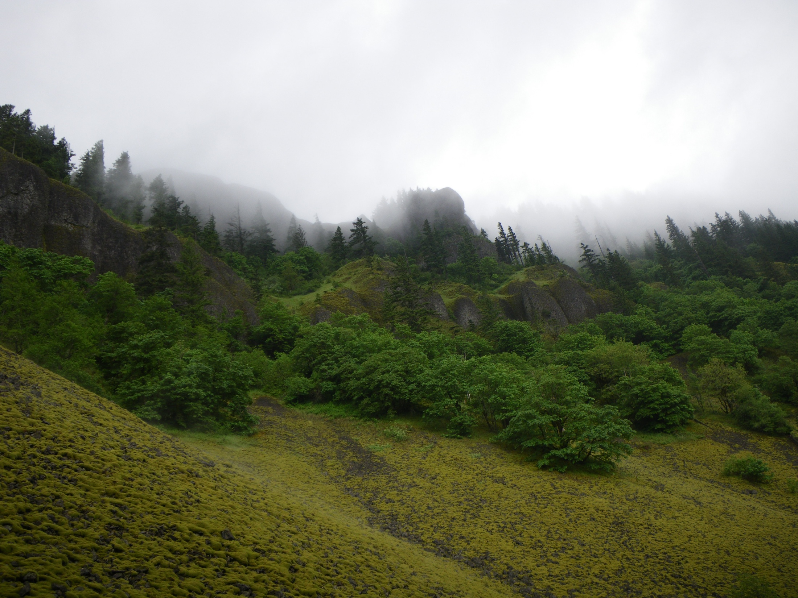
Columbia Gorge
Cooperative Weed Management Area

Slide 2
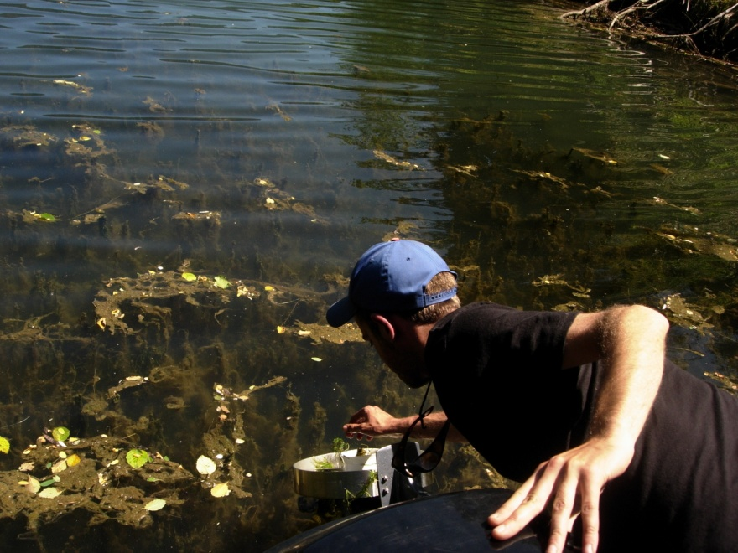
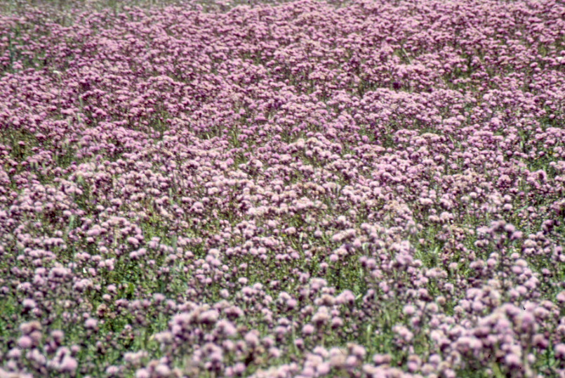
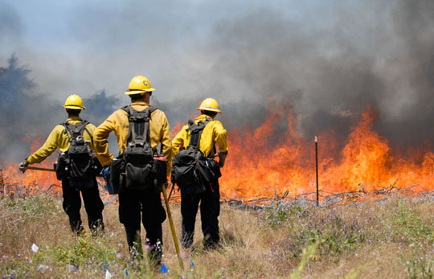
Invasive Plant Impacts
Plant Communities
Wildlife habitat
Water resources
Fisheries
Recreation
Natural processes

Slide 3
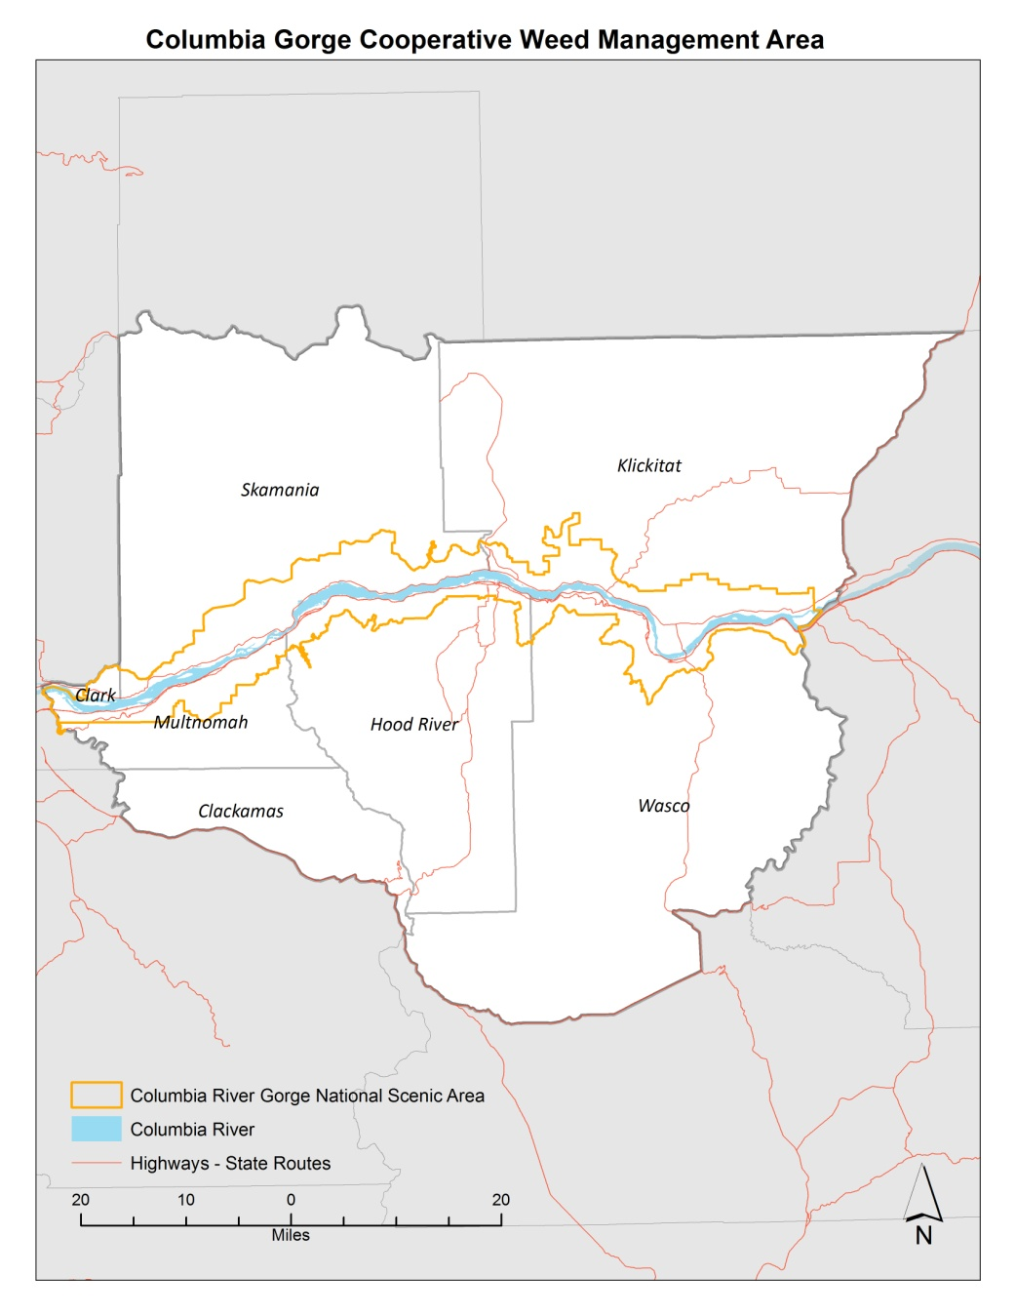
CWMA Overview
The Columbia Gorge Cooperative Weed Management Area (CWMA) is a voluntary network of public and private interests in Northwestern Oregon and Southwestern Washington that are concerned with management of invasive plants.
The CG-CWMA seeks to prevent the introduction and control the spread of the most harmful invasive plant species by facilitating cooperative management amongst willing land owners and managers.

Slide 4
Columbia Gorge CWMA Participants
Aaron Pedersen, US Forest Service Christina Wesseler, US Forest Service
Jerry Asher, Private citizen Melissa Rowesoll, Private citizen
Aaron Morehouse, Gorge Ecology Institute Andrea Ruchty, US Forest Service
Alison Halpern, Washington State Noxious Weed Control Board Amy Pulus, US Geological Survey
Andrea Berley, Oregon State Parks and Recreation Department Angie Brewer, Columbia River Gorge Commission
Angie Kimpo, City of Portland Water Bureau Billy Don Robinson, Oregon Native Plant Society
Brian Walker, Oregon State Department of Agriculture Chelsie Morris, US Army Corps of Engineers
Carlo Abbruzzese, Washington State Department of Natural Resources Carol Chandler, US Forest Service
Carolyne Wright, Washington State Department of Natural Resources Curtis Musson, Private citizen
Casey Gozart, Clark County Vegetation Management Claire Hibler, US Bureau of Land Management
Chris Aldassy, East Multnomah Soil and Water Conservation District Chet Behling, Oregon State Department of Forestry
Dan Richardson, Underwood Conservation District David LaDoucer, US Army Corps of Engineers
David LaDoucer, US Army Corps of Engineers Diana Lebo, US Forest Service
Dick Dewey, Portland State University Doug Kreuzer, The Nature Conservancy
Lauren Brown, 4-County CWMA Emily Stevenson, Private citizen
Greg Haubrich, Washington State Department of Agriculture Erik Plunket, Washington State Parks and Recreation
Heidi Christensen, US Bureau of Land Management Jeanette Burkhardt, Yakama Nation Fisheries Project
Jennifer DeShong, US Forest Service Jill Hariman, US Geological Survey
John Cowan, Oregon State Parks and Recreation Department Jim White, Private citizen
Jordan Kim, Hood River Soil and Water Conservation District Jon Pampush, Western Invasive Plant Alliance
Justin Bush, Skamania County Noxious Weed Control Program Josh Thompson, OR NACD
Kent Nogowski, Oregon State Department of Transportation Keith Kohl, Oregon State Department of Forestry
Keyna Bugner, Washington State Department of Natural Resources Kevin Fitzgerald, Multnomah County
Linda Cartwright, US Forest Service Lindsey Wise, Portland State University
Lisa Midlam, Oregon State Parks and Recreation Department Lynn Gibbons, Menuca
Lucas Nipp, East Multnomah Soil and Water Conservation District Meagan Saunders, Private citizen
Mark Stevenson, Oregon State Parks and Recreation Department Michele Dailey, Columbia River Gorge Commission
Marty Hudson, Klickitat County Noxious Weed Control Board Nate Lain, Hood River County
Mitch Bixby, City of Portland Bureau of Environmental Services Patti Caswell, Oregon State Department of Transportation
Noel Bacheller, Oregon State Parks and Recreation Department Peter Cornelison, Friends of the Columbia Gorge
Rick Till, Private citizen Robin Dobson, US Forest Service
Rod French, Oregon State Department of Forestry Ron McDonald, US Army Corps of Engineers
Ron Turner, Washington State Department of Transportation Sandy Smith, Wasco County
Ryan Bessette, Wasco County Soil and Water Conservation District Sarah Canham, US Bureau of Land Management
Sam Leininger, Clackamas County Soil and Water Conservation District Shawna Bautista, US Forest Service
Scott Hancock, Washington State Department of Natural Resources Steve Stampfli, Hood River Watershed Council
Shannon Brubaker, Oregon State Department of Agriculture Tania Siemens, Oregon State Sea Grant
Tim Counihan, US Geological Survey Tim Darland, US Army Corps of Engineers
Todd Murray, Washington State University Extension Tona Morensen, Oregon State Department of Forestry
Vern Holm, Western Invasives Network/Oregon Invasive Species Council Tova Tillinghast, Underwood Conservation District
Will Lackey, Oregon State Department of Transportation Will Bloch, Private citizen

Slide 5
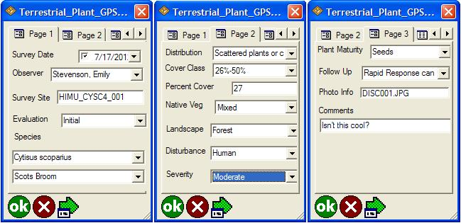
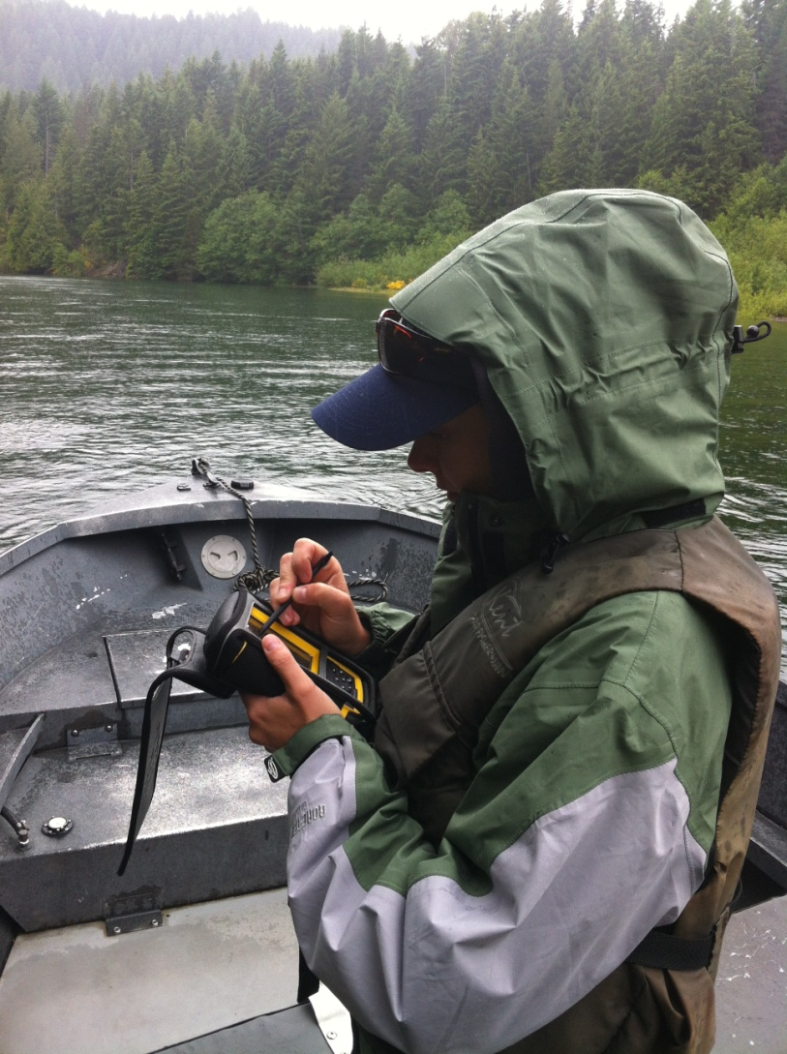
Standardization of Invasive Plant Data
Compilation of partner invasive plant data for landscape scale planning and decision making.
Creation of standardized forms for inventory and treatment, for use groupwide.

Slide 6
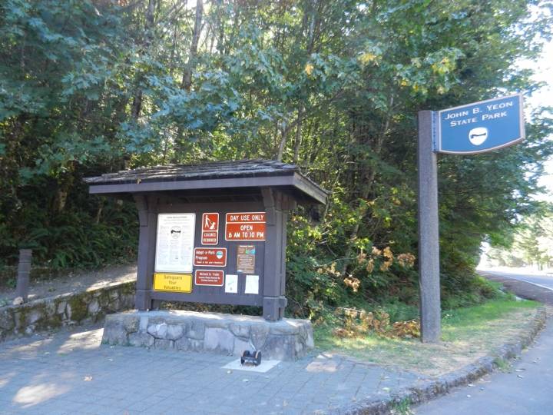
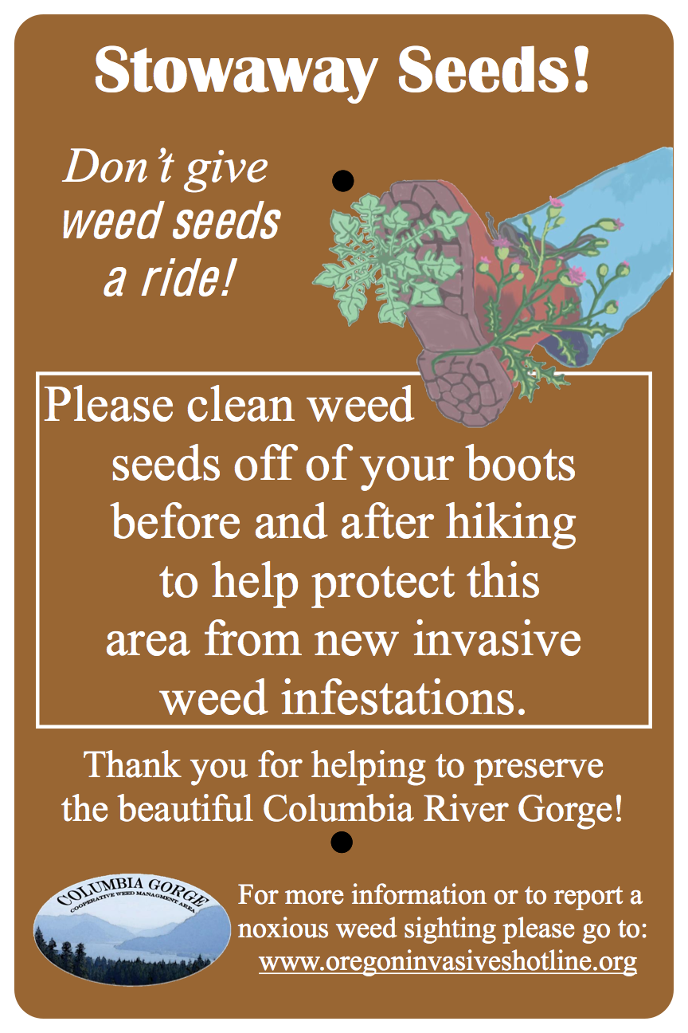
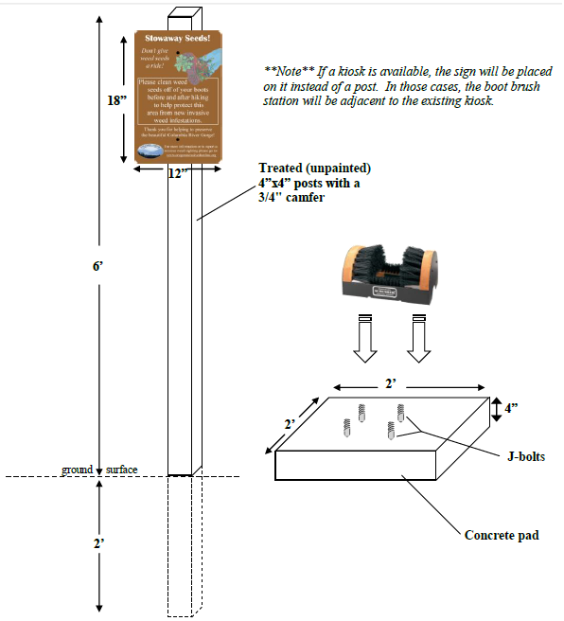
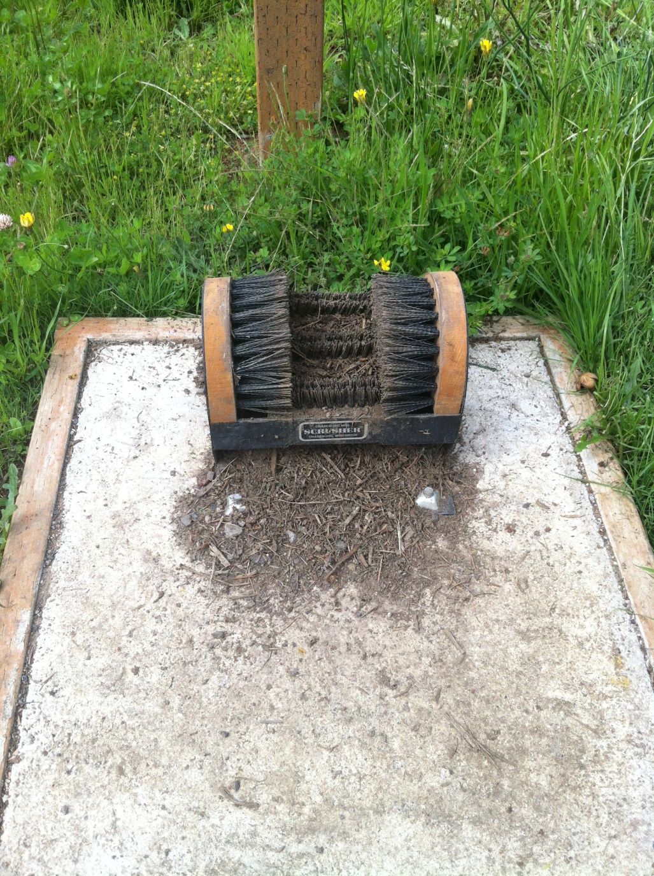
Trailhead Boot Brushes

Slide 7
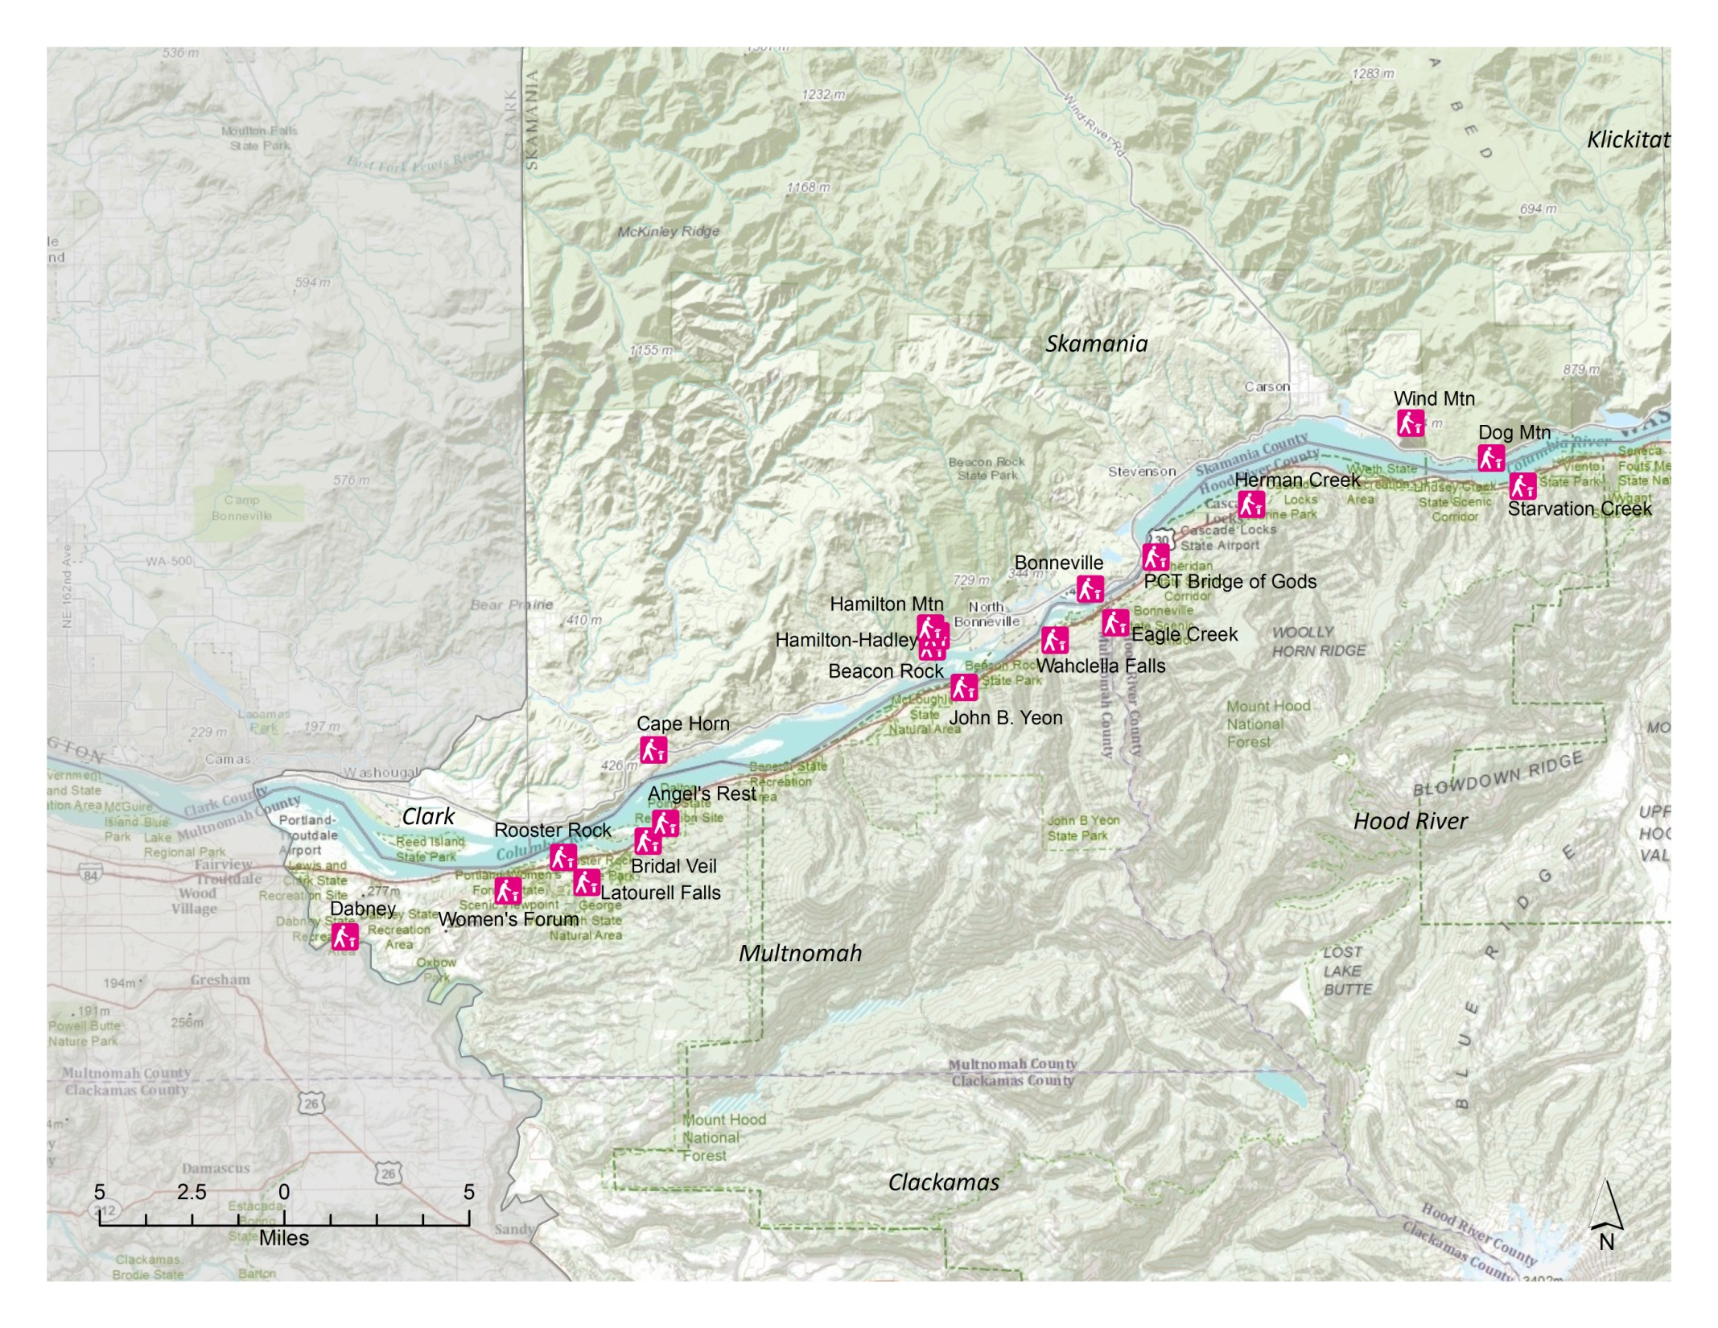
Western Gorge Boot Brushes

Slide 8
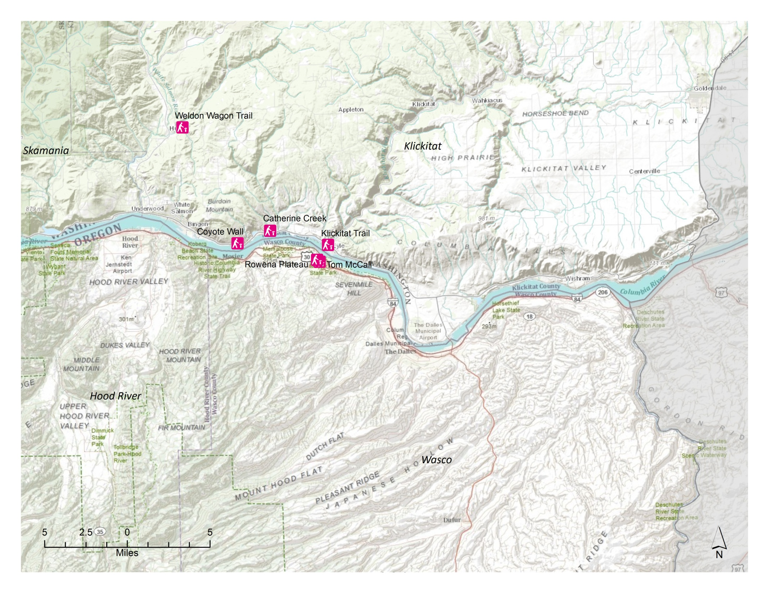
Eastern Gorge Boot Brushes

Slide 9
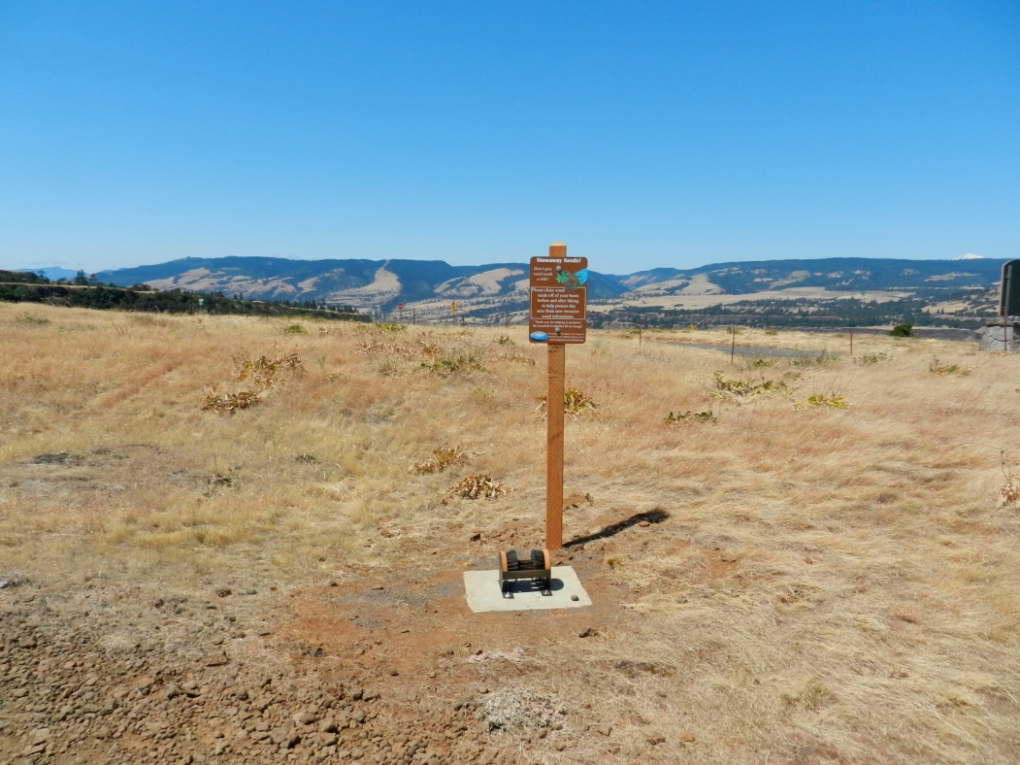
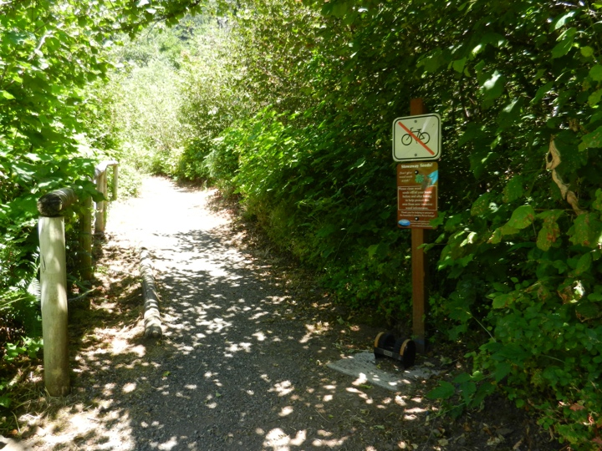
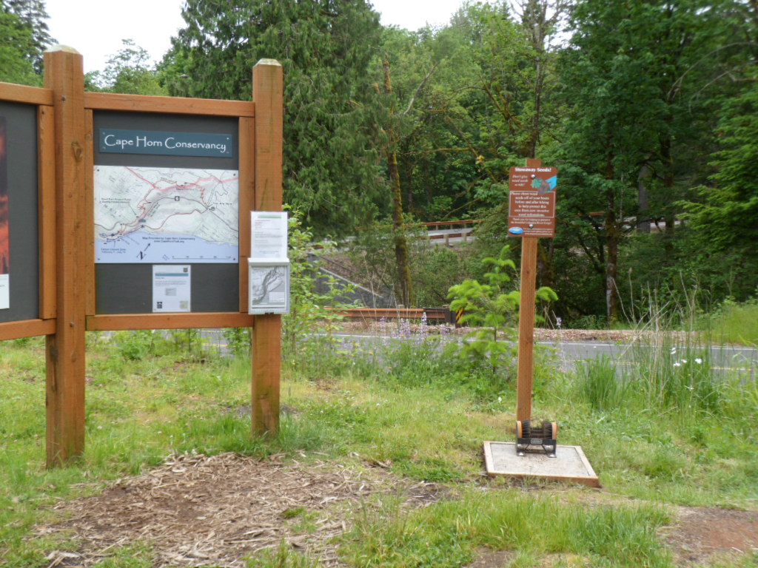
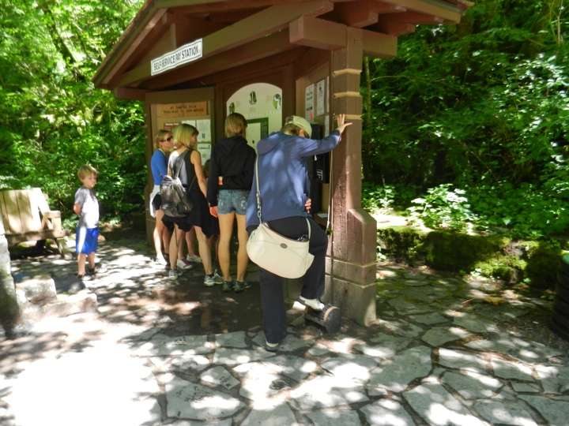

Slide 10
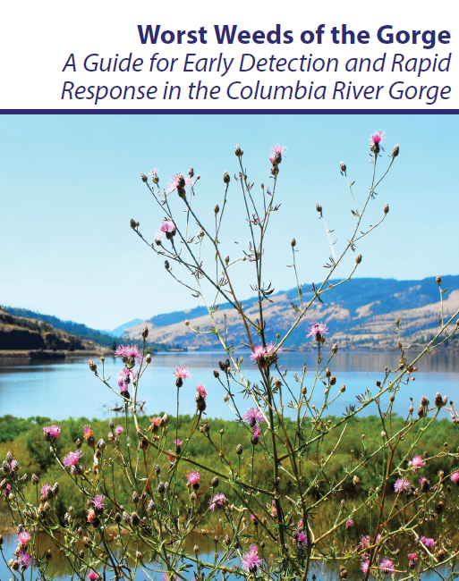
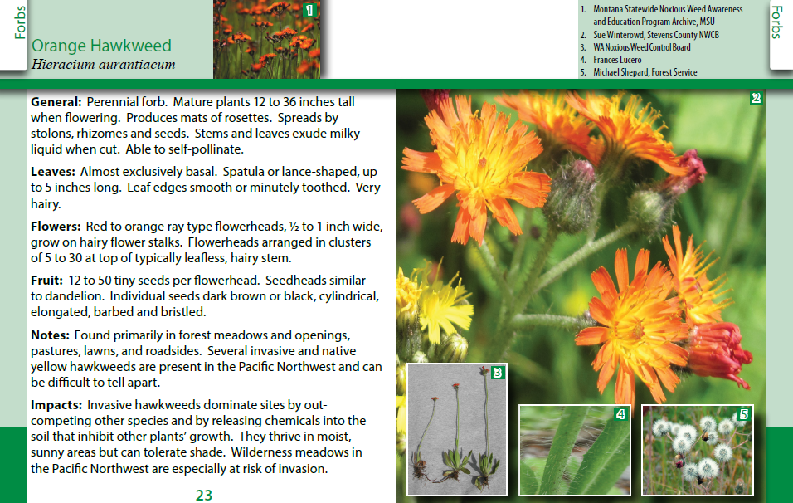
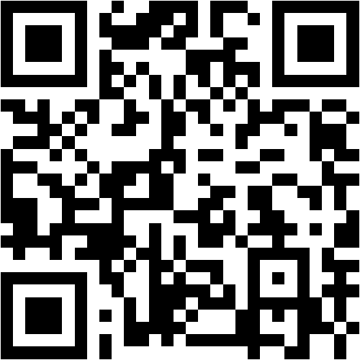
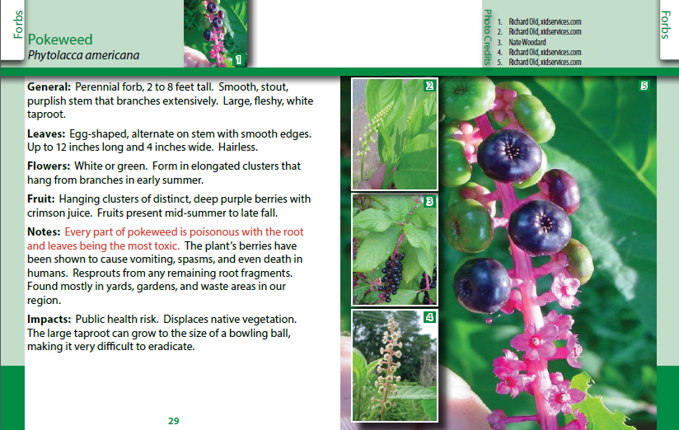
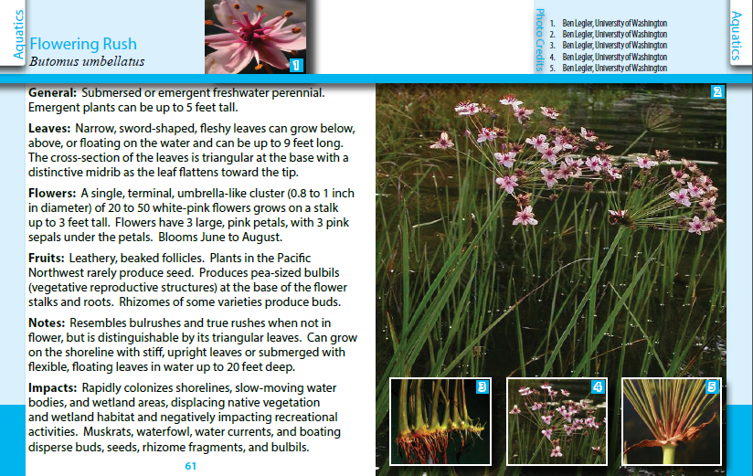
Worst Weeds of the Gorge Field Guide
Download the guide digitally here!

Slide 11
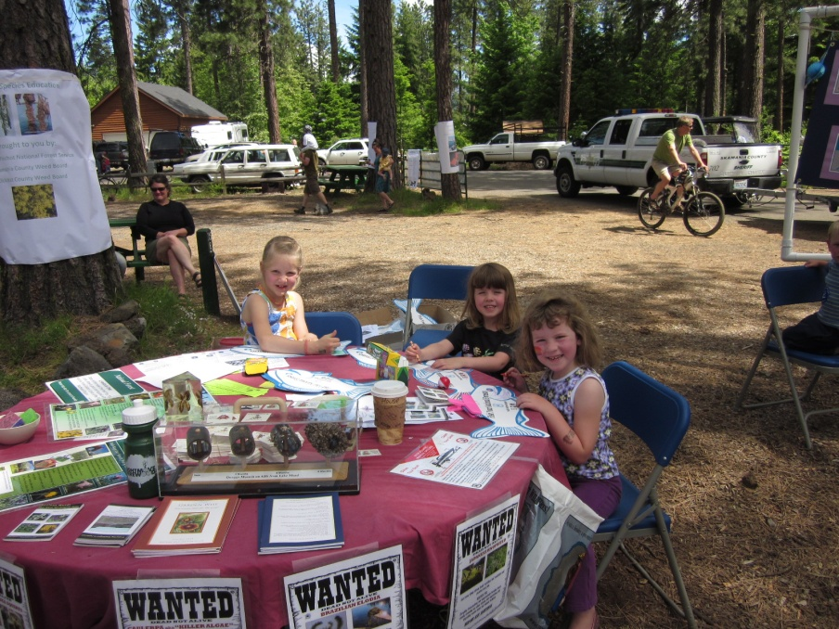
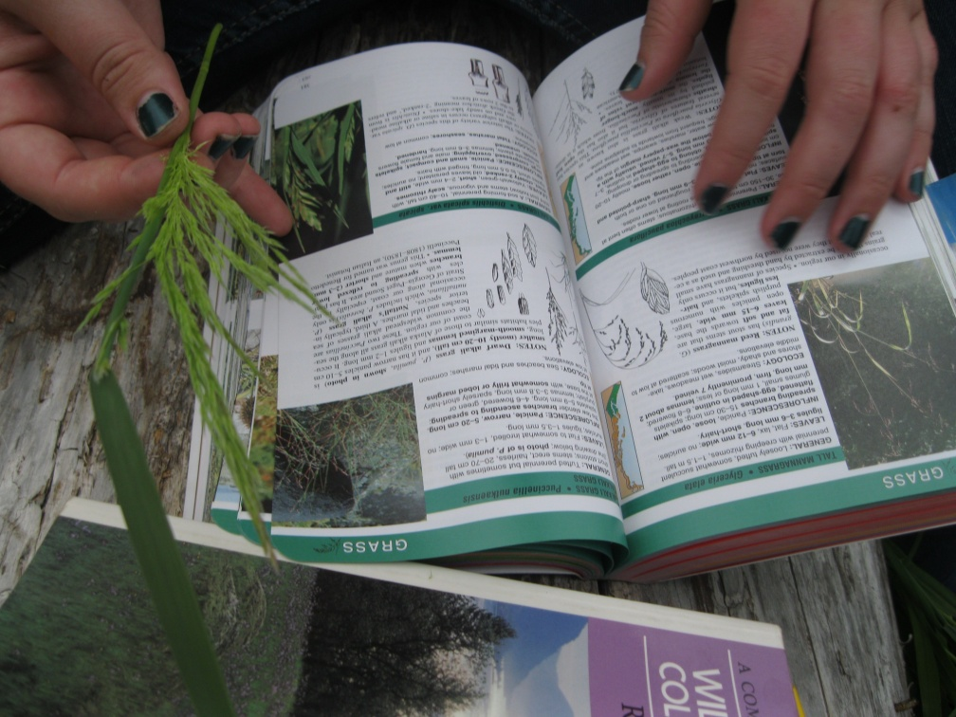
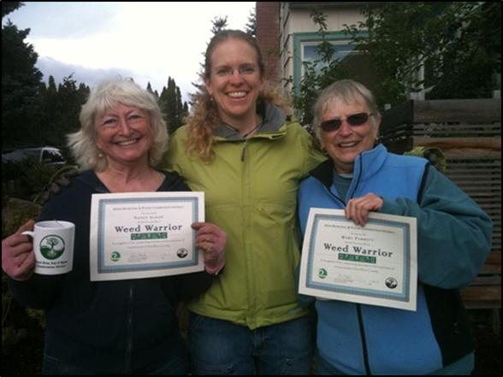
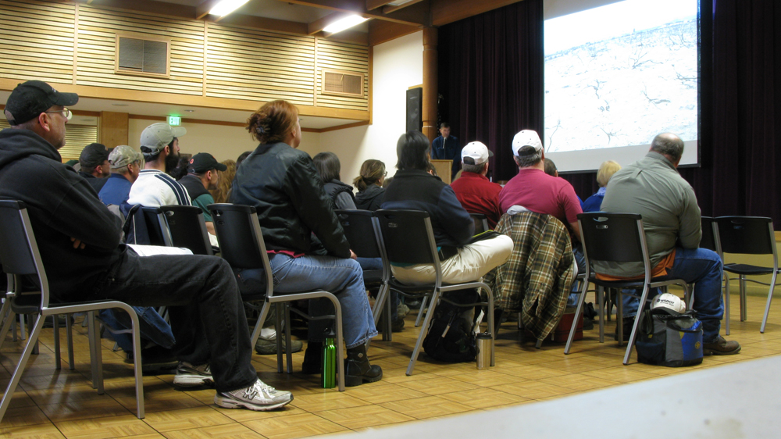
Invasive Plant First Detector Trainings

Slide 12
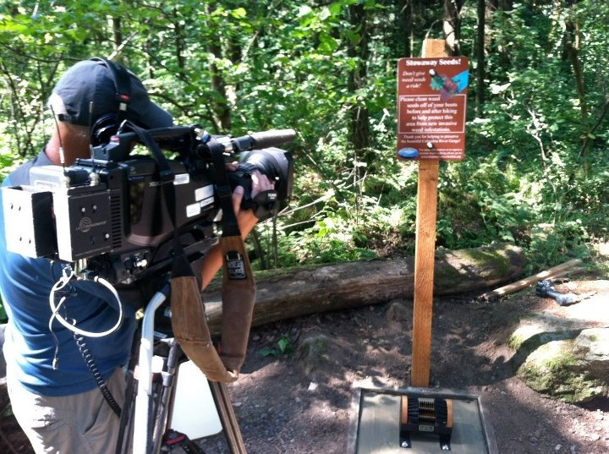

OPB’s Oregon Field Guide
http://www.opb.org/programs/ofg/segments/view/1836

Slide 13
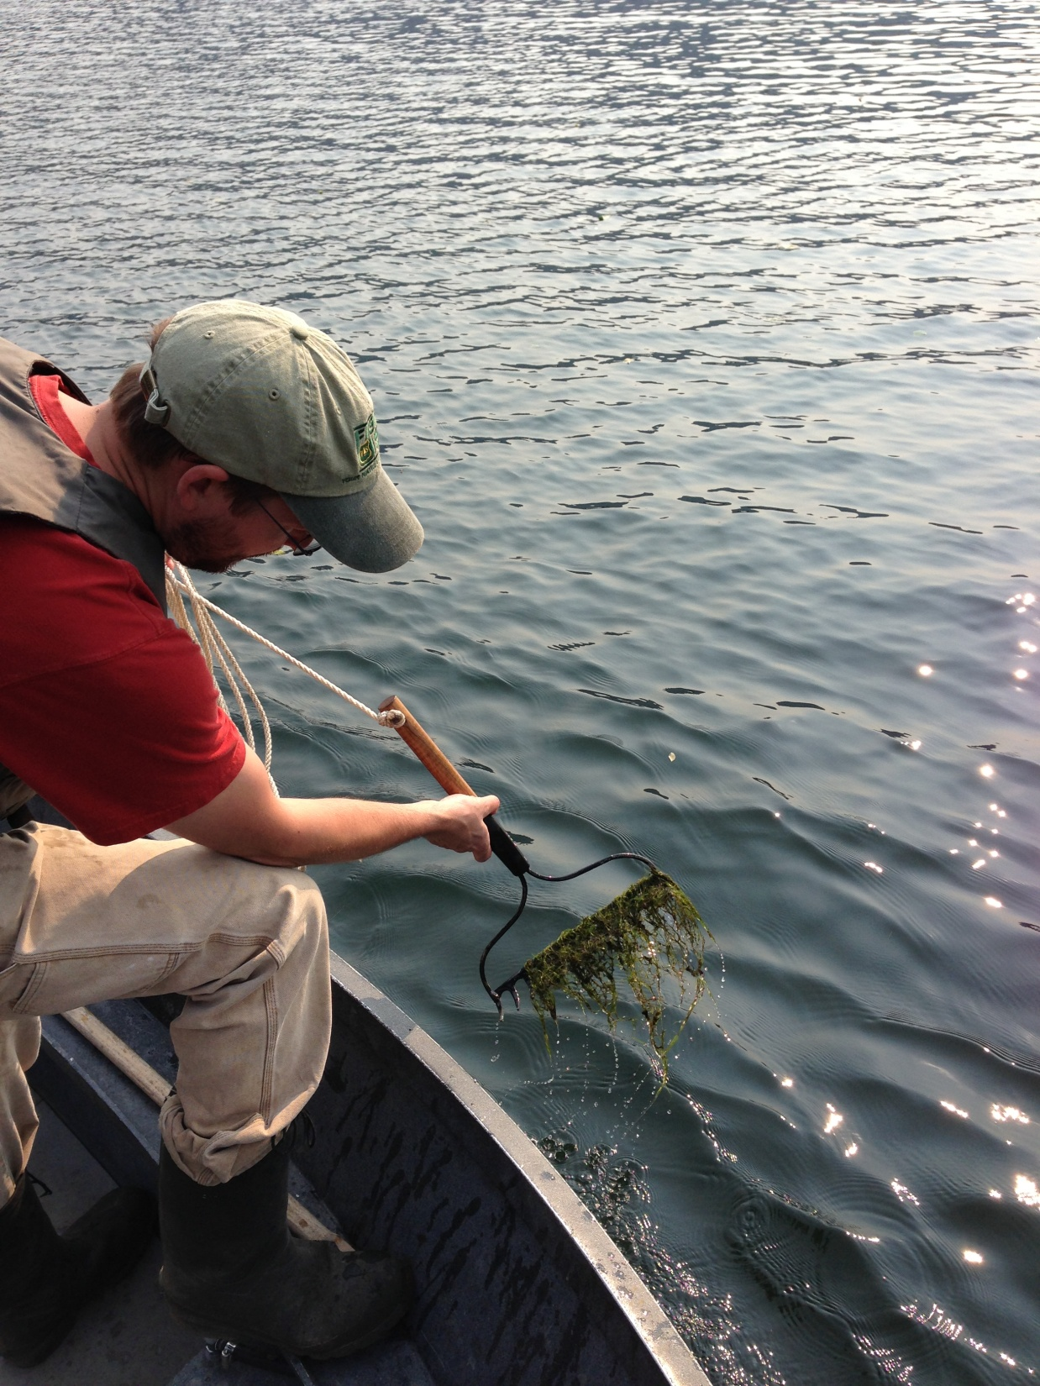
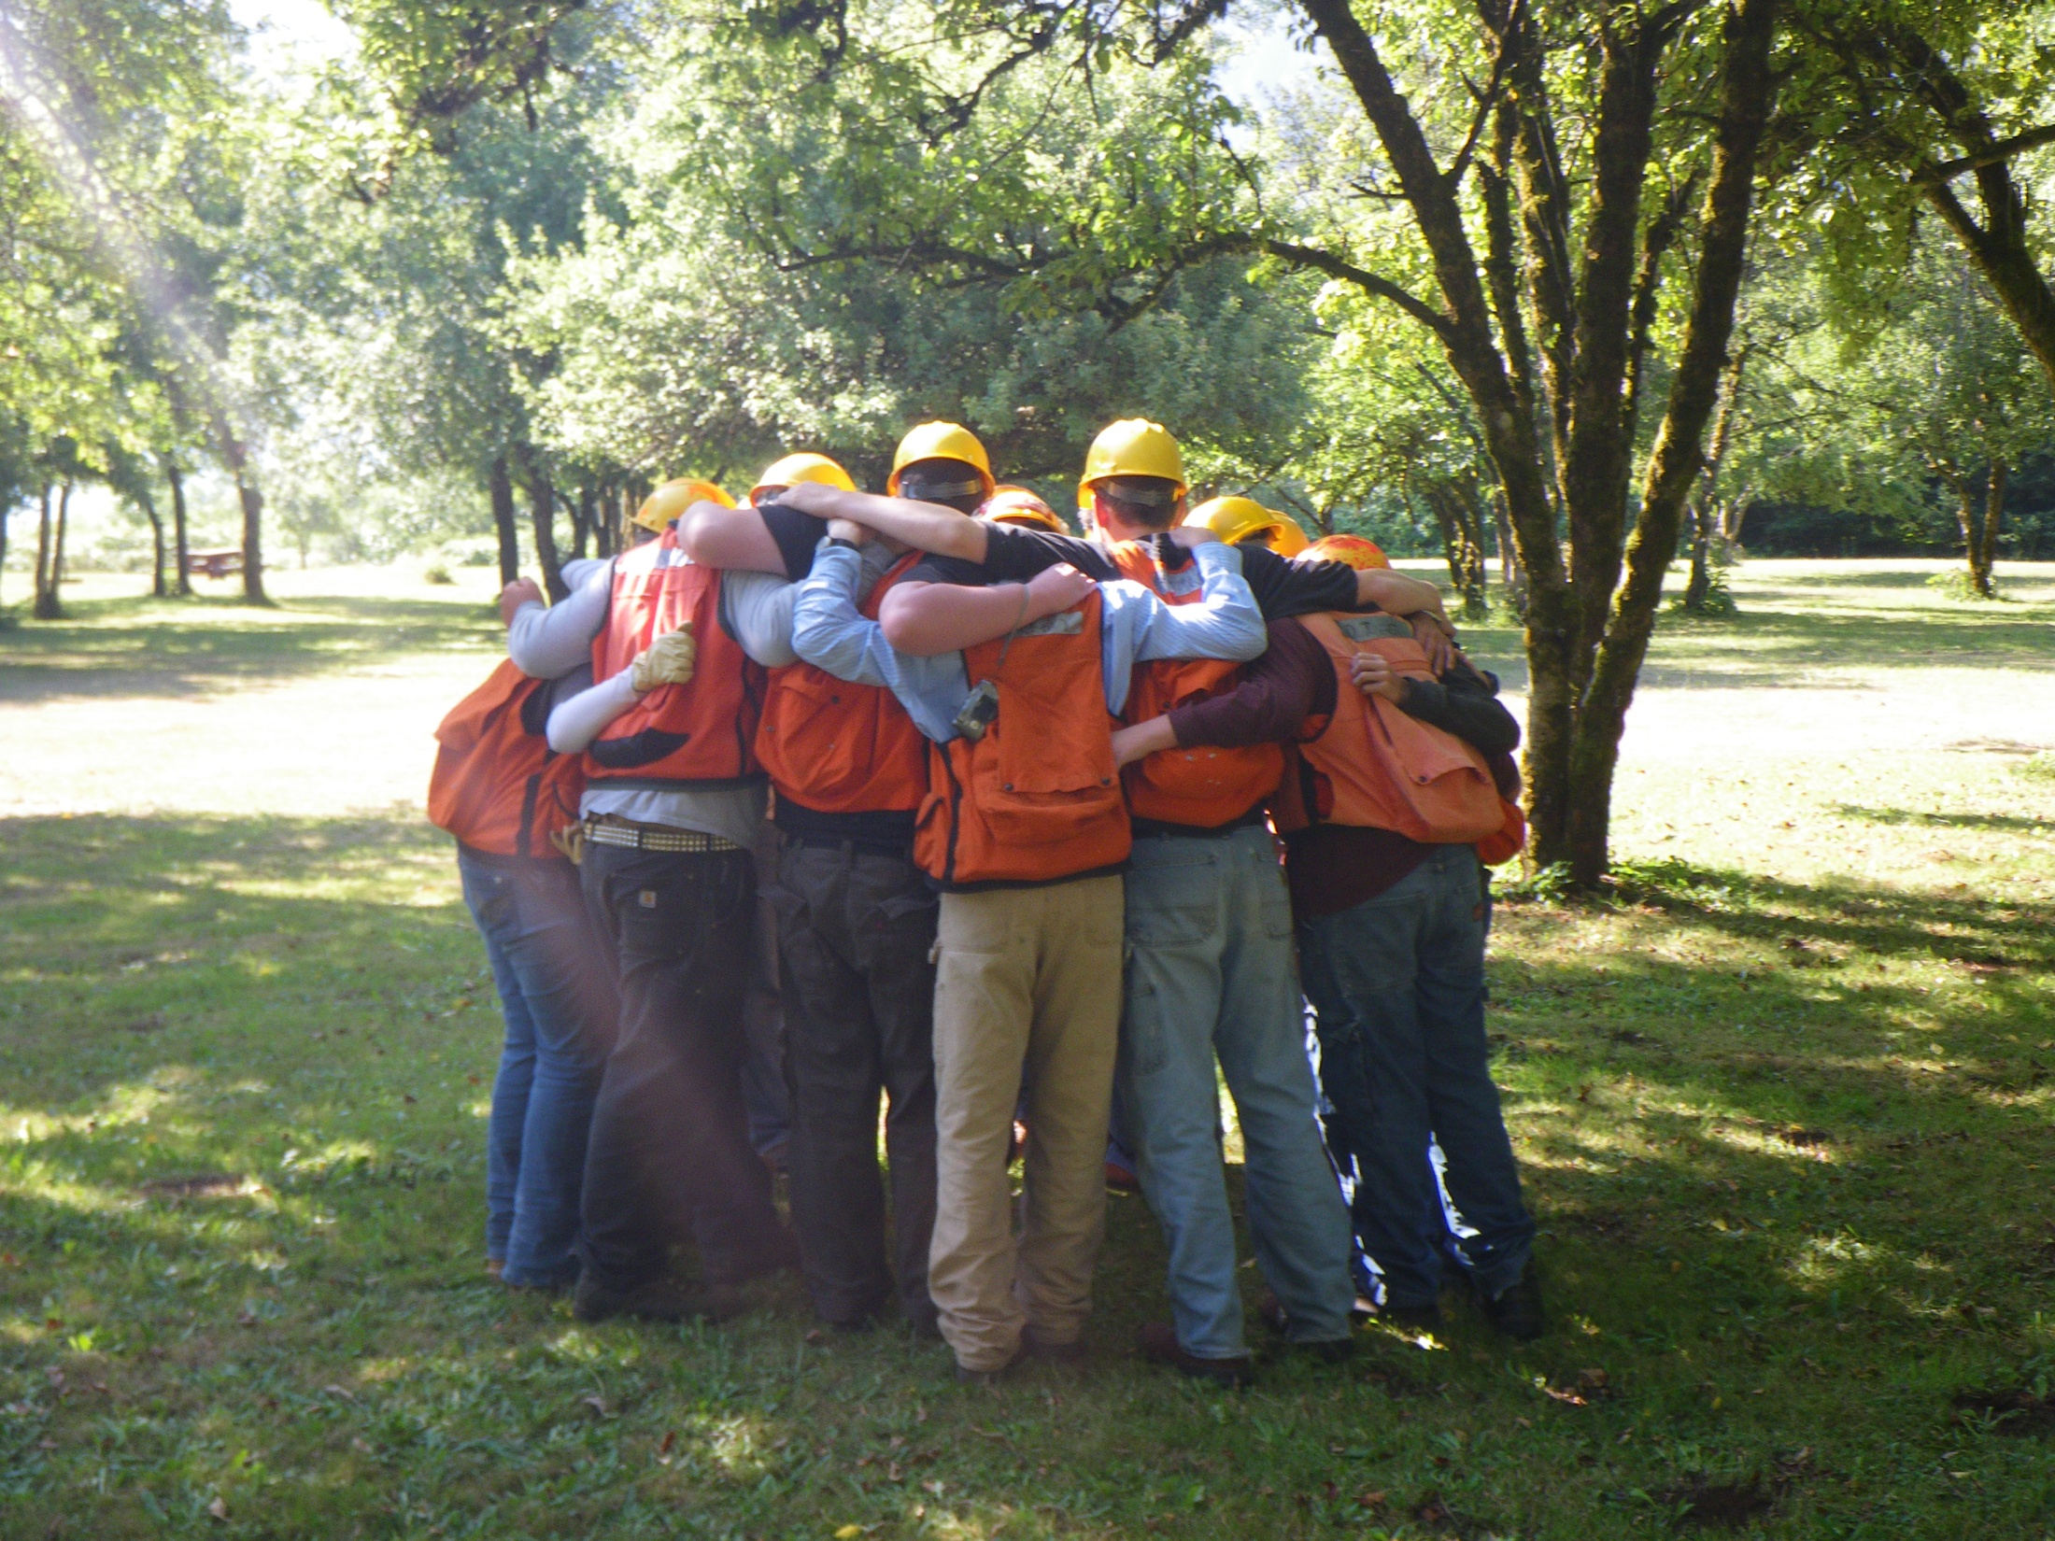
Questions?

