Slide 1

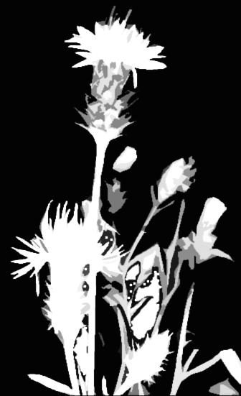



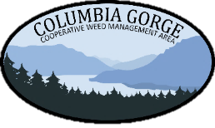

STOP THE INVASION!
WEED MANAGEMENT 101

Slide 2
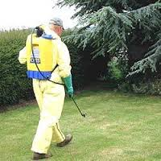
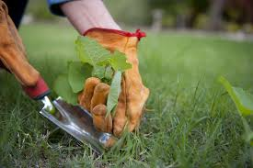
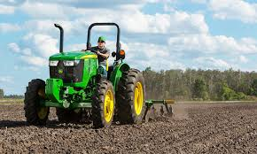
Properly identify the weed so you can learn about its biology:
methods
timing of control
types of herbicide
Notes:
The basis for any weed control plan is to learn how to properly identify weeds so you can learn about its biology and what method is best to use, the timing of control, and what types of herbicide will be most effective

Slide 3
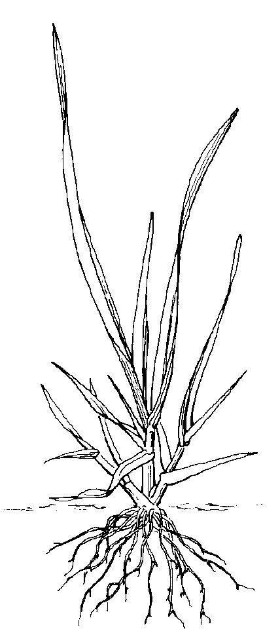
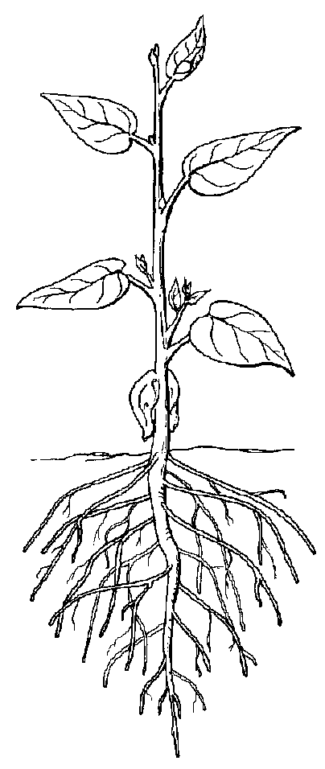
Plant groups are designated according to structural characteristics common to all plants in each group.
grass
broadleaf
Notes:
Grasses have 1 leaf when they emerge. Most have fibrous root systems. The growing point is usually located below the soil surface
Broad leafs emerge with 2 seed leave and form a taproot with a relatively coarse root system. The Growing points are on buds at the end of each stem and in the leaf axil.

Slide 4
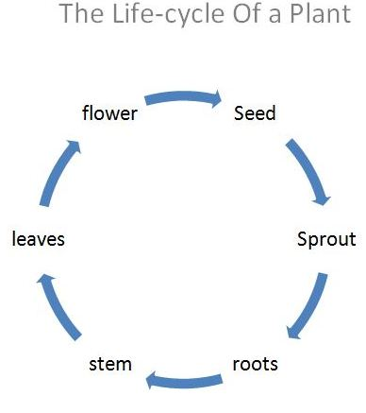
Plant Life Cycle
Plants are classified by their life cycle as being
Annuals
Biennials
Perennials
Notes:
The plants life cycle will determines when it will be most vulnerable to control measure.
Successful management depends on timing control measures to coincide with stages in the plants life when they are most vulnerable,

Slide 5
Annuals (winter and summer)
Complete their life cycle in less than one calendar year.
Normally the easiest type of weed to control.
Difficult due to rapid growth, and high seed production.
Long term control requires stopping the seed production and exhausting the seed bank
Winter Annual: Garlic mustard, Shiny geranium
Summer Annual: Puncture vine
For best results control seedlings as soon as possible after emergence because they are easiest to kill at this stage
Notes:
Annuals, their life cycle in less than one calendar year. Easiest type of weed to control, problem because of their rapid growth produce abundant seed.
Long term control requires stopping seed production and exhausting the seed bank
Winter annual plants germinate from late summer to early winter, and overwinter in a vegetative stage (this means having the power to support growth). Then in the spring or early summer start to grow, flower , set seed, mature and die but live for less than one full year. Seeds then lie dormant in the soil during the summer months and germinate again in the fall.
Summer annuals germinate in the spring and summer, grow , flower and set seed before winter. The seeds lie dormant in the soil until spring or several springs later when the cycle repeats itself.
Annuals are usually the easiest type of weed to control. They are a continual problem because of their rapid growth, high seed production and abundance of dormant seed. SEED BANK?

Slide 6
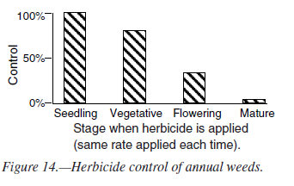
ANNUALS
Seedling stage. For best results, control seedlings as soon as possible after emergence.
Vegetative stage. Control is still feasible but more difficult than at the seedling stage.
Flowering. It is most difficult to kill older, annual plants with chemicals. Foliar herbicide applications at this stage may prevent seed production.
Maturity. Maturity and seed set complete the life cycle of annuals. Chemical control is not effective or practical at this stage.
Notes:
Control of annual weeds becomes increasingly more difficult as the plant matures the easiest time to kill annuals is during the seedling stage. Annuals gets harder to kill as they mature At maturity Chemical control is not effective or practical at this stage.
Annual Plants in the vegetative stage are still controllable but more difficult than seedlings
During the flowering stage, most of the energy is put towards seed production. It is difficult to kill older annual plants,
but Some foliar herbicide applications may be able to prevent seed production.
At maturity, the seed has set and the life cycle of an annual plant is complete.
collect the seed heads off of the plants and dispose of them properly. Vital to keep more seed from hitting the ground

Slide 7
Biennial
Complete their life cycle within 2 years.
In the first year, plants form basal leaves (rosette) and a tap root.
The second year, the plant flowers matures and dies
Example: Tansy Ragwort, Bull thistle, Poison hemlock,
For best results, control biennial weeds as seedlings. Control of the rosette stage is second best. Control decreases as plants mature.
Notes:
Biennials complete their life cycle within 2 years. The first year the plants form basal leaves, called a rosette, and a tap root.
The second year, the plant will flower and die.
Sometimes people confuse winter annuals with biennials. Winter annuals live DURING 2 calendar years but complete their life cycle in less than 12 months.

Slide 8
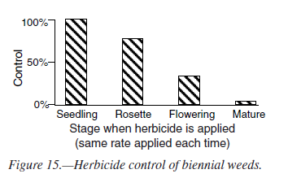
Biennials
*There are no biennial grasses
Seedling stage. For best results, control seedlings as soon as possible after emergence.
Vegetative stage. Control is still feasible but more difficult than at the seedling stage.
Flowering. It is most difficult to kill older, annual plants with chemicals. Foliar herbicide applications at this stage may prevent seed production.
Maturity. Maturity and seed set complete the life cycle of annuals. Chemical control is not effective or practical at this stage.
Notes:
The control of biennials is the same as the annual. the most effective control is as a seedling, followed by the rosette stage, and decrease as
the plants mature
Biennial plants
Biennials take 2 years to develop through the same growth stages as annuals. The first year, the plant forms basal leaves (rosette) and a taproot; the second year it bolts, flowers, matures, and dies.
For best results, control biennial weeds as seedlings Control of the rosette stage is second best. Control decreases as plants mature.

Slide 9
Perennials (simple or creeping)
Simple
Spread primarily by seed
Large tap roots, even cut off below ground level they can still resprout
Examples: Dandelion, Pokeweed, Giant hogweed
Creeping
reproduce by creeping horizontal stems above ground (stolons) or below ground (rhizomes)
Example: Canada thistle, Field bindweed
Perennials are the most difficult to control . Do not let perennial weeds become established. Most reproduce by seed and also vegetatively (fragments)
Notes:
Perennials live more than 2 years, and may live indefinitely.
They are classsified by how they sprout Simple and Creeping. SIMPLE- spread primarily by seed, they have large roots that can resprout when cu
t
CREEPING PERENNIALS reproduce by creeping horizontal stems either above ground (STOLONS) or below(RHIZOMES)
perennials are the most difficult to control Because of the resprouting roots and plant fragments
Once an area is infested, creeping perennials that send up new shoots from the roots often are the most difficult weeds to control. Control might require repeated mowing or cutting, herbicide application(s), or combinations of all methods.
Store nutrients in their expansive root system, and can regrow from small portions of the root or stem that may be left behind after pulling.
Creeping: canada thistle, leafy spurge, field bindweed

Slide 10
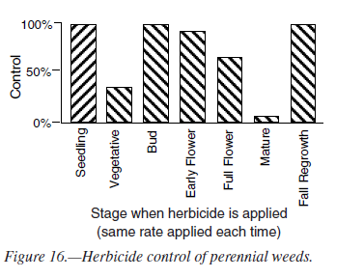
Perennials
Seedling stage. Perennials are easiest to control during the seedling stage, just like annuals and biennials
Vegetative stage. Chemical control is generally poor during this stage but improves when the weed reaches the bud stage
Flowering. At this stage, the plant’s energy goes into production of flowers and seeds. Chemical control is most effective just prior to flowering (bud stage)
Maturity. Most herbicides are ineffective at this stage. The underground roots and stems remain alive through the winter and send up new shoots the following spring.
Fall regrowth. Some perennials produce shoots in the fall just prior to frost. These shoots make more sugars for storage in the roots. Applying herbicides to fall regrowth is very effective.
Notes:
To understand perennial weed control, you should know that • herbicides move with the flow of plant sugars. Therefore, to move herbicides down into the roots, apply them when the flow of sugar is downward into the roots , This is during summer as seedlings establish their root system again at the bud stage when food is transported and stored in the roots, and then again in the fall
Control is effective seedling stage decreases at the vegetative stage. Then improve as the plant move towards the bud stage
Herbicide control is most effective just prior to flowering at the bud stage
most sugars are moving up the stem to support new growth, so little herbicide is moving to the roots.
Maturity. Until the bud stage, most sugars are moving up the stem to support new growth, so little herbicide is moving to the roots.
system. and fall
• Plants store sugars in their roots during winter. In the spring they use the sugars to grow shoots, depleting the root reserves. In the summer and fall after flowering, the plants restock the roots with sugars for next year’s growth.

Slide 11

Seedling weeds are more easily controlled than any other growth stage, whether using mechanical or chemical control.
The seedling growth stage is susceptible in all weeds
—annuals, biennials, and perennials!
Notes:
As we have shown Seedling stage is when weeds are most easily controlled no matter whether they are annuals, biennials or perennial, and whether you are using herbicide or mechanical control

Slide 12

Soil Seed Banks
Soils seed bank is the natural storage of seeds in the soil
    Seed viability varies among weed species
Scotch broom seed is purported to live up to 80 years and still germinate under the right conditions.
Long term control requires stopping the seed production and exhausting the seed bank
Notes:
Long term weed control requires stopping the seed production and exhausting the seed bank it requires
The goal of a weed control effort is to deplete the seed bank.
A seed bank is the storage of seed in the soil from plants that have lived their life cycle and dropped their seed. Weed seeds can be viable in the soil for many years waiting for the right conditions to sprout and grow. Disturbance is a major cause of germination of weed seeds that have laid dormant until the disturbance occurs.
For example: One garlic mustard plant can produce well over 10,000 seeds per plant and it looks as though the seeds are viable as long as 9 years. So letting one plant go to seed can really set you back in the long term goal of eradication . This is why it is SO important to keep weed from going to seed and making it a high, if not the highest priority in your control program.
So lets get into some specific best management practices

Slide 13
Integrated Vegetation Management
Mechanical control
They include hand-pulling, blading, grubbing, and mowing.
Cultural control
Cultural practices can include burning, flooding, mulching, tillage, and planting of competitive, desirable vegetation.
Chemical control
Proper herbicide application method, rate, and timing, can selectively control broadleaf plants, grasses, or control all vegetation for short or long time periods
Biological control
Biological control uses living organisms (insects, animals, or pathogens) to control undesirable vegetation.
Notes:
Mechanical techniques are the oldest methods of vegetation control, that includes hand-pulling, grubbing and mowing
cultural control includes methods like burning, maybe a flooding regime, or planting desirable vegetation to out compete weeds.
Chemical control is the application of herbicides, and
Biological control that uses living organisms to control undesirable vegetation.

Slide 14
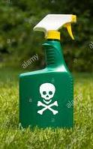
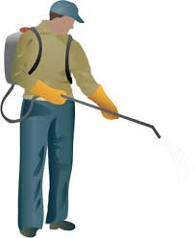
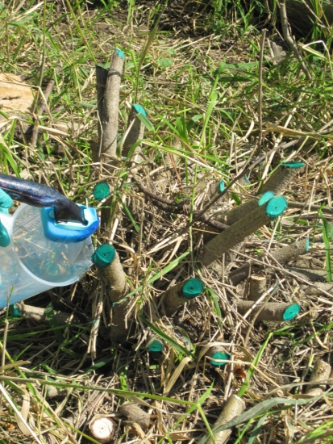
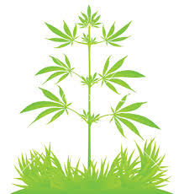
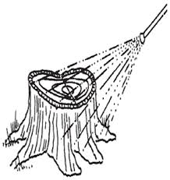
Herbicide Application Methods
Foliar applications –made directly to plant foliage at the proper time via backpack, boomsprayer, or a ready to use container
Cut stump/stem- cutting weed, tree or shrub at its base. Herbicide is then painted on, applied via sponge type dauber, or sprayed on
Notes:
The following slides discuss herbicide applications so I want to define those for you
Foliar applications are made directly to the foliage of a plant via backpack sprayer, boom sprayer, or from a ready to use container
Cut stump and stem these applications involve daubing, painting or Spraying the surface with herbicide.
For effective control,good coverage of the surface area is necessary, and for trees the herbicide must be placed where the tree sap flows called the (cambium layer)—located near the outside rings of the stump.
Cut surfaces begin to dry within minutes of cutting. Herbicide solution must be applied as soon as stem is cut. These type of treatments typically utilize a high concentration of herbicide.

Slide 15
Selective vs. Nonselective
Selective
Herbicides that control weeds while doing little or no damage to desirable vegetation (i.e. 2,4-D)
Nonselective
Herbicides kill or injure almost all plants—weeds as well as desirable vegetation. (i.e. Glyphosate)
Notes:
SELECTIVE Herbicides that control weeds while doing little or no damage to desirable vegetation. For instance controlling a broadleaf weed in grass. An example of a selective herbicide is 2,4’D
Non selective will kill all the vegetation, including grasses i.e. glyphosate. .revegetation is often recommended with using non selective
To be effective herbicides must 1. adequately contact plants,
To be effective, the herbicide must enter the plant. Leaf angle, size, hairiness, and thickness of wax and cuticle greatly affect the retention and absorption of foliar-applied herbicides

Slide 16
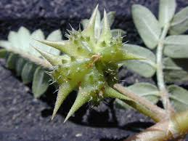
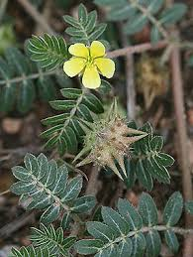
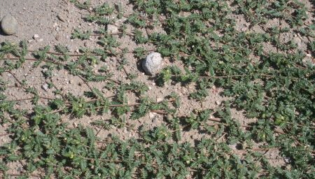
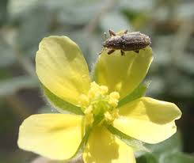
Puncturevine
summer annual
Prevent establishment by destroying the first plants found before burrs form –easy to pull and remove
Shallow tilling in spring- mowing is not recommended
Mulches are effective but must be at least 3 inches deep
Aeration of compacted sites and planting competitive species
Herbicide applications containing 2,4-D amine, glyphosate, and dicamba
There are biological control agents available for puncturevine.
Microlarinus lareynii seed feeding weevil
Goal: stopping seed production and exhausting seed bank
Notes:
Thebest way to control this plant is to prevent its establishment. It is a very easy plant to pull. Hopefully you can get to it before the burs begin to form.
Shallow tilling before the burs form is very effective. MOWING is not recommended as it will likely just contribute to the spread, and if the burs are present they will get caught in the tires and spread that way.
Mulching over the top of this plant can be effective if the mulch is deep enough. Must be at least 3 inches. OR Aeration of compacted sites and planting competitive species can be beneficial in an area where control has started to take place
2,4-D, glyphosate and dicamba are effective herbicide treatments, and as an annual, the younger the plant, the better. After this plant has matured, chemical control is not an effective tool, and one should concentrate on collecting the seed if possible.
REFERENCE CONTRACTOR SECTION OF THE BMP=we have expanded on the herbicide options for contractors and licensed applicators.
Important to check your shoe tread, tires and tools to keep the m free of the burrs so as to not contribute to the spread

Slide 17
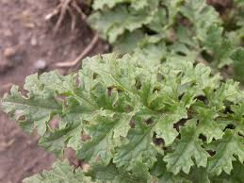
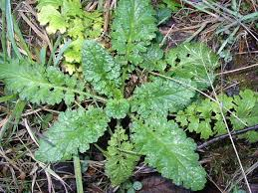
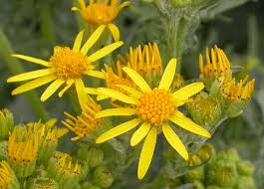
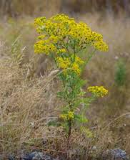
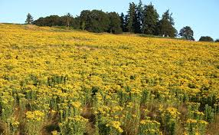
Tansy ragwort
biennial or short-lived perennial
Pull or dig before flowering, typically in May to June. Mowing is not effective
Herbicides can be applied in spring before flowers appear and in the fall after rains have initiated seed germination and rosettes appear
Herbicides effective on tansy include 2,4-D and dicamba or a combination
Spot spray with glyphosate
Retreatment the following year is necessary to control late germinating plants
Continue to monitor until the seed bank is depleted, and following any disturbance
Toxic to livestock
Notes:
Bag flowers
Manual control is feasible, it is important to get all of the roots, because this plant will resprout. If flowers have formed, carefully cut bag and remove them to Prevent seed deposit into the bank. The seed from tansy is viable up to 15yrs. I control tansy manually within my own pasture, and very often find that plants have sprouted from roots that have broken off while I was pulling, Revisiting within the season is necessary
Mowing is not an effective tool against tansy because mowed plants can persist as short lived perennials or can flower below the level of the mower. Also important to note: Mowing may increase the amount of toxin ingested by livestock because they have a hard time differentiating between the weeds and small grasses as they graze.
Herbicides applied in the spring before flowering, the younger the plant, the easier it is to control, control decreases as the plant matures. Fall Herbicide application to rosettes that appear following the fall rains is also very effective and also effective. If you have the ability to treating tansy in the spring and fall, Herbicides that are effective on tansy include 2,4_D and dicamba or a combination of those 2. An example of that would be Weedmaster or Weed B Gone. Please note that Dicamba and 24D can harm alfalfa and other legumes and it is important to read and follow the label. Glyphosate will work when spot spraying. Glyphosate is non selective, so revegetate as necessary.
.

Slide 18
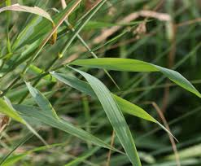
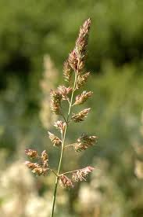
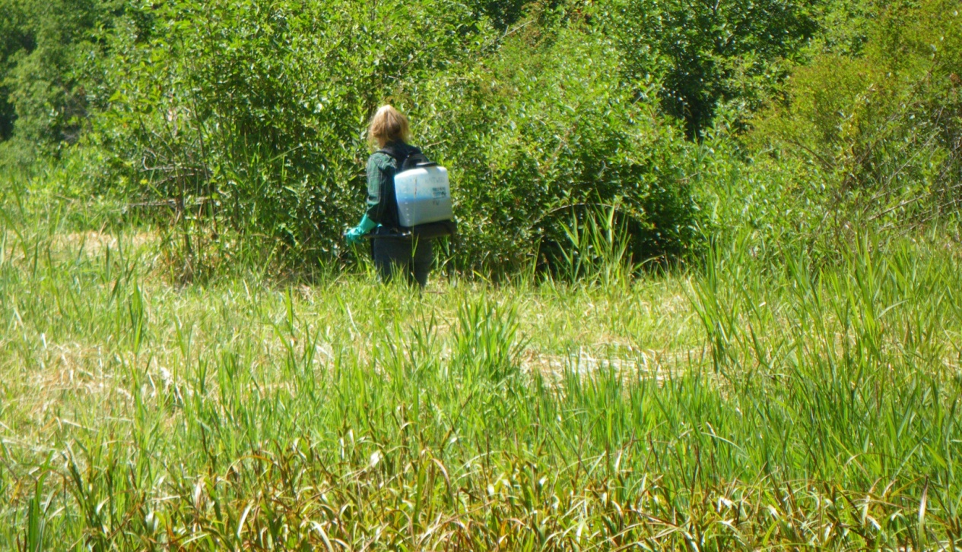
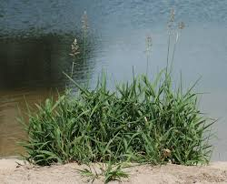
Reed canarygrass perennial grass
A string trimmer can be used to cut as low to the ground as possible
Tillage can be successful combined with a flooding regime
Solarization, shading and mulching on small sites, planting trees
Mowing or burning followed by an herbicide treatment when plants are boot high
Herbicides such as glyphosate, applied when the plant is actively growing, or regrowth after trimming
Permits may be required to make applications in a wetland
Notes:
Manual and mechanical control of reed canary grass is very difficult, of not impossible. cutting several times in a season can help prevent seed. Since RCG occurs mostly in wetlands, mot of the time, mowers aren’t used.
Smaller isolated patches can be covered and mulched. RCG is shade intolerant, so planting trees will help eventually shade out RCG and can be a long term tool
Controlled burn followed by herbicide when plants have grown a foot or so is very effective, Permits may be required to make applications in a wetland
An application of glyphosate to young actively growing plants is effective, as is string trimming before the plant goes to seed then following up with a glyphosate application to regrowth.
Since RCG is frequently found in wet areas, only herbicides and surfactants formulated for aquatic use may be permitted and
Permits may be required to make applications in a wetland

Slide 19
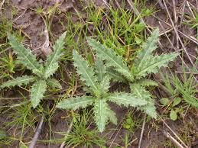
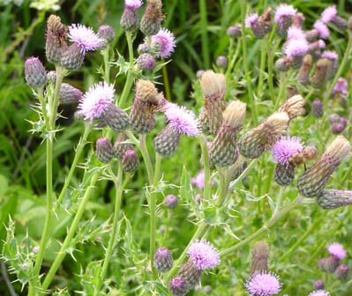
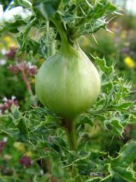
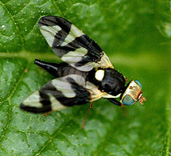
Canada thistle
Creeping Perennial
Hand pulling or cutting individual plants or very small infestations, bag and remove seeds from site
Prescribed fire late spring between May and June
Herbicides containing triclopyr, 2,4-D amine, dicamba, or a combination of dicamba and 2,4-D (Weedmaster), clopyralid or aminopyralid (Milestone) applied during the growing season
Foliar spot application of glyphosate applied in the spring when plants are 6-10 inches tall
Annual treatments for 2-3 years will be necessary.
Gall fly- Urophora cardui
Biocontrol available
Growth and flowering can be reduced but this agent alone does not kill plants or prevent spread
Notes:
Handpulling or cutting may eventually reduce very small infestations over a long period of time but it is not advised for larger infestations because it will likely promote the growth of the rhizomes
Prescribed fire can be effective, the most detrimental time being late spring.
Herbicide applications during the growing season is effective
Herbicides containing triclopyr, 2,4-D amine, dicamba, or a combination of dicamba and 2,4-D such as (Weedmaster), clopyralid or aminopyralid (Milestone)
Careful spot applications of glyphosate to plants that are 6-10 inches tall is effective remember that glyphosate in nonselective grass and revegetation may be necessary.
There is biocontrol available but these do not eliminate infestations, rather, they inhibit seed production
Growth and flowering can be reduced, but this agent alone does not kill plants or prevent spread. Mowing should not be used in conjunction with this bio-control

Slide 20
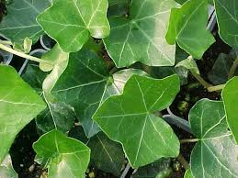
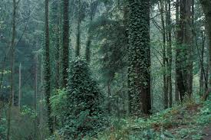
Ivy
perennial vine
Can be dug or pulled removing entire root
Cut vines on trees near the ground at a comfortable height to kill upper portions and relieve tree canopy
Covering or mulching effective for smaller infestations
Improper disposal of this plant is the primary cause of infestations!!
Glyphosate, triclopyr or a mix of glyphosate + triclopyr (Ortho Poison Ivy and Brush Killer) in winter when temps are above 50
Glyphosate in early spring on young plants with 2-4 newly expanded leaves
Application of glyphosate+triclopyr right after string trimming
Revisit site often, vigilance is required to ensure long term control
Notes:
it is helpful to prioritize Ivy can be pulled or dug out taking care to get the entire root.. sCutting the vines on trees pulling as much as possible off to Release trees and clearing a buffer at the base is often the first priority, followed by working your way from the outside in., as you work toward controlling the entire infestation. It is possible to prevent the spread of ivy by seed by cutting a 12 “ gap in vines on trees.
Covering and mulching has been effective for small isolated infestations.
Glyphosate, or triclopyr or a mixture of both i.e. Ortho Poison Ivy and Tough brush killer) can be applied on a sunny day in winter when temps are above 50, ideally early to mid January
The glyphosate + triclopyr combination can also be effective when applied to ivy after it has been cut with a string trimmer.
RECENT TRIALS in Portland have shown a 4-2-2 combination to be 95% or better success. That is a combination of 4% glyphosate, 2%triclopyr, with 2% surfactant (I think they used competitor)
Ivy that has received an herbicide application should not be mowed until it appears dead. Ivy can take several months to die after an herbicide application, so be patient
2 applications of 2,4-D one month apart provides good control in early summer then again on regrowth in late summer .
Revisit site often vigilance is required to ensure long term control. And of course, Revegetation is always beneficial in areas where there was a large infestation.
Please dispose of plants properly. Improper disposal of this plant is the primary cause of infestations Propoer disposal of ivy could include bagging it and disposing of it in the trash, or building a burnpile that definitely gets burned. Keep an eye on it for any escapees Composting is not recommende,d because ivy will regrow from fragments.

Slide 21
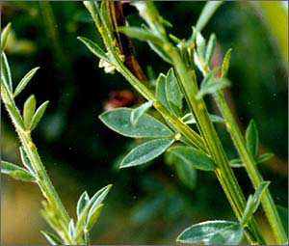
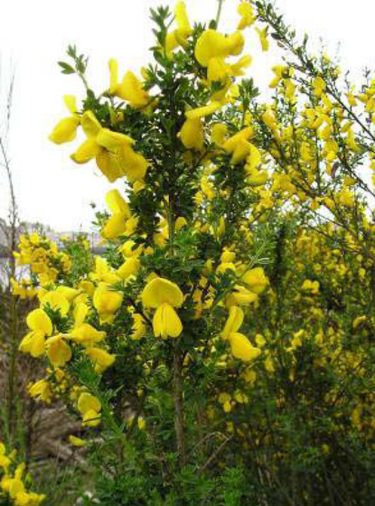
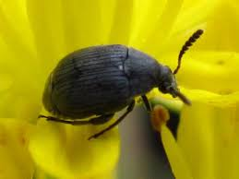
Scotch broom
perennial shrub
Dig or pull out by the root before seed pods form or cut plant below the crown (usually just below soil level)
Mowing is effective on plants 2 inches in diameter or greater
Triclopyr and Glyphosate can both be used as cut stump treatments
Foliar applications of triclopyr, (Garlon3A) or triclopyr+2,4-D (Crossbow)
Herbicide applications when scotch broom is actively growing is very effective. Coverage must be at least 80%.
Retreatment the following year will be necessary to control late germinating plants.
Monitoring will be necessary for many years, small whips can be hand pulled
Several species of beetle are available for biocontrol
Bruchidius villosus- seed weevil
  Seeds remain viable in the soil for decades
Notes:
Older plants are less likely to resprout from cut stems Resprouting can be abundant in young plants. Herbicide should be applied directly after the cut is made. Addition of surfactants to spray solution will improve results
You can control scotch broom be pulling young whips or wrenching plants out of the ground, but it is important to note that disturbing the ground WILL activate the seed bank, so the least amount ground disturbance the better. It is for this reason that we do not recommend bulldozing as a form of control for cysc. Lopping plants off below the root crown is also pretty effective. The root crown is usually located just below soil level. The larger the plant the less likely they will resprout after lopping. Mowing can be effective on older plants with a 2 in diameter stem or greater. Important to note that the Regrowth on younger mowed plants will be abundant. An herbicide application to this regrowth can be very effective. We know of several sites where a cysc was mowed in the spring to prevent seed set, then the regrowth rec’d an herbicide treatment, and that has proven very effective. Triclopyr and glyphosate can both be used for a cut stump treatment. Painting or daubing with herbicide should occur shortly after the cut is made.
Herbicide treatment just prior to bloom is the most effective time, but anytime the plant is actively growing is fine. CYSC will put on a growth spurt in late summer, Good coverage is key, you need to wet at least 80% of the plant to effectively kill it and the addition of a good surfactant will improve results. Plan to retreat any lat germinating plants the following year, often small whips can be handpulled, but plan to monitor scotch broom sites for years, especially if the scotch broom was well established and dumped years worth of seed into the ground, and definitely if there is any disturbance that occurs.
Biocontrols may be considered as part of a long term management strategy on very large infestations where other options may not be viable

Slide 22
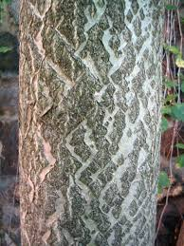
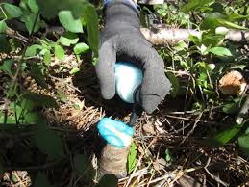
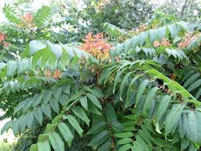
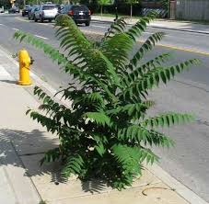
Tree of Heaven
perennial
Small seedlings can be pulled
A heavily shaded environment will reduce the establishment of Tree of Heaven
Glyphosate, triclopyr or aminopyralid+triclopyr (Capstone) as a foliar spot treatment when leaves are fully emerged. Thoroughly wet all leaves but not to run-off
Cut stump treatments with undiluted glyphosate or a 20-25% solution of triclopyr in water.
Cut stump treatment can occur any time but late summer-early fall is recommended. Cut stems horizontally and immediately apply herbicide
Notes:
This plant is really making itself known more and more in our area. It is really making a go of it in ROW’s along power lines, roadsides I am seeing tremendous growth along RR’s Small seedlings can be pulled. A shaded environment can help reduce its establishment, so over planting with natives is helpful.
Cut stump treatments can be made anytime, but late summer-early fall is recommended. Why is that? Right- because sugars are moving down into the root system In general, best woody plant control occurs when the majority of the sap flow is not moving up the tree.
Interesting facts about tree of heaven- 2-3 yr old plants can produce viable seed, sprouts can grow 10-14ft tall in the first year and maintain that growth rate for up to 4 years, Mature trees produce up to 300,000 seeds and those seeds can disperse up to 330 ft. away from the parent

Slide 23
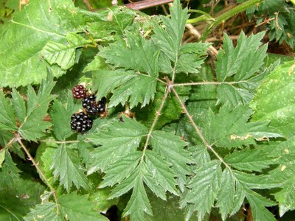
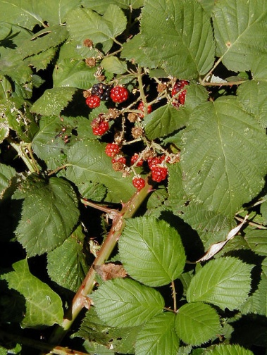
Cutleaf/Himalayan Blackberry
perennial vine
Digging up root crowns and grubbing roots is slow but effective and will control blackberry.
Mowing or cutting several times a year over several years is necessary to exhaust the roots and energy reserves.
Herbicide applications on blackberry is most effective late summer after fruiting until first frost.
Triclopyr, Triclopyr+2,4-D (Crossbow), or Glyphosate + Triclopyr (i.e. Roundup Wild Blackberry Plus Vine Killer) or Glyphosate
Re-treatment the following years will be necessary to control any returning plants.
Continue to monitor for new plants for several years after the initial treatment and following any disturbance to the soil such as tilling or construction.
Notes:
Digging up root crowns and grubbing roots is slow but effective and will control blackberry. This method is best suited for small infestations. Root fragments left in the ground will resprout so it is necessary to monitor.
Repeated mowing in dry areas over several years will eventually render good control, but it is important to note that birds like to nest in blackberry early spring through July, so mowing after that time is important and mowing during dry periods in the fall and winter is a good time, and you can follow up by mowing the young plants in the summer.
Herbicide applications are most effective in the fall Why? Because sugars are moving to the roots.
Planting native tree species can help control blackberry in the long term by shading them out. Revegetating with natives or overplanting a desirable crop as site conditions favor
As always, overplanting with native species or a desirable crop will aid in lessening the unwanted invader
For example, to control blackberries with glyphosate, application is most effective in September or October. Use of triclopyr amine for blackberries works best in midsummer. Per OHSU ROW veg mgmt handbook pg 51

Slide 24
Climatic factors, including temperature, humidity, precipitation, and wind influence weed control and safety to desirable vegetation.
Notes:
When planning to go out and spray Make sure you follow label directions and heed the precautionary statements regarding application.

Slide 25

Label directions might say:
“Do not apply if temperature is likely to fall below 40°F during or shortly after treatment” or “Do not spray when daytime temperatures are expected to exceed 90°F within the next 2 or 3 days.”

Slide 26

Precipitation
Rainfall occurring soon after a foliar-applied herbicide treatment may wash off the chemical and reduce control. Herbicide labels may indicate the
rain-free period required.
Notes:
Herbicide labels indicate the rain-free period required.

Slide 27
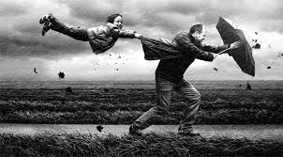
Wind
Wind increases drift, reducing the herbicide dose to the target weeds and potentially impacting non-target weeds.

Slide 28

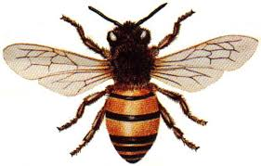

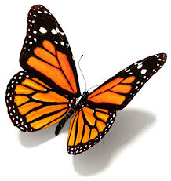
Practices to minimize impact to pollinators should be utilized
Minimize impacts to bees and other pollinators by controlling weeds before they flower.
If possible, make herbicide applications in the morning or evening when bees are least active.
Avoid spraying pollinators directly.
Abide by herbicide label.
Notes:
Hand out consider planting some other sources of food for pollinators seed packets

Slide 29

When to read a label?
Before buying to determine:
Whether it is the product you need to do the job
Whether it can be used safely under the application conditions
Whether you have the necessary PPE (Personal Protection Equipment)
How much is needed
Notes:
If it is the correct herbicide for the plants you want to treat
PPE Personal protective equipment
Whether to buy the big or small sized container and ready to use or concentrate
Read the label to make sure you’re buying the right product for the job. This will save you time, money, and frustration. • Buy only what you need. If you buy too much, pass the product on to someone who can use it, with the label instructions. Some products might not be effective if stored for long periods of time. A larger size is not a good value if you can’t use it. • Use the right amount. Labels indicate the correct amount to use. Using more can waste the product, your money and can cause harm to people, pets and the environment.

Slide 30
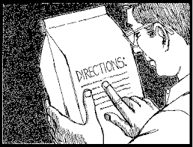
READ THE LABEL
Before mixing the herbicide to determine:
What PPE you should use
How much to use
The mixing procedure
Before applying the herbicide to determine:
What safety measures you should follow
When and how to apply
If there are any restrictions (water)
Before storing or disposal to determine:
Where and how to store the herbicide
How to dispose of the pesticide container
Notes:
You should also Read the label before mixing to determine what PPE (Personal Protection Equipment you will use, how much herbicide and the mixing procedure if you need to mix. Before applying to determine safety measures, where it is appropriate to use the herbicide and if there are any restrictions, for example, within a certain distance to surface waters.
Before storing or disposal to learn the proper way to store the herbicide and the best way to dispose of the container

Slide 31
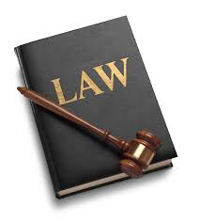
WHY?
Pesticide product label directions must be followed to make sure the pesticide does its job and does it safely.
The label is the law!!
The Environmental Protection Agency (EPA) oversees the pesticide label process to verify that all required information is included
Notes:
Why read the label? It is important to know if you are using a product that will be effective, and how to use that product safely and so it does what you need it to do. Label is the law!!
Remember! It is a violation of federal law to use a pesticide product in a different manner than instructed on the label

Slide 32
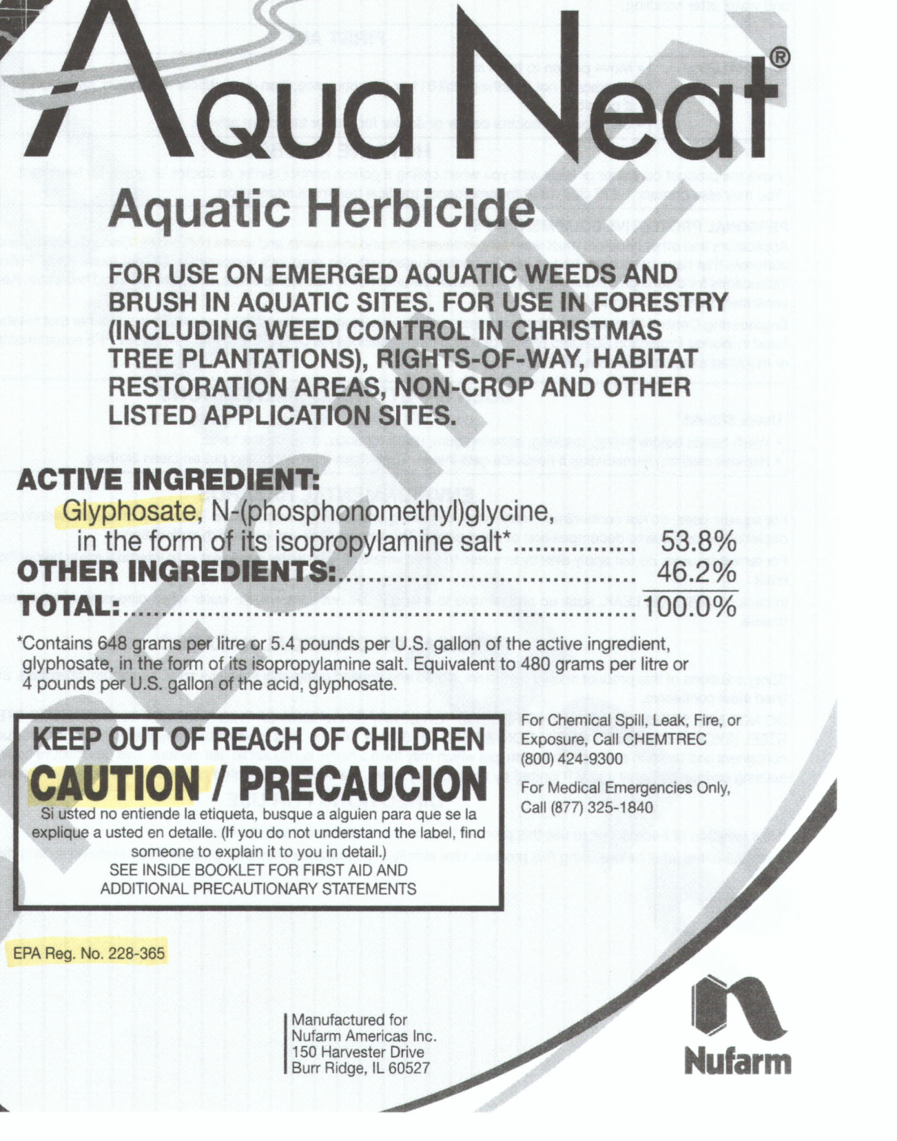
Trade/Brand name
Active ingredient
Signal words and Precautionary Statements
EPA registration number
Notes:
The brand or trade name is the name chosen by the manufacturer for marketing purposes. Often the same herbicide formulation is marketed for different uses under different brand names. Several manufacturers produce pesticides with the same common name, but with different brand names. An example of this is the herbicide with the common name glyphosate, which is sold with dozens of brand names i.e. Roundup, Rodeo, Aquamaster, or Glypro.
The active ingredient is listed either as the common name and/or as the chemical name. The label will give the percentage of product that is active ingredient and the percentage of inert ingredient given as “other
The next thing you will notice on pesticide labels are signal words and precautionary statements. The signal words are usually in close proximity to Precautionary statements. These statements provide guidance in protecting humans and animals from pesticide exposure
Also the EPA registration number will be located close by.
This is the number assigned by the EPA when an herbicide becomes registered. It demonstrates that it has been reviewed by the EPA and approved for sale and use in the united states and represents minimal risk if used correctly. This number also represents the facility where the final stage of product production took place. This is an important number to reference if ever having to report an incident, or for poison control or doctors to know in case of poisoning.
”. Inert ingredient is the portion of the product that is inactive toward the target pest, and might include such things as a compound that helps the product emulsify,

Slide 33

Signal Words
The signal word is a general indication of the potential hazard level from the pesticide to humans and animals.
Notes:
The signal words “danger”, “warning”, or “caution” is determined by a combination of acute toxicity studies.
The EPA requires that the signal word be printed in the front of all labels. Signal words help alert users to special hazards of a product, and what type of PPE or personal protective gear may be required.
Caution means the product is slightly toxic if eaten, inhaled or absorbed through the skin, or if it causes slight eye or skin irritation. Warning indicates the product is moderately toxic if eaten, absorbed through skin or inhaled, or if it causes moderate skin or eye irritation Danger means that the product is highly toxic by at least one route of exposure. It may be corrosive, causing damage to the skin or eyes. If it is highly toxic when eaten, absorbed through the skin or inhaled, then the word “POISON” must also be included in red letters on the front panel of the label.
Regardless of the signal word, it is important to remember that every product still has the potential to be dangerous at high doses. And Special care should be taken to understand and follow all label directions.

Slide 34

First aid or statement of practical treatment
Personal Protective Equipment
Environmental Hazard Statement
Directions for use
Notes:
First Aid Guidelines. Instructions for what to do if, for example, the product gets in someone’s eyes or is swallowed.
The label lists PPE needed to prevent exposure to the pesticide. Be sure to read this section before purchasing the pesticide.
This section indicates if the product can cause environmental damage – if it’s harmful to wildlife, fish, pollinators, endangered plants or animals, or water bodies such as ponds, lakes, rivers and wetlands.
Environmental Hazards:These statements include information on how to prevent environmental contamination with the pesticide
Directions for use. Directions for use-best way to find out how to apply the product This sections tells you how much to use and how to mix if needed. It also states timing and how environmental conditions will affect the use. i.e. temperature or rainfastness.
The pests the product will control
Proper equipment to be used
How much to use (rate) and how often to apply
Where and when material should be applied

Slide 35
Lack of statement does not rule out the need for additional protection.
USER SAFETY RECOMMENDATIONS
Wash hands before eating, drinking, chewing gum, using tobacco, or using the toilet.
Remove clothing immediately if pesticide gets inside then wash thoroughly and put on clean clothing.
Remove and wash contaminated clothing before reuse. Wear clean clothes daily.
Do not use in or store in or around the house.
Do not allow children or domestic animals into treated area until dry.
Remove PPE immediately after handling this product. Wash outside of gloves before removing. As soon as possible, wash thoroughly and change into clean clothing.
Common sense guidelines that should be followed by every applicator
Notes:
labels vary in Personal proctecion equipment required. Some labels carry no statement at all. And may instead say something like this “user safety recommendations” Lack of statement does not rule out the need for additional protection.
Even though you will find labels that do not specifically recommend gloves, it is good practice to always wear chemically resistant gloves when handling and mixing herbicide.
We ALWAYS use gloves, it just becomes part of the daily gear, like sun block.
Like I said earlier, it is generally accepted that use of gloves with herbicide products is just common sense good practice.

Slide 36

Storage and Disposal
Notes:
Another important section of the label is Storage and Disposal. This section describes how to safely store and dispose of the product.
Always keep products in the original container
Disposal of pesticide containers in a manner not listed by the label could lead to contamination of the environment or harm to other people.
Read carefully and follow all directions for safe storage and disposal of pesticide products.

Slide 37
TIPS
Measuring cup in fluid ounces
Wash gloves before removing, have soap and water on hand
Triple rinse and dispose of rinsate properly
Spill response, shovel and bucket
Basic Hygiene
Notes:
TIPS: some products have a built in measuring device, but If you have to measure when mixing your herbicide solution, make sure your measuring cup is for fluid ounces. Proof your measuring cup,
It is nice to have soap and water on hand. Wash your gloves before you take them off. If possible we rinse over a bucket and dispose of that water properly. If you utilize a sprayer, triple rinsing the sprayer will help preserve the integrity of the sprayer and fittings, and ensure a clean solution the next time you mix.
If you don’t have a commercial spill kit, A shovel and a bucket or garbage bag can be used to contain spills that happen on soil. Simply use the shovel to remove the material and place the material into the garbage bag.
Common sense dictates that you should bathe and wash your clothing after applying herbicide. It is preferable to wash my herbicide clothing separately from the rest.
Several factors affect herbicide persistence in the soil. Photodegradation. Sunlight can break down some herbicides s
Microbial degradation. When soil microorganisms such as bacteria and fungi use herbicides as part of their food supply, Chemical degradation. Some herbicides break down in the soil through natural chemical reactions. Adsorption to soil and organic matter.
Removal by plants. Plants absorb and subsequently metabolize many herbicides, removing them from the soil.

Slide 38
WEED DISPOSAL
Drying: plants without flower or seeds
Pile and Tarp: Leave tarped until material is completely dried out
Bag and Trash: When possible, allow plants to rot in a sunny location then dispose of in regular trash
Chipping and Compost: Woody plants that do not spread vegetatively can be chipped and left on site to compost
Burning: Burn only in accordance with the law and required permits. Monitor weather conditions, not advisable to burn some toxic plants i.e. poison hemlock
Notes:
: Plant parts that don’t have flower or seed but still may spread vegetatively, should be left on tarps, the pavement or other surfaces that don’t allow them to take root. . Chip before plants flower and develop seed

Slide 39
Remember
Home compost does not get hot enough to kill the seeds of many weeds (ie. english ivy and scotch broom)
Monitor yard debris for escaped weeds
Never dump yard debris in natural areas
When moving noxious weeds in a vehicle for disposal, secure plant material so that none can escape during transport
Remember to clean your shoes and clothing from any material that could propagate plants

Slide 40



