Slide 1
Invasive Weed Identification
Christina Mead, USFS Botanist

Slide 2
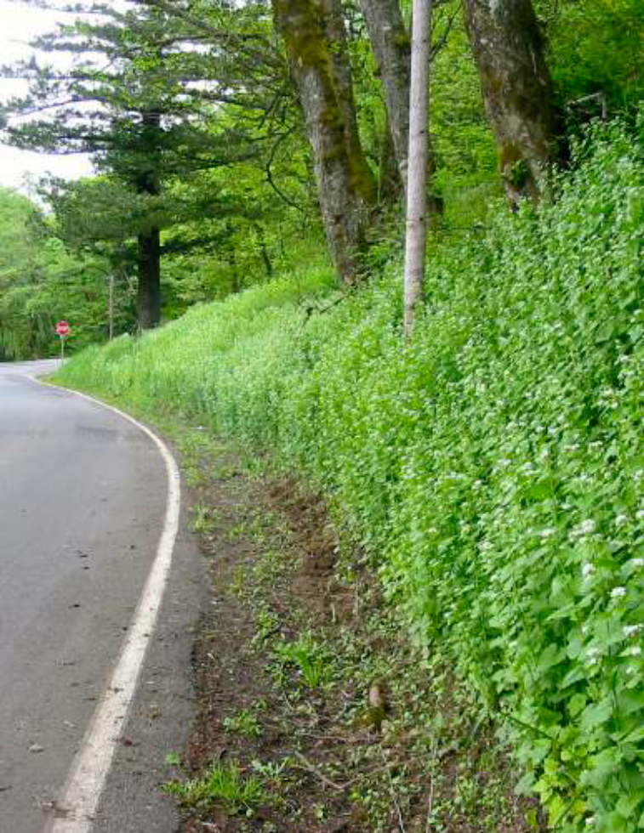
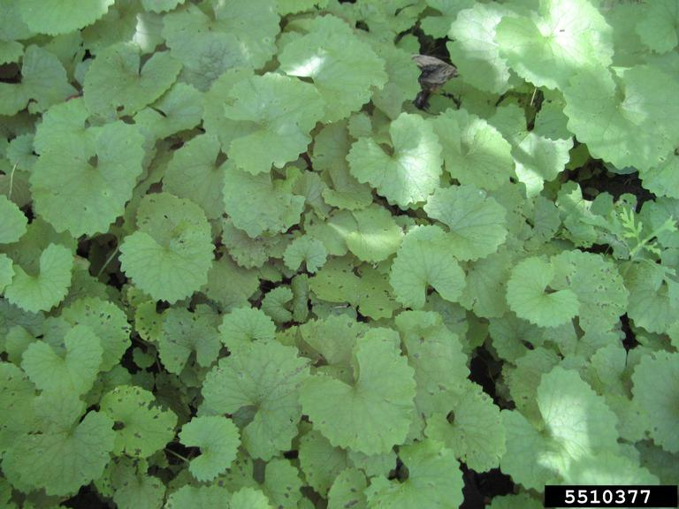
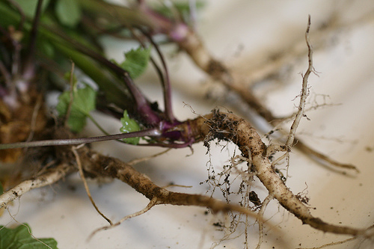
Garlic Mustard
Alliaria petiolata
Member of the mustard family
Native to Europe, well established in western Oregon and Washington.
1-3 feet tall
These plants regrow from root fragments
Displaces native understory, decreasing diversity and forage.
Oregon Department of Agriculture

Slide 3
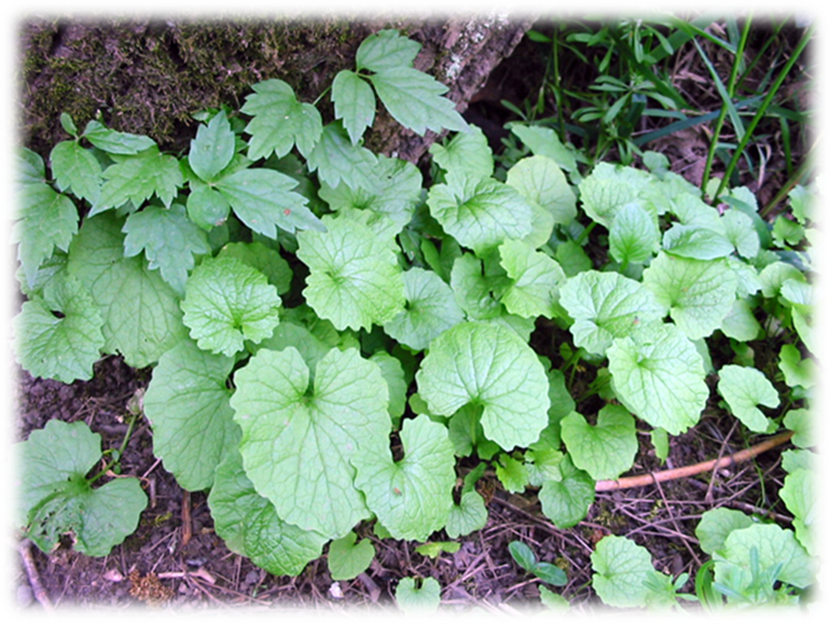
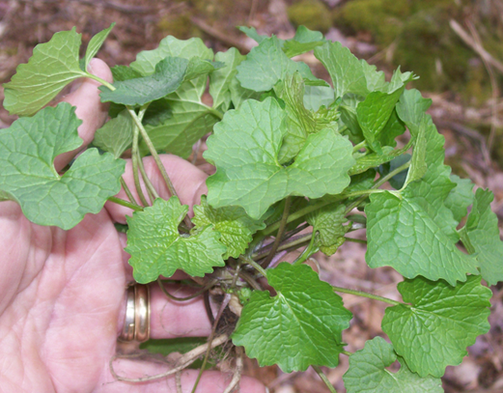
Garlic Mustard
The rosette leaves are dark green, heart-shaped (cordate) or kidney-shaped, and have scalloped or broadly serrate (toothed) leaf margins
The leaf stalks (petioles) are reddish-purple
The stem leaves are more triangular, with sharp teeth, and alternate up the flowering stem
They produce a distinct garlic odor when crushed

Slide 4
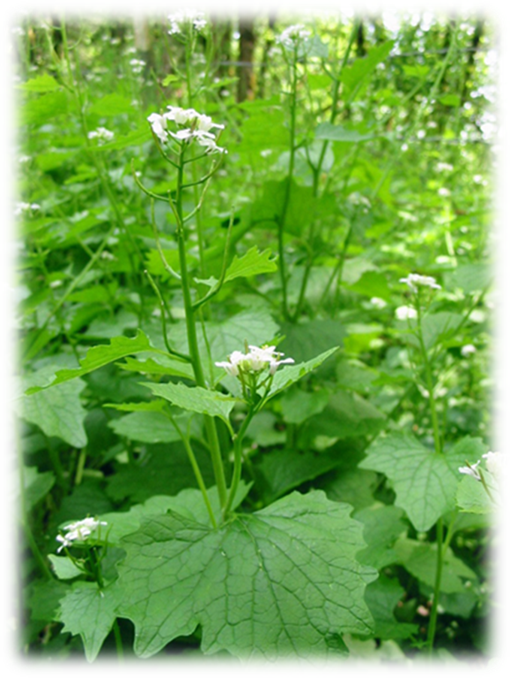
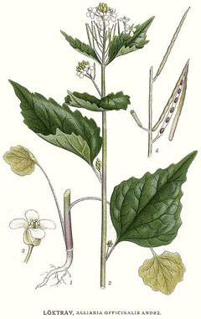
Garlic Mustard
In April to June of its second year, this plant will produce flowering stalks and small, white, four petaled flowers
These will develop into long, thin seed pods (siliques), which will split open and release the seeds.
This splitting will launch the seeds a fair distance around the parent plant.

Slide 5
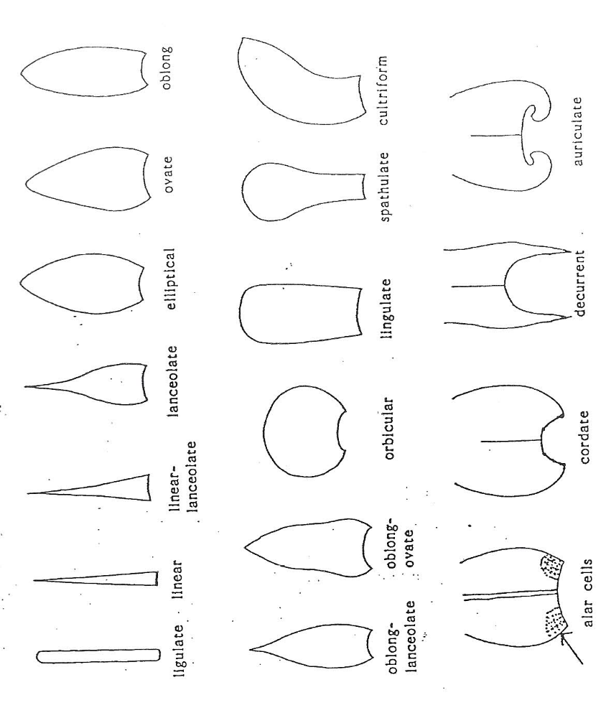
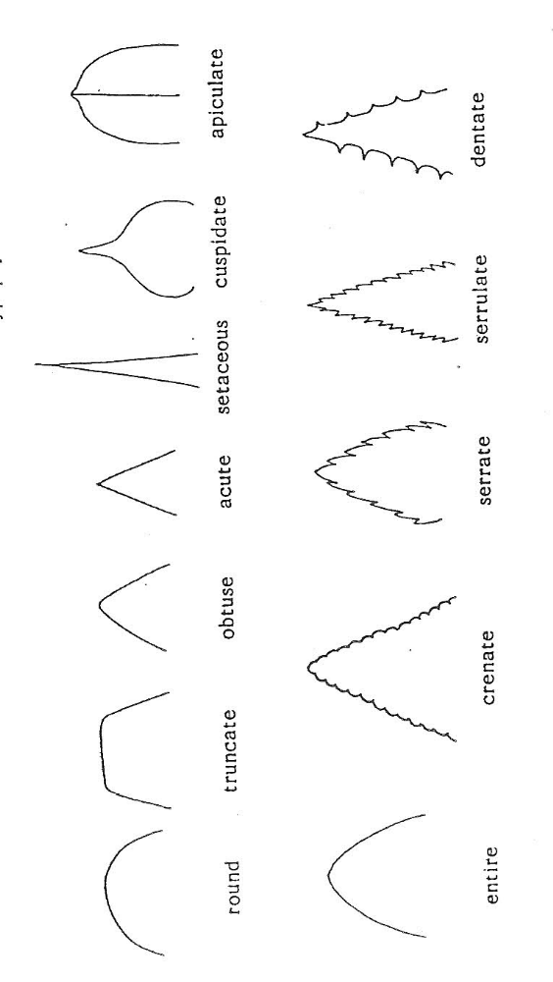
Vocabulary: Leaf shapes + margins
Plant leaves come in a bewildering array of shapes and sizes
There is specific vocabulary to help identify the form of leaves

Slide 6
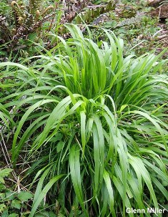
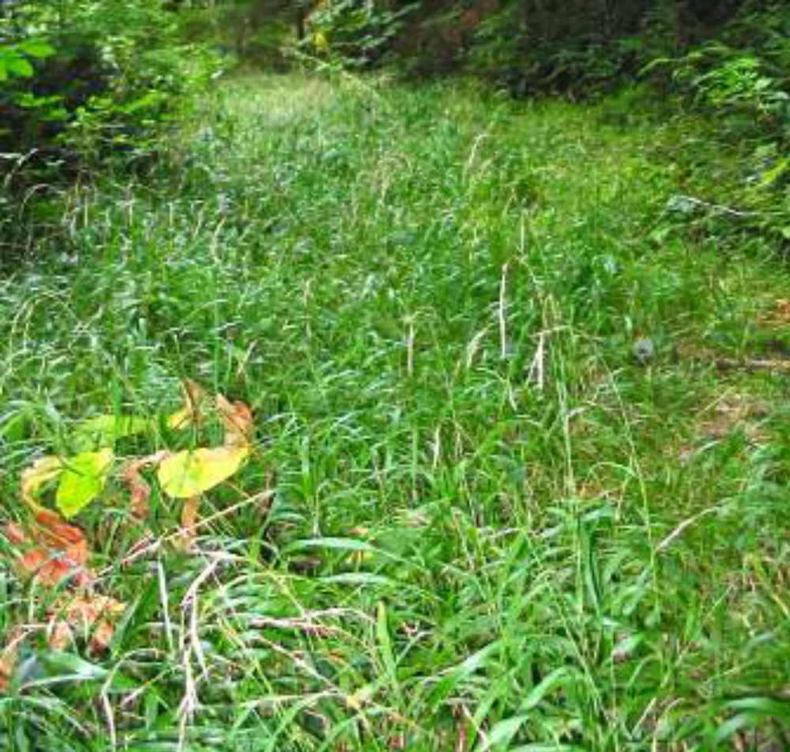
False Brome
Brachypodium sylvaticum
Native to Europe, Asia and North Africa
Perennial grass forms attractive bunches of lime-green leaf blades.
Quickly becomes the dominant plant in forest understories. It is shade and drought tolerant.
Oregon Department of Agriculture

Slide 7
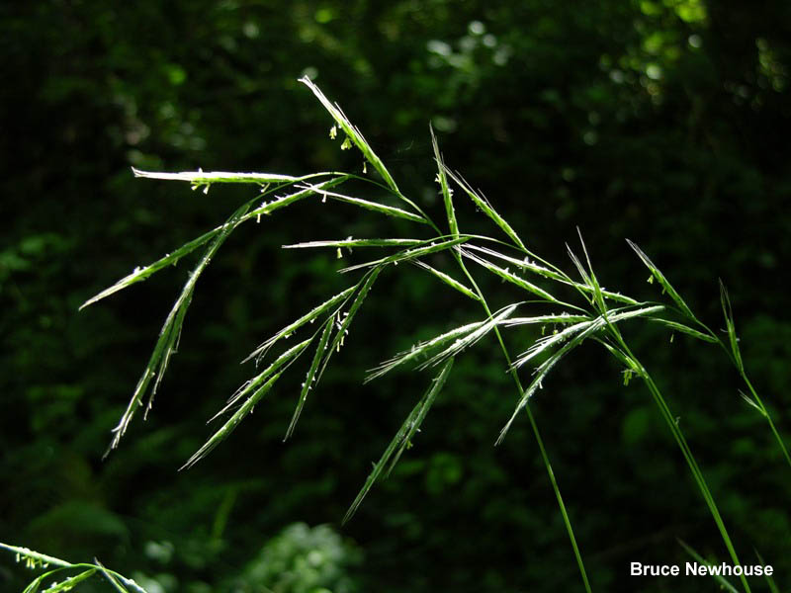
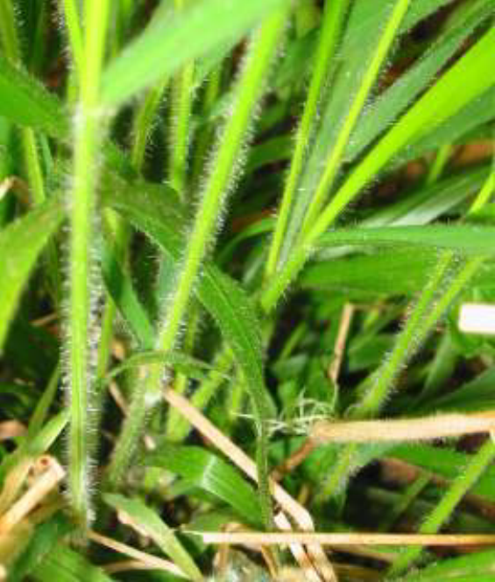
False brome
Leaf color is bright green throughout the growing season, turning bleached white during the winter
Leaf margins and lower stems are hairy, and lack red streaking on the stems (as with native bromes)
Leaves and flowering stalks are droopy
Oregon Department of Agriculture

Slide 8
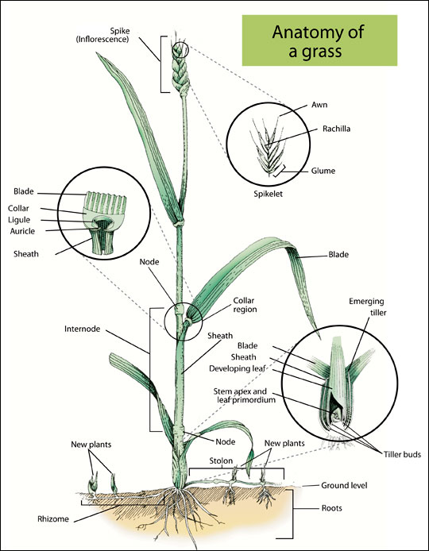
Vocabulary:
Parts of a grass
Grasses have specific terms for features of the leaf, stalk and seedhead.
When identifying grasses, you’ll want to be aware of these terms.
In particular, the leaf blade, and the structures where it sheaths to the stalk are important features before a grass produces seed.

Slide 9
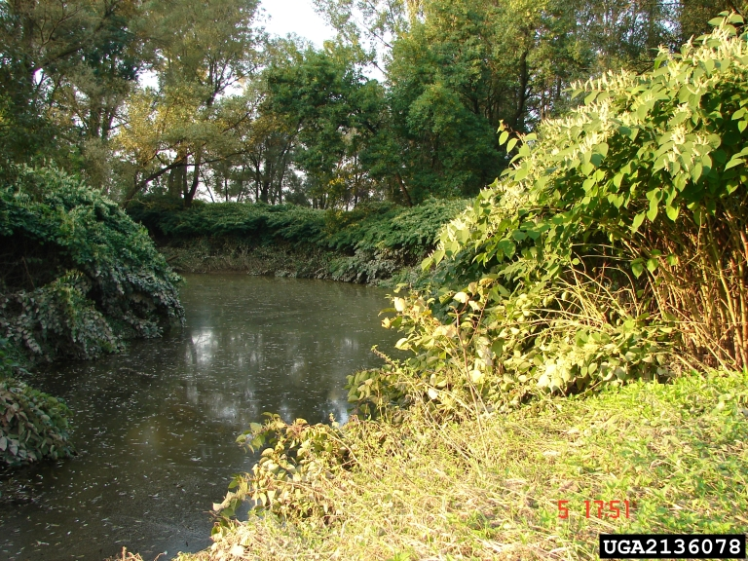
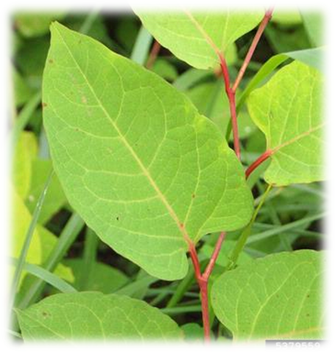
Japanese Knotweed
Polygonum cuspidatum
Native to Eurasia
Introduced as an ornamental and planted for stream bank stabilization
A deciduous perennial
Grows 4-9’ tall from a deep rooted, creeping rhizome
Creates dense canopies that exclude natives.
Re-grow from broken off stem and rhizome fragments created during management or flood events

Slide 10
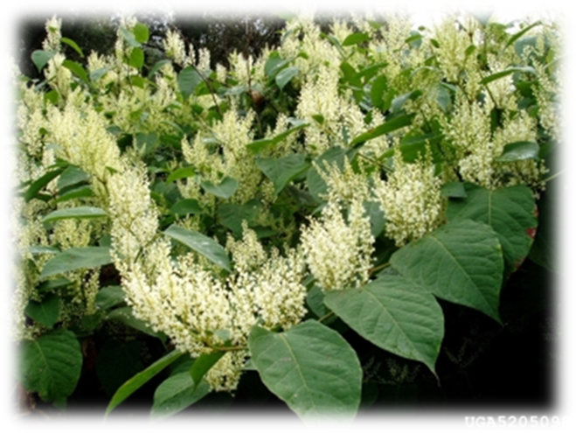
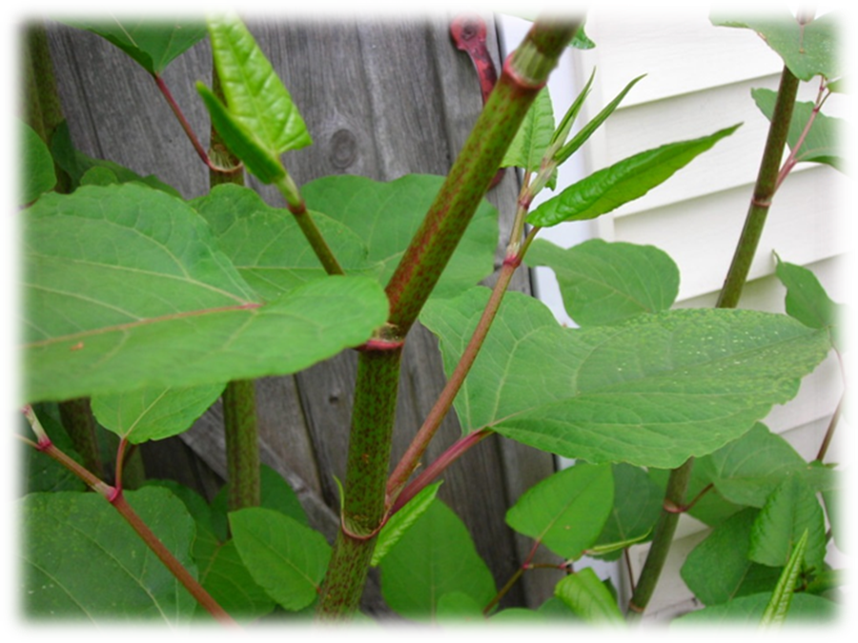
Japanese knotweed
This plant dies completely back each fall, and re-emerges in the spring from the rhizomes to form clonal patches
Zig-zagging stems have reddish-brown spots or streaks
Leaves are large (6-8” long, and 4-5” wide), and slightly heart-shaped
The flowers are greenish-white to cream and form large plumes at the ends of the stems from late July to October

Slide 11
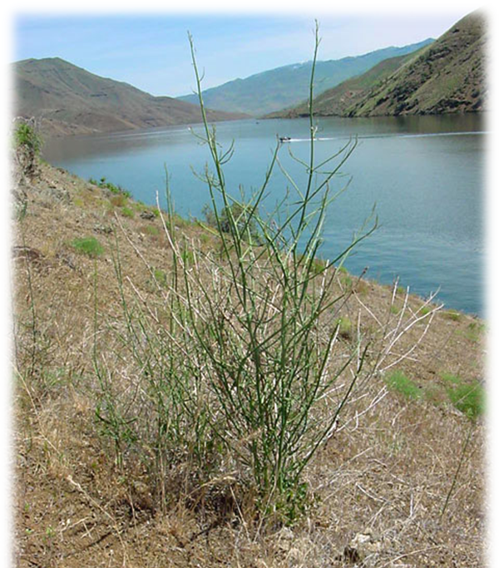
Rush Skeletonweed
Chondrilla juncea
Native to Eurasia
Deep-rooted perennial with tough, wiry, latex-filled stems.
1-4 feet tall
Stems are almost leafless, giving this plant a skeletal appearance
Regrows from broken taproot, making handpulling ineffective
Aggressive range and cropland weed
Oregon Department of Agriculture

Slide 12
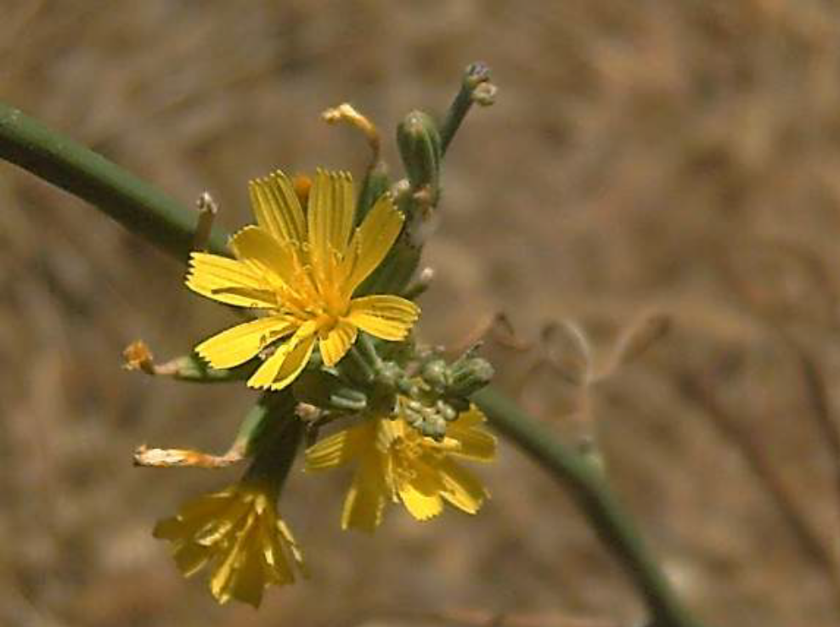
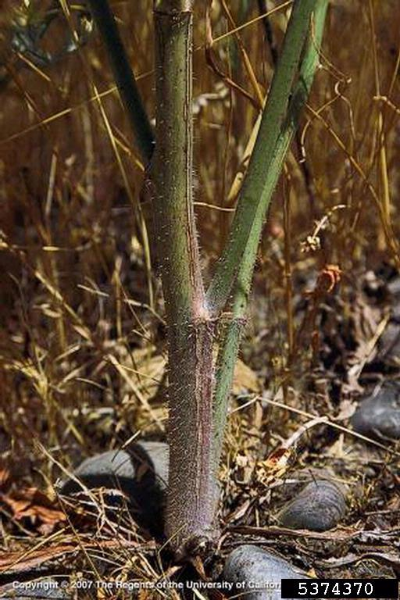

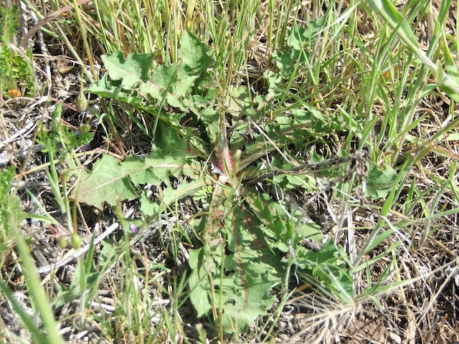
rush skeletonweed
Small yellow flowers bloom July to September
The airborne seeds spread easily
Basal leaves similar to dandelion leaves
Tough green stem with bristly, downward pointing hairs on the lower 4-6” of the stem base
This stem base is also reddish
Oregon Department of Agriculture

Slide 13
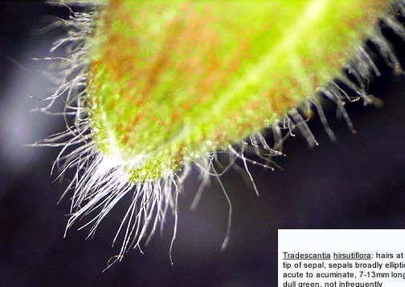
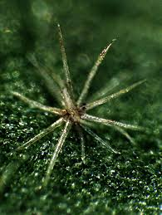
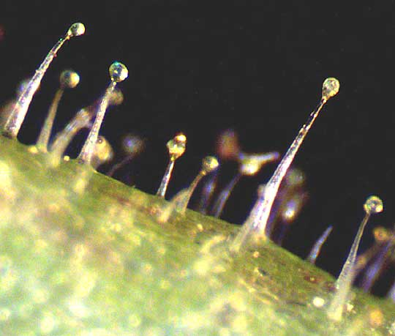
Vocabulary: Hair
Plants may have long, soft hairs (lanate, wooly), harsh, stiff hairs (hirsute, hispid), irritating or stinging hairs , glandular hairs, or even branched (forked, stellate) or may simply be hairless (glabrous).
In fact, there are over 50 terms related to the shape or function of plant hairs.
You may see a number of these words describing plants, so consider what kind of “hairy” your weed is.

Slide 14
Resources
Flora of the Pacific Northwest, C. Leo Hitchcock and Arthur Cronquist 1973
Weeds of the West, Tom D. Whitson, et al. 1991
Plant Identification Terminology: An Illustrated Glossary, James G. Harris and Melinda Woolf Harris 1994

