Slide 1
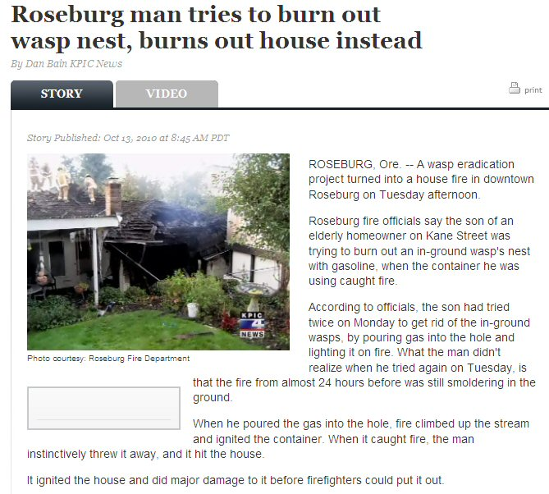
Integrated Pest Management
OR
Non-Stupid Pest Management
WHY IPM?
Todd Murray
WSU Extension

Slide 2
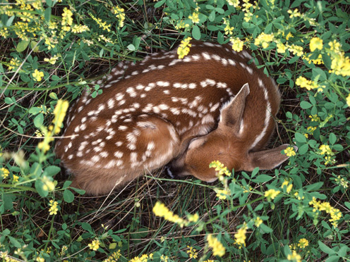
What is a Pest?
A deer is not a pest when…
  Its in the forest being cute.

Slide 3
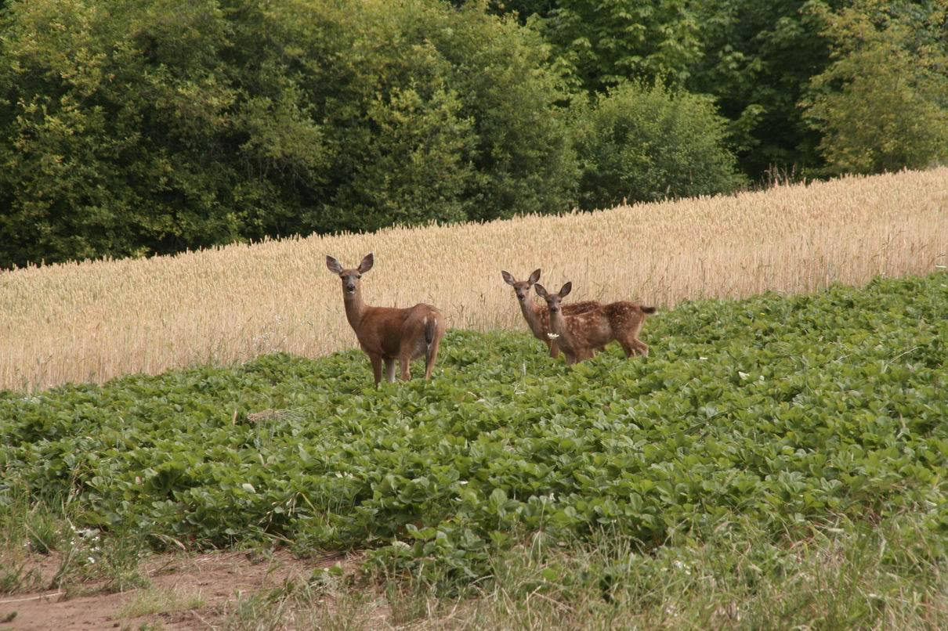
What is a Pest?
A deer is a pest when…
  It eats my strawberry plants.

Slide 4

What is a pest?
A species that interferes with human activities, property, or health or is objectionable.
Mammals, Birds, Insects, Weeds, Fungi, Bacteria, Virus…
Most are not pests
For example… < 1% insect pests

Slide 5
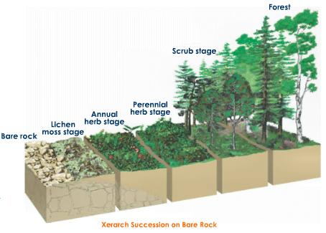
First, Some Fundamentals
Succession:
  The non-seasonal, directional continuous pattern of colonization and extinction on a site by populations

Slide 6
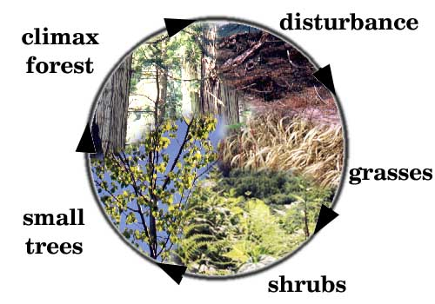
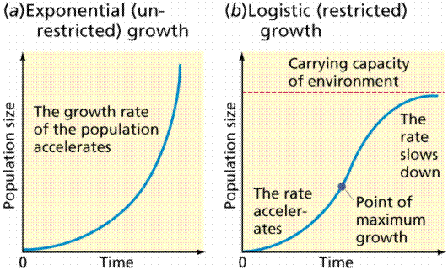
First, Some Fundamentals
Invasive Species Ecology
  Abiotic/biotic disturbance & changes
Life has 2 strategies:
  Reproduction
  Competition
    Which one do pests use?
    Which one do we use?

Slide 7

So what the heck does this have to do with Farming?
What’s the first thing you do when you farm, garden or develop a plot of land?

Slide 8
History of Pest Management
2500 B.C. Sumerians use sulfur
1200 B.C. Armies used ash & salt on conquered farms
1000 B.C. Homer writes about sulfur fumigation
300 B.C. Phenology concept
100 B.C. Romans use hellebore for urban pests
324 B.C. Biological control

Slide 9
History of Pest Management
900 A.D. Chinese use arsenic
1101 Insecticidal soap by Chinese
1600’s Arsenic and botanical pesticides
1690 Tobacco extracts as contact poison
1700’s Temperature modeling
1700’s Plant resistance to insects

Slide 10
History of Pest Management
1800 Pyrethrum used. Lime/sulfur for disease and insects. Whale oil for scale control
mid-1800’s Classical biological control
1848 Rotenone used in Asia
1867 Paris green used in US for mosquito control and Colorado potato beetle
1873 DDT discovered
1880 First pesticide sprayer in France
1892 Lead Arsenate used for Gypsy moth in USA
1904 First power sprayer in Germany
1921 Arial sprayers

Slide 11
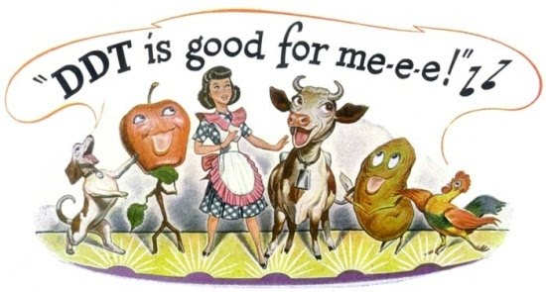
Pesticide Era ~ 1939-1962
1948 Muller won Nobel Prize for DDT
WW II Bayer discovers insecticide properties of organophosphates
Strategy for all pest management was: identify pest and select ‘most effective’ pesticide
Calendar-based treatments

Slide 12

Green Revolution 1943-mid 1970’s
Famine in India, Africa
Development in South America
Produced extensive systems of monoculture, chemically and soil-disturbance intensive agriculture in developed and undeveloped nations
Refined and produced technologies in equipment, chemical fertilizers, pesticides, high-yielding crops
Attributed to producing A LOT of FOOD

Slide 13
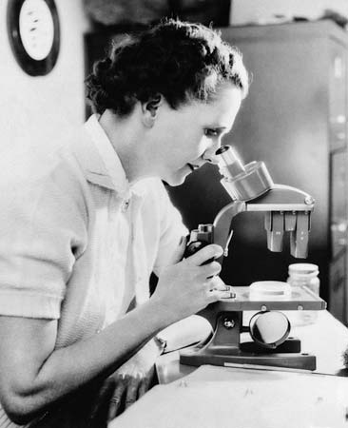
Silent Spring
1961: Pest ‘Management’ coined L.R. Clark & P.W. Geier
Early 60’s: Integrated control
1962: Rachel Carson
1965: Presidential Science Advisory Committee on Environmental Quality
1977: Presidential decree of IPM + 75% farm-acreage practicing IPM in year 2000

Slide 14
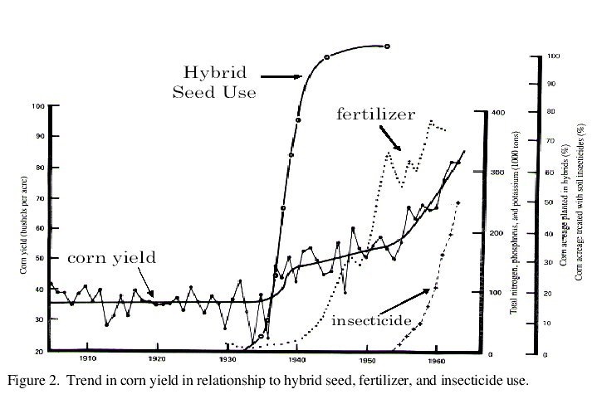
But Consider…

Slide 15
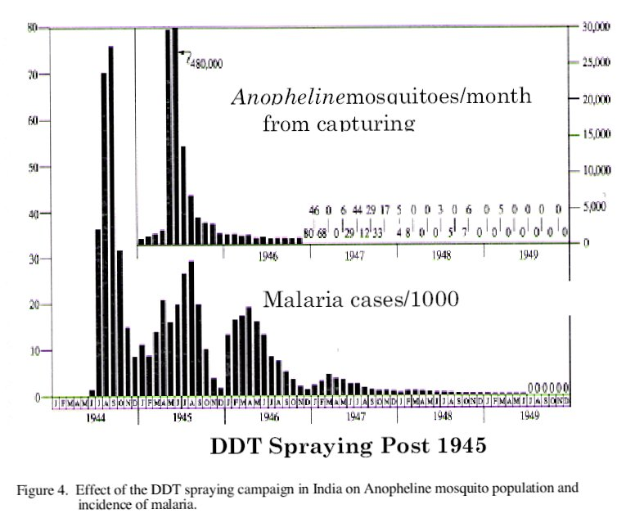
And this…

Slide 16
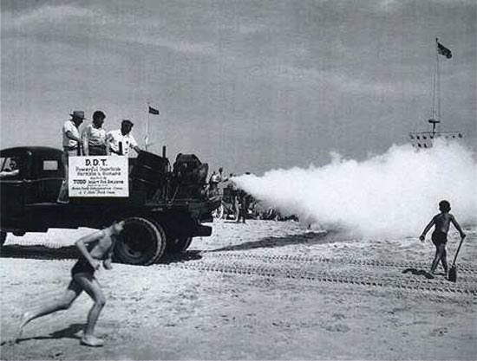
The Message Learned…
Over use and mis-use of pesticides can cause negative side-effects.
Strategic and judicial use of pesticides can have beneficial outcomes.
There is always a trade-off when doing pest management.

Slide 17
Definition
Integrated Pest Management (IPM) is a strategy to effectively prevent and suppress pests with minimum impact on human health, the environment and non-target organisms.

Slide 18

What is IPM?
IPM focuses on Pest Management versus pest control

Slide 19

IPM Components
Information gathering/ Diagnosis
Monitoring
Threshold determination
Record keeping
Selection of least disruptive strategies
Evaluation/ follow-up

Slide 20
IPM for Insects Considers:
Least Toxic and Most Effective for Long Term Solutions
  The ‘Do Nothing’ Strategy
  Cultural
  Physical
  Biological Control
  Chemical Management

Slide 21
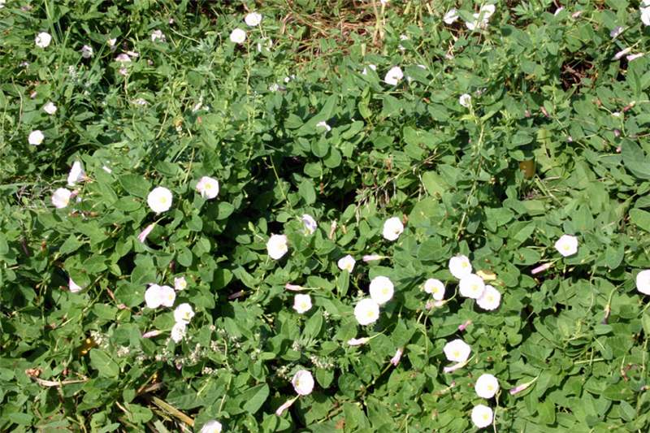
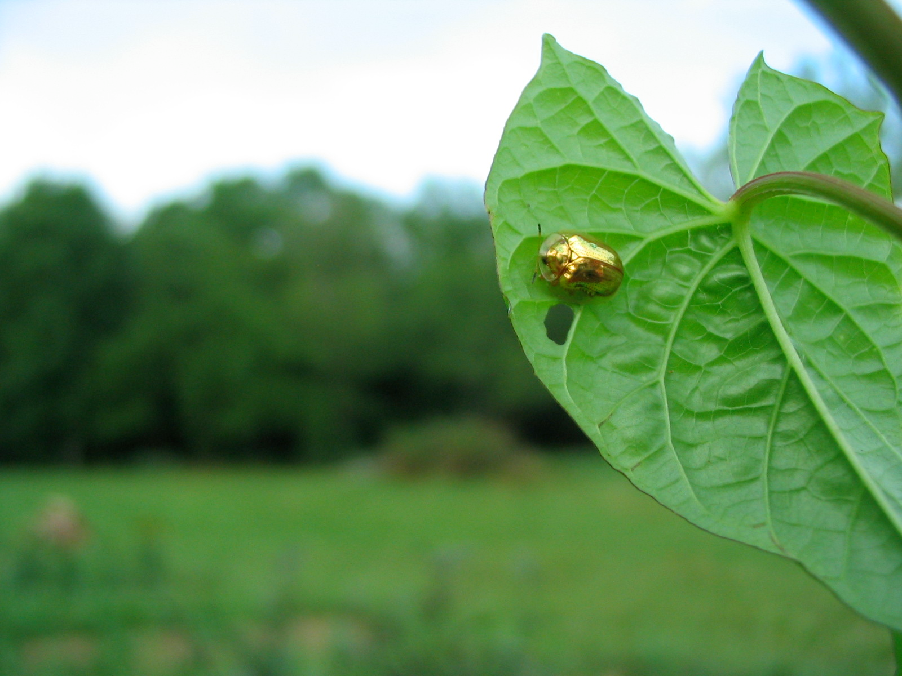
Bindweed
Cultural
  Mulch
Physical
  Hand pull roots, don’t rototill!
Chemical
  Selectively applied herbicide, ‘glove of death’
Biological

Slide 22
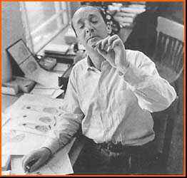
“A good laugh is the best pesticide“
Vladimir Nabokov

