Slide 1
Introduction to Non-Plant Invasive Species
Presented by:
Justin Bush, Washington Invasive Species Council
& Jalene Littlejohn, Oregon Invasive Species Council
May 6, 2017

Slide 2
What is an Invasive Species?
National
An invasive species is defined as a species that is Non-native (or alien) to the ecosystem under consideration and Whose introduction causes or is likely to cause economic or environmental harm or harm to human health.
Washington – RCW 79A.25.310
Invasive species include nonnative organisms that cause economic or environmental harm and are capable of spreading to new areas of the state. Does not include livestock, intentionally planted agronomic crops, or non-harmful exotic organisms
Oregon - ORS 570.750
Nonnative organisms that cause economic or environmental harm and are capable of spreading to new areas of the state. "Invasive species" does not include humans, domestic livestock or non-harmful exotic organisms.

Slide 3
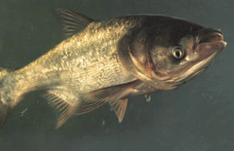
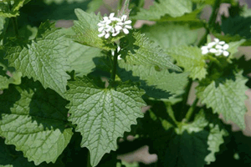
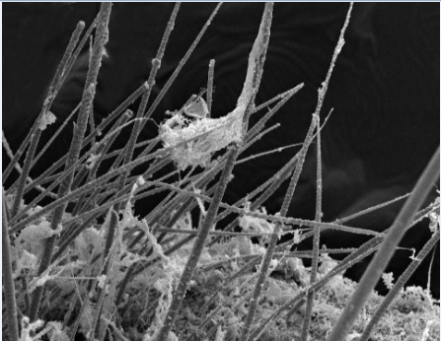
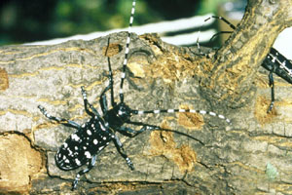
Introduction to Invasive Species
Examples include:
Plants
Reptiles
Amphibians
Crustaceans
Diseases
Insects
Mollusks
Birds

Slide 4
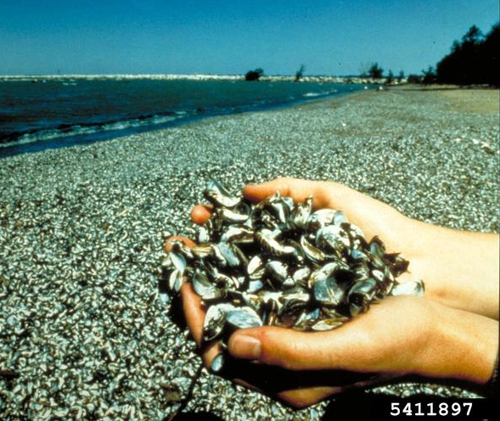
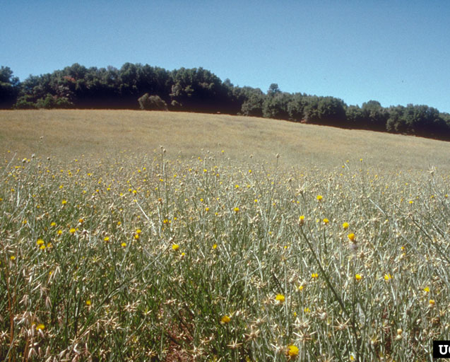
Introduction to Invasive Species
Impacts

Slide 5
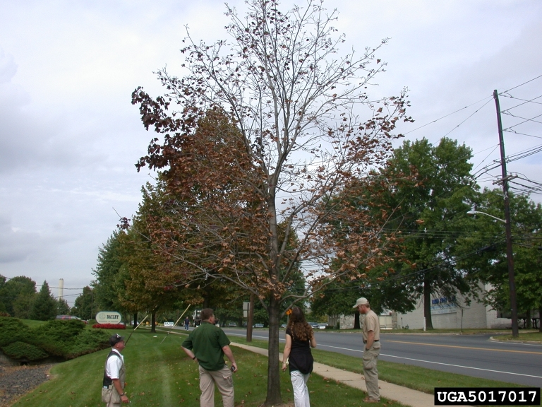
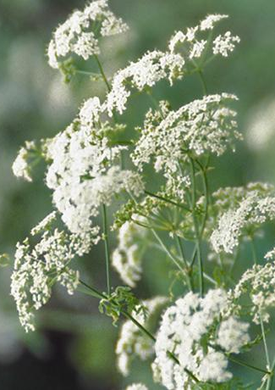
Introduction to Invasive Species
Impacts

Slide 6
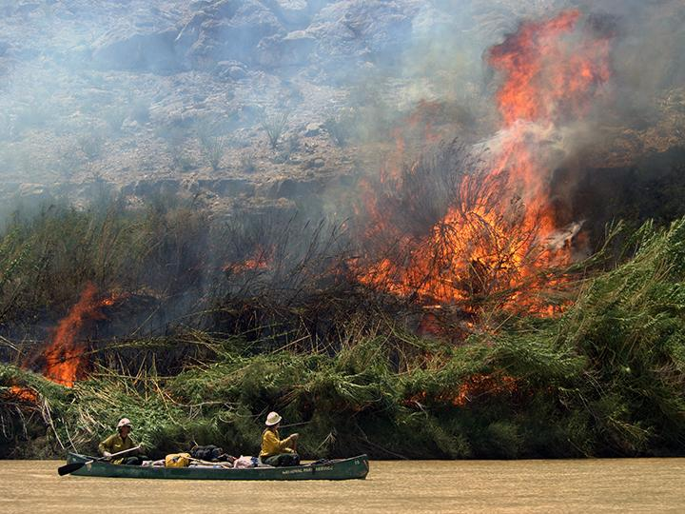
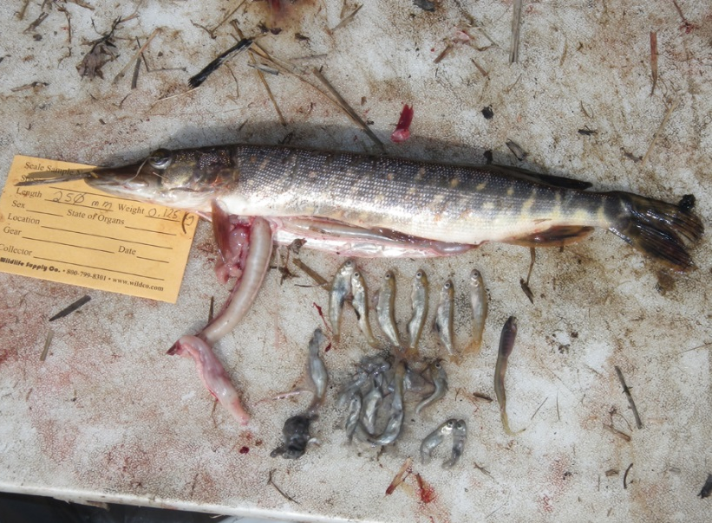
Introduction to Invasive Species
Impacts

Slide 7
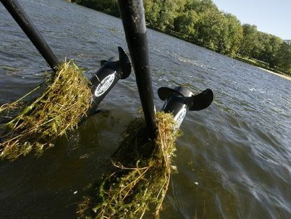
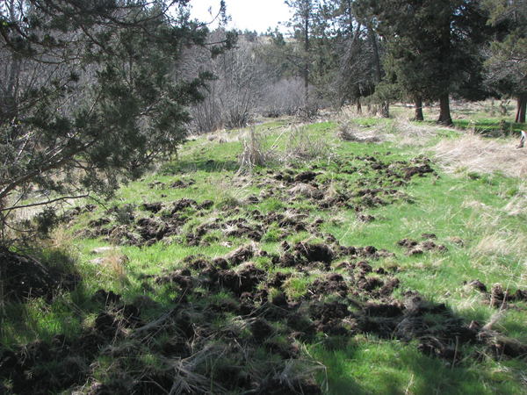
Introduction to Invasive Species
Impacts

Slide 8
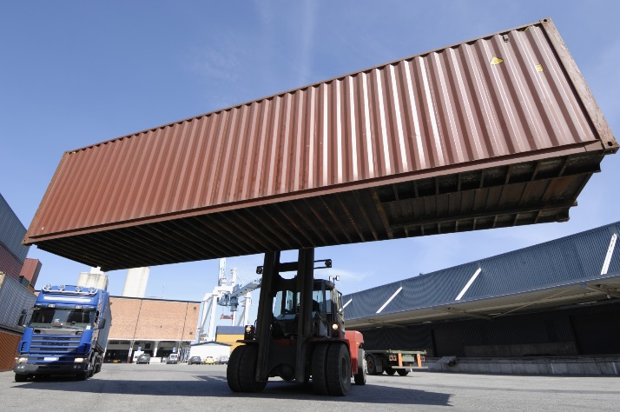
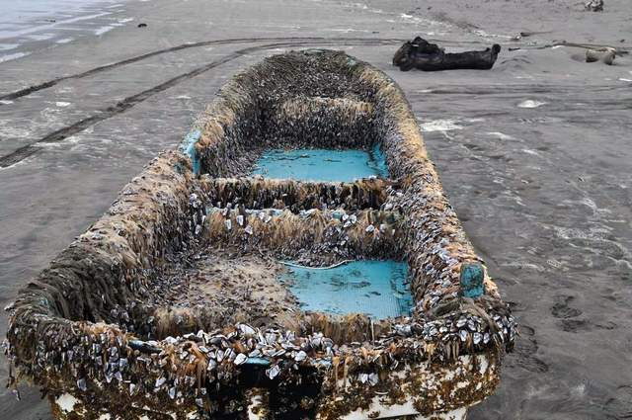
Introduction to Invasive Species
Pathways into the US

Slide 9
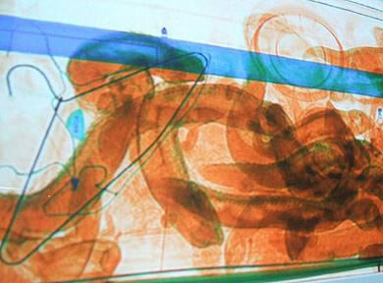

Introduction to Invasive Species
Pathways into the US

Slide 10
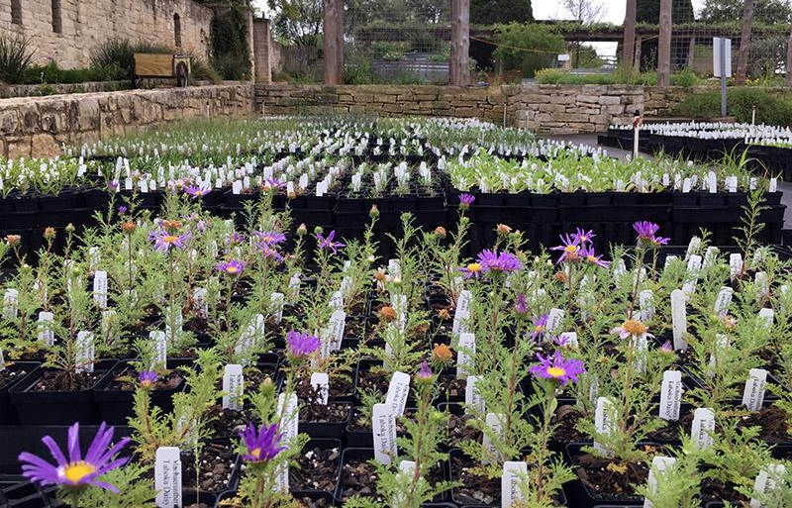
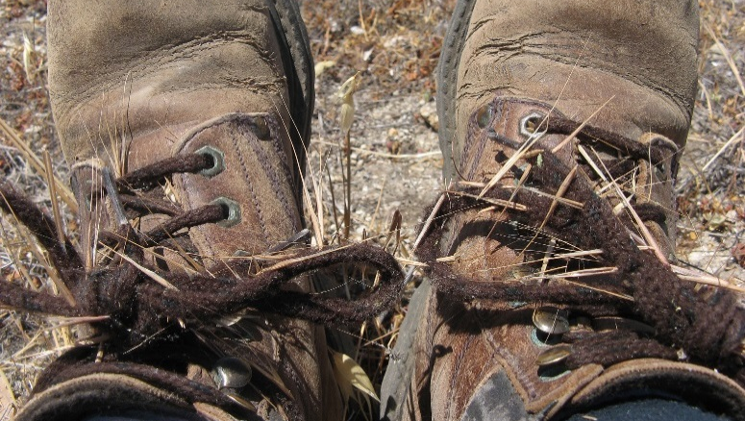
Introduction to Invasive Species
Pathways within the US

Slide 11

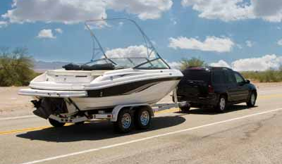
Introduction to Invasive Species
Pathways within the US

Slide 12
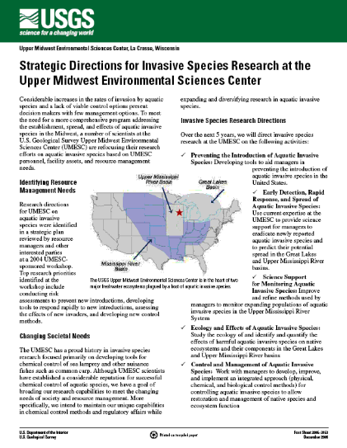
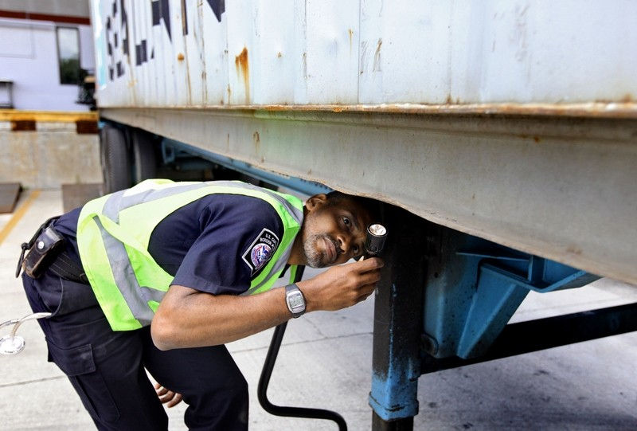
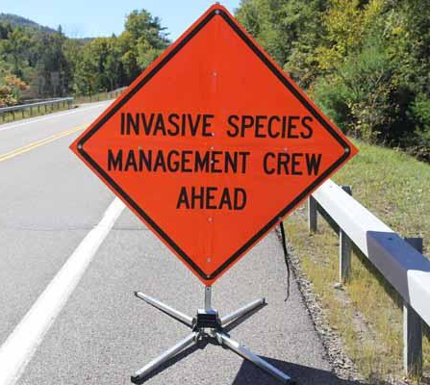
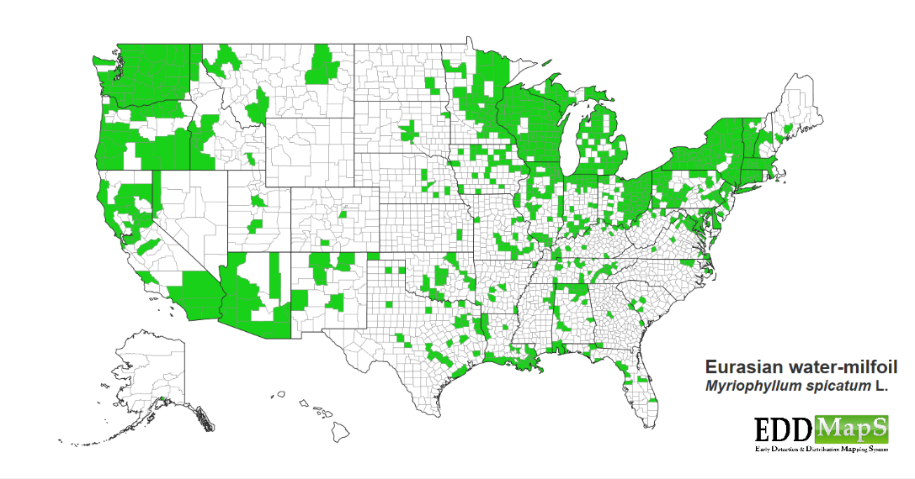
Introduction to Invasive Species
What’s being done?

Slide 13
Introduction to the
Washington Invasive Species Council
Washington Invasive Species Council
  Established by the legislature in 2006, extended in 2011, and 2016. Currently exists until June 30, 2022.
Vision
  Sustain Washington's human, plant, and animal communities and our thriving economy by preventing the introduction and spread of harmful invasive species.
Mission Statement
  The council provides policy level direction, planning, and coordination that will:
    Empower those engaged in the prevention, detection, and eradication of invasive species.
    Include a strategic plan designed to build upon local, state, and regional efforts, while serving as a forum for invasive species education and communication.

Slide 14
Introduction to the
Washington Invasive Species Council
Ray Willard, Chair
Washington Department of Transportation
Pat Stevenson, Vice Chair
Stillaguamish Tribe
William Tweit, Immediate Past Chair
Washington Department of Fish and Wildlife
Brad White
Washington Department of Agriculture
Todd Murray
Washington State University Extension
Alison Halpern
Washington Noxious Weed Control Board
Clinton Campbell
USDA APHIS PPQ
Kendall Farley
Northwest Power and Conservation Council
Rob Fimbel
Washington Parks and Recreation Commission
Mary Braswell
U.S. Customs and Border Protection
Anna Lyon
Okanogan County
Shuan Seaman
Chelan County Public Utility District
Mark Taylor
Trout Unlimited
Lizbeth Seebacher
Washington Department of Ecology
Curtis Taner
U.S. Fish and Wildlife Service
Shawna Bautista
USDA Forest Service
John Gammon
Washington Department of Natural Resources
Eric Young
U.S. Coast Guard
Steven Burke
King County
Joseph Maroney
Kalispel Tribe
Todd Hass
Puget Sound Partnership

Slide 15
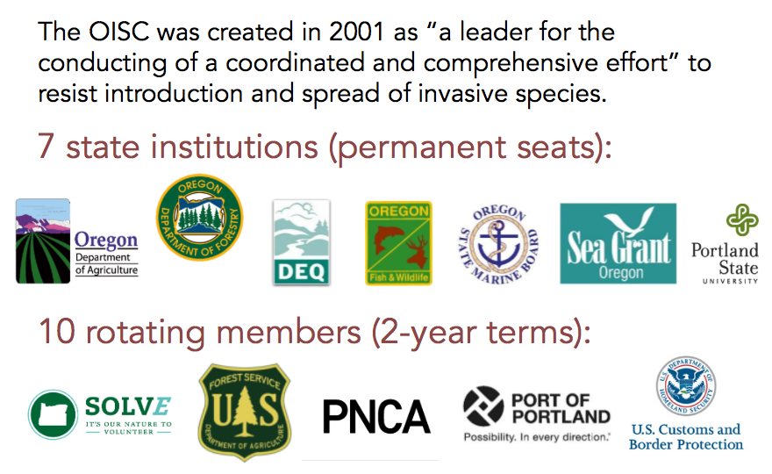
Introduction to the
Oregon Invasive Species Council

Slide 16
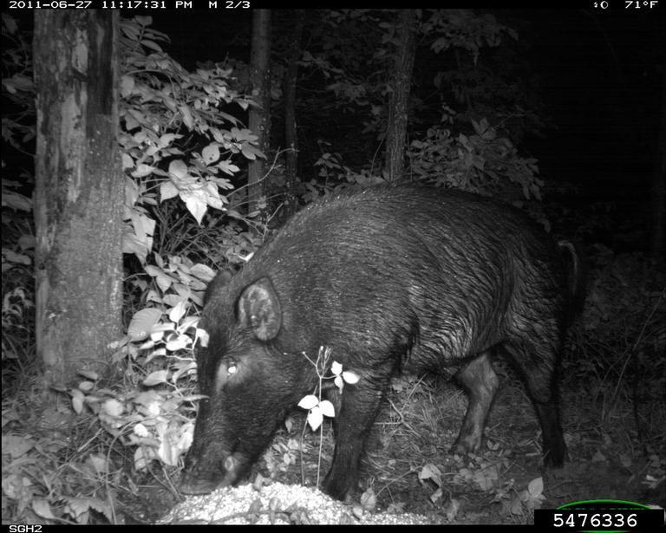
Feral Swine
Sus scrofa
Family Suidae:
  Native to Eurasia
  Intelligent, cautious, adaptable
  Strong sense of smell
  Live in groups, some solitary males
Family Tayassuidae:
  Peccaries/javelinas
  Native to South & Central Americas
Craig Hicks, Bugwood.org

Slide 17
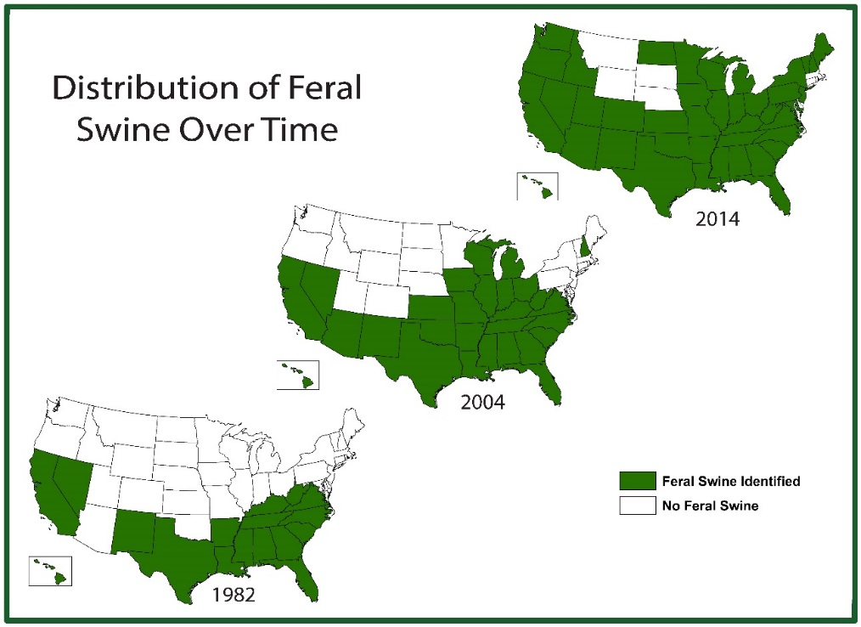
History + Distribution
Feral descendants of domesticated wild boar
Introduced as early as 1500s
Escapees + intentional release
North American Population: unknown millions
  1.26 million in Texas alone
Not established in WA – occasional sightings
Established in South, OR and especially CA
Year | Number of States with Feral Swine
1982 | 17
2004 | 28
2014 | 41
2017 | 35

Slide 18
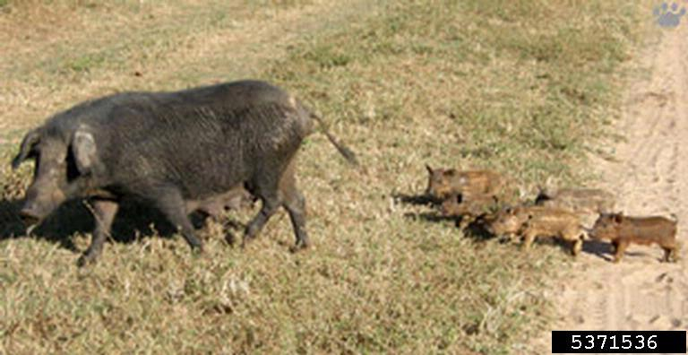
Identification
Variable size and appearance
Free-roaming, wild-born or released swine
Or, non-domesticated European wild boar or hybrids
Any pig you see running around freely is bad news
Vladimir Dinets, University of Miami, Bugwood.org

Slide 19
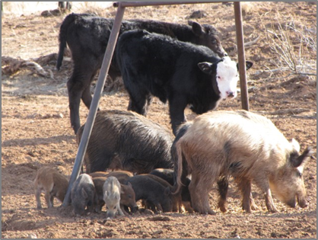
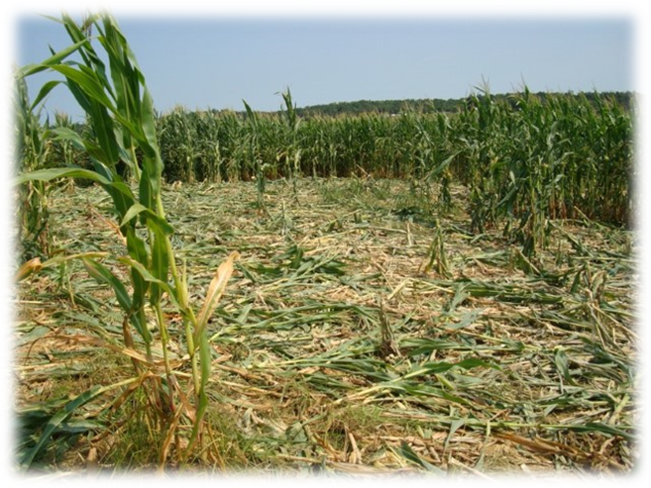
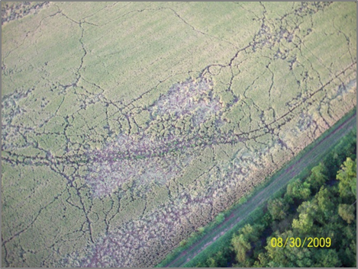
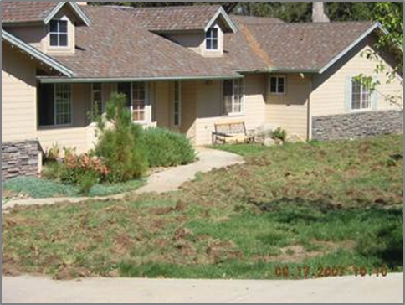
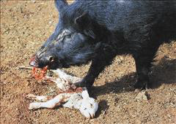
Impact + photos
Damage caused by:
  Foraging
  Rooting
  Trampling
  Wallowing
Damage to:
  Agriculture and Livestock
  Natural and Cultural Resources
  Property
  Human and Pet Health and Safety

Slide 20
Impact + photos
Disease
  Carry or transmit > 30 diseases or parasites
    Swine cholera
    Brucellosis
    Pseudo rabies
Value of Potentially-Affected Crops and Animals in WA
Community | Value (Millions) | Data Year
Cattle & Calves | $1,163.3 | 2015
Sheep & Other Livestock | $144.4 | 2015
Apples | $1,914.8 | 2014
Cherries | $507.4 | 2014
Peaches | $11.0 | 2014
Pears | $236.1 | 2014
Potatoes | $764.9 | 2014
Grapes, Wine | $304.8 | 2014
Barley | $16.1 | 2015
Hay | $623.5 | 2015
Hops | $280.0 | 2015
Wheat | $629.1 | 2015
Total | $6,595.5
Sources: PSU, 2007; USDA, 2015; USDA, 2014.

Slide 21
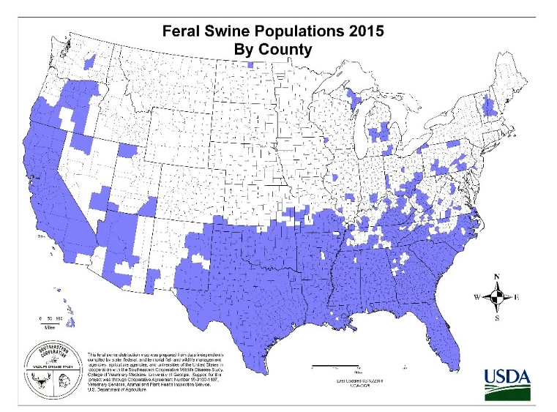
Regulations in WA
  WAC 16-54-010
    Animals of the genus Sus that are free roaming on public or private lands and do not appear to be domesticated,
    Swine from domesticated stocks that have escaped or been released or born into the wild state,
    European wild hogs and their hybrid forms, regardless of whether they are free roaming or kept in confinement.
  WAC 16-54-065
    Feral swine are prohibited from entering WA.
  WAC 16-54-111
    Feral swine are prohibited in WA.
  WAC 232-12-017
    Feral swine are deleterious exotic wildlife

Slide 22
Regulations in OR
The 2009 HB 2221 requires landowners and land managers to notify ODFW when they become aware of free roaming feral swine on their property and prohibits sale of feral swine hunts
ORS 610.002: “Predatory animal” or “predatory animals” includes feral swine as defined by State Department of Agriculture
If you see feral swine or feral swine damage, call the Squeal on Pigs hotline (1-888-268-9219) or your local ODFW office

Slide 23
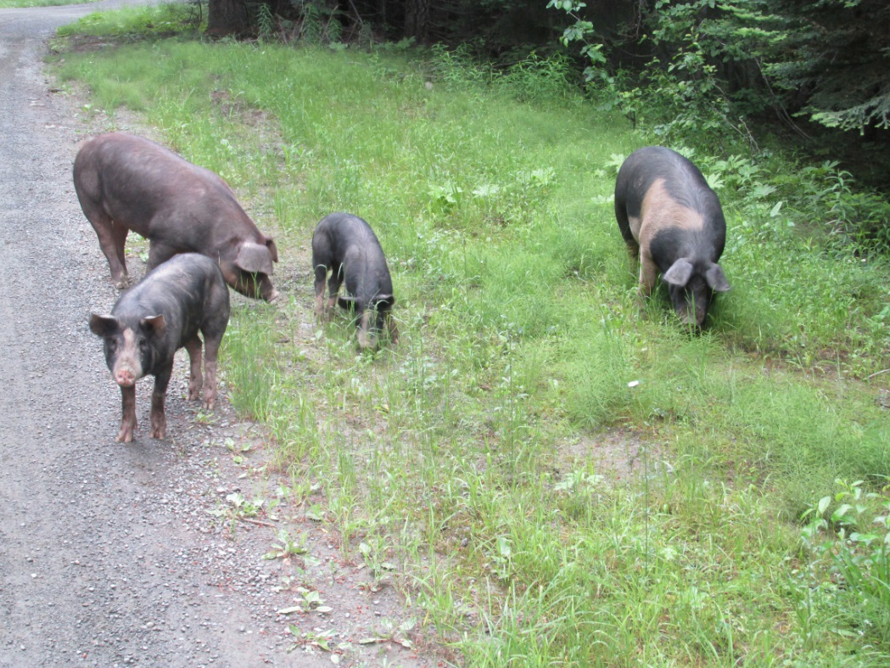
Populations in WA
  Currently—1 known feral pig in WA
  1990s – Wynoochee watershed, Olympic Peninsula
  2016 – Angry Mountain, Gifford Pinchot National Forest
  2015-17 – Desert Unit, Columbia Basin Wildlife Area

Slide 24
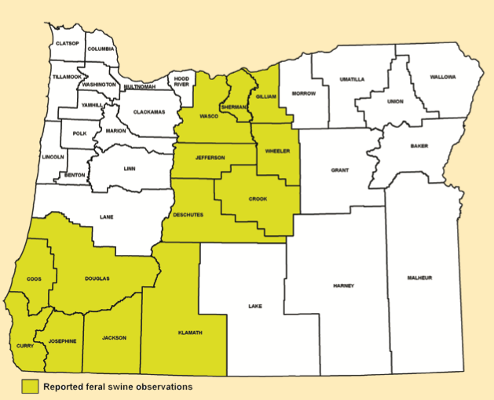
Populations in OR
As of 2009, feral swine have been observed in 13 counties in the state of Oregon
In 2012, ODFW estimated that there are between 2,000 and 5,000 roaming the state
ODFW

Slide 25
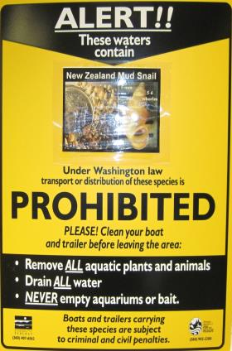
New Zealand Mud Snail
Potamopyrgus antipodarum
Family Tateidae
Hardy and prolific
Fresh or brackish water
Operculum – ‘trapdoor’ seals shell
Can survive out of water, in guts of animals
Reproduce clonally in NA

Slide 26
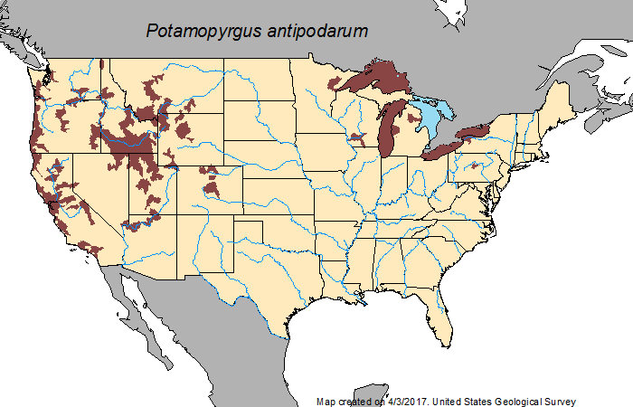
History & Distribution
Native to New Zealand
Likely introduced into Great Lakes in ships from Europe
First discovered NA – 1987
Discovered in WA – 1999
  Lower Columbia – 2002
  Capitol Lake – 2009
  Long Beach, Kelsey Creek, Thornton Creek, Lake Washington
Can spread in damp or muddy recreational gear/equipment
Red areas showing distribution of NZMS.

Slide 27
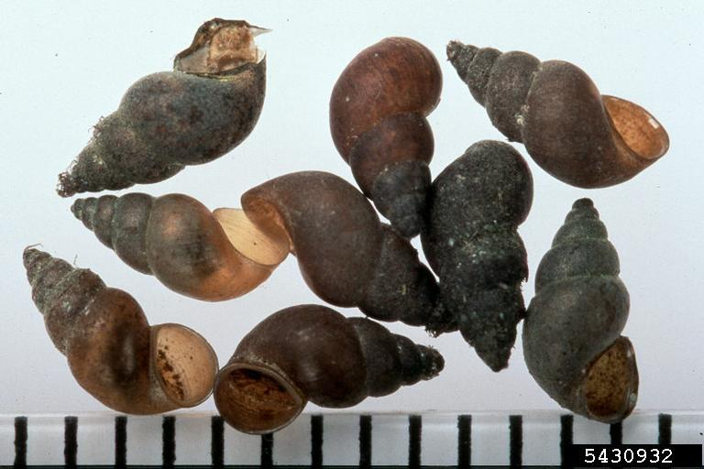
Identification
Extremely small - 4-6mm long
5-6 whorls on right-coiling shell
Brown, appear black when wet
Mike Gangloff, Bugwood.org

Slide 28
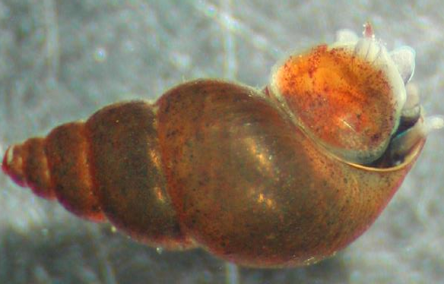
Identification
Full grown shell, fairly elongate with 5-6 whorls, maximum length usually 5mm, occasionally 6 mm
Shell is usually horn colored but ranges from light brown to black and may be encrusted with algae, etc.
Operculum –only visible on live snails
Dextral –opening to the right of the animal

Slide 29
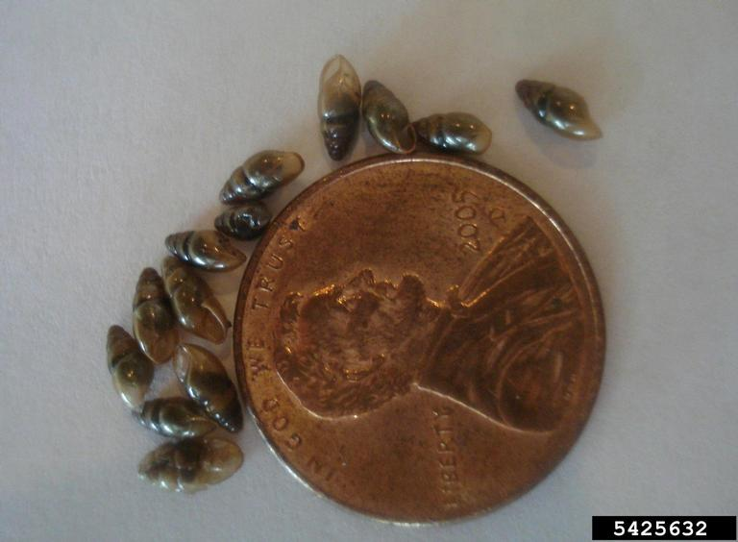
Impact
Lacks natural parasites that would keep #s in check
Reproduces rapidly
Outcompetes other grazers & macroinvertebrates
  Disrupts food chain
  Reduces food for fish
Alters nutrient flows
Potential biofouler of facilities
Mohammed El Damir, Bugwood.org

Slide 30
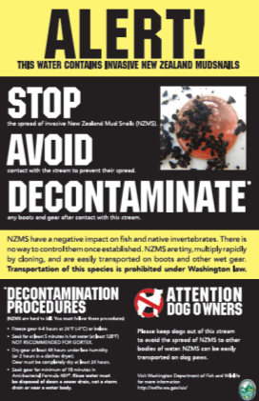
Regulations in WA
Chapter 77.135 RCW Invasive Species
77.135.30 (1)c RCW Classification of species
  Species classified as prohibited level 3 pose a moderate to high invasive risk and may be appropriate for prevention, rapid response, or other prohibited species management plan actions by the department, another agency, a local government, tribes, or the public.

Slide 31
Regulations in OR
In OR, New Zealand mudsnails are a prohibited species and require a permit to possess alive
In 2009, the Oregon Legislature passed HB 2220
  Aquatic Invasive Species (AIS) Prevention Program and new user fee to boaters: “Aquatic Invasive Species Prevention Permit”.
  The AIS Prevention Program is co-managed by the Oregon Department of Fish and Wildlife and Oregon State Marine Board
Per ODFW, trying to protect upper headwaters and inner state tributaries

Slide 32
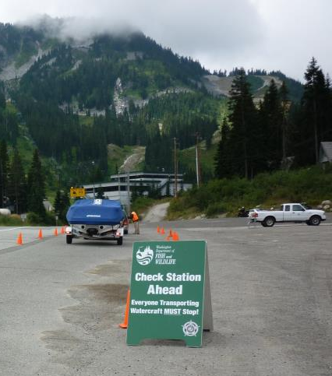
Regional Response
Mandatory Check Stations
  Containment: active management to minimize spread
Frequent inspections
Potential citations
Designed to be outreach and educational
Roving stations located along roadways and waterbodies statewide

Slide 33
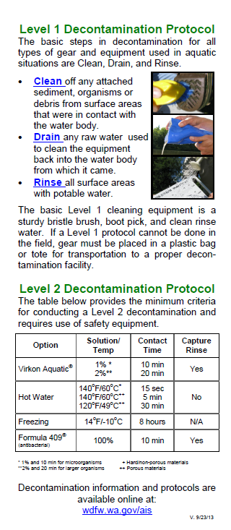
Decontamination and Prevention
Basic Precautions
  Choose equipment that is easily inspected and cleaned.
    Wading boots
  Regularly inspect and clean field gear
  Use dedicated equipment for a watershed or waterbody if invasive species are known to be present in one and not the other
  Conduct a Level 1 decontamination whenever you leave the water.
  Conduct a Level 2 decontamination when moving between waterbodies

Slide 34
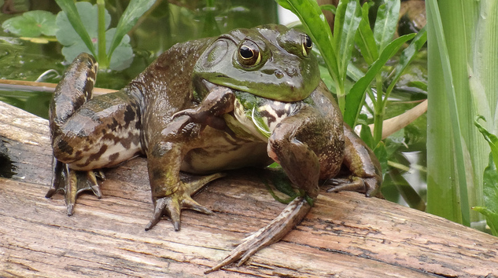
Bullfrog
Lithobates catesbeianus (Formerly Rana catesbeianus)
Native to central & eastern US and southeast Canada
Thrive in warm waters of ponds, lakes, marshes, sloughs, irrigation ditches, and streams
Will eat anything that it can fit in its mouth
Cady May, Flikr

Slide 35
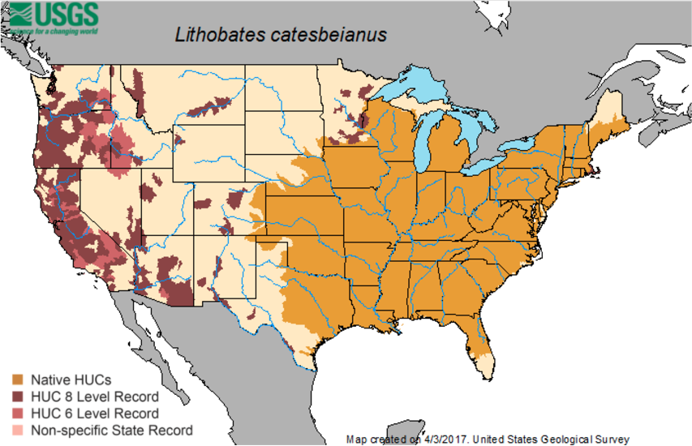
History & Distribution
Introduced to OR in early 1900s as food item & contaminant in fish stocking
Populations grow rapidly
  Female bullfrog can lay up to 20,000 eggs at once vs. 2,000-5,000 eggs from native frogs
  Limited number of predators
USGS

Slide 36
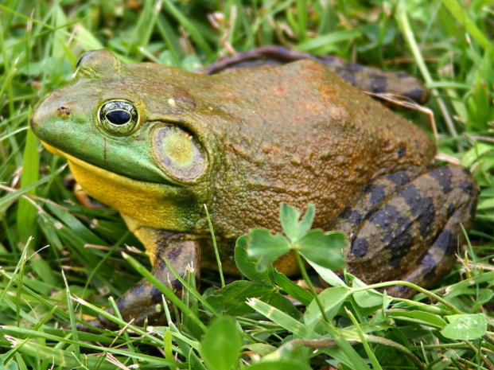
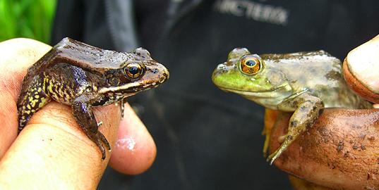
Identification
Adults 3.5-8 inches, tadpoles 4-6 inches
Largest frog in the US (up to 1 lb.)
Usually green, mottled with brown
Golden eyes & large tympanum
Red-legged frog
Bullfrog
Carl D. Howe
Alderleaf Wilderness College

Slide 37
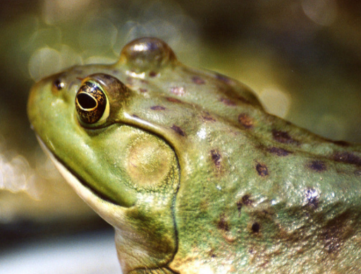
Impacts
Decline in native frogs, snakes, and amphibians
Spread Ranavirosis- infects native frogs
Carrier of chytrid fungus- contributes to worldwide decline in frog populations
Damage to water supply infrastructure
ODFW, Flickr

Slide 38
Regulations
In OR, WA, and CA bullfrogs are classified as controlled species
  People allowed to trap and kill bullfrogs without a permit (OAR 635-056-0070 Controlled Species).
Individual bullfrogs may be collected from the wild and held indoors in an escape proof aquarium (OAR 635-044-0035)
  Release is prohibited unless the person first obtains a permit from the Director.
Call 1-866-Invader

Slide 39
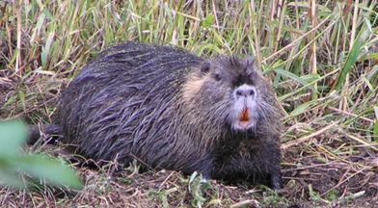
Nutria
Myocastor coypus
Semiaquatic rodent
Native to South America
Burrows into banks of rivers, lakes, and ponds
Typically nocturnal
Don VandeBergh, ODFW

Slide 40
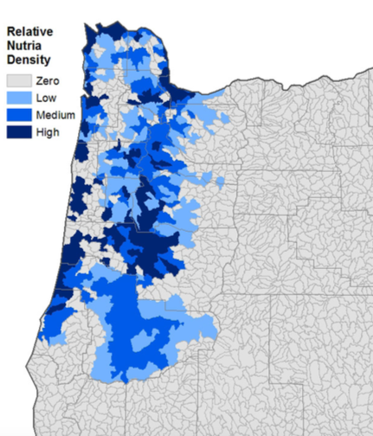
History & Distribution
Introduced to Western US as early as 1899 for their fur
  Escaped and were intentionally introduced into natural and artificial streams, ponds, and rivers
Lowland areas of Western OR, including Willamette river and coastal areas, have well-established populations dating back to 1930s
Trevor Sheffels, USFWS

Slide 41
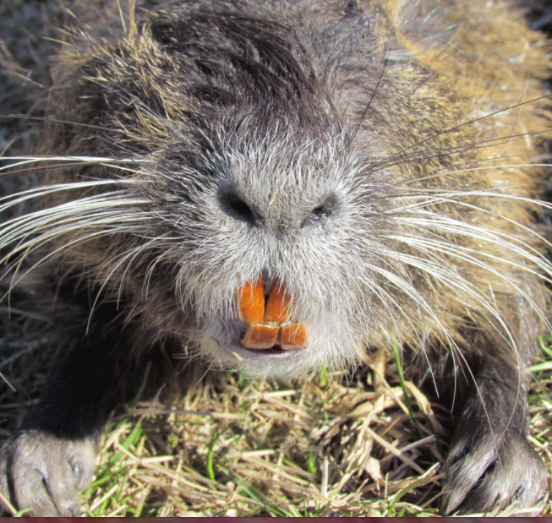

Identification
10-20 lbs, 30 inches long (including 10 inch tail)
Partially webbed hind feet
Heavy, scaly, rat-like tail
Long white whiskers and large orange teeth
Often mistaken for beaver
USFW
USFW

Slide 42
Impacts
Damage to crops, trees, lawns, and native plant communities
Muskrat numbers have been greatly reduced where nutria have become established
Burrows can cause bank and infrastructure failure
  Implicated in the failure of the levees after Hurricane Katrina in 2005
Human health concerns include:
  Contaminated water with giardia from feces, spread parasites, “nutria itch”, tuberculosis, septicaemia, and tularaemia

Slide 43
Regulations
Oregon
Nutria classified as unprotected Nongame Wildlife (OAR 635-044-0132) and may be trapped (cannot be relocated) or shot. No license is needed for a landowner to control nutria on his/her own property.
Washington
The nutria is classified as a Prohibited Aquatic Animal Species. All nutria should be euthanized and not returned to the wild. No special trapping permit is necessary for the use of live traps. There is no bag limit or restriction on firearms.

Slide 44

Japanese Beetle
Popillia japonica
Native to Japan, persistent east of Rockies
Destructive to many things we love! Roses, grapes, orchard fruits, cane berries, hops, outdoor cannabis and trees.
Detected in OR and successfully eradicated several times over last 30 years
Infestation detected by ODA Summer 2016 in Cedar Mill, Just outside of Portland
  Treatment of target areas now
ODA
www.japanesebeetlepdx.info

Slide 45
Questions?
Justin Bush
Executive Coordinator | Washington Invasive Species Council
justin.bush@rco.wa.gov | www.invasivespecies.wa.gov
Jalene Littlejohn
Lead Coordinator | j.littlejohn@samarapdx.com
Oregon Invasive Species Council | www.oregoninvasivespeciescouncil.org

