Slide 1
Reporting Invasive Weeds (and others!)
Presented by:
Justin Bush, Washington Invasive Species Council
& Jalene Littlejohn, Oregon Invasive Species Council
May 6, 2017

Slide 2
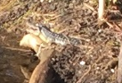
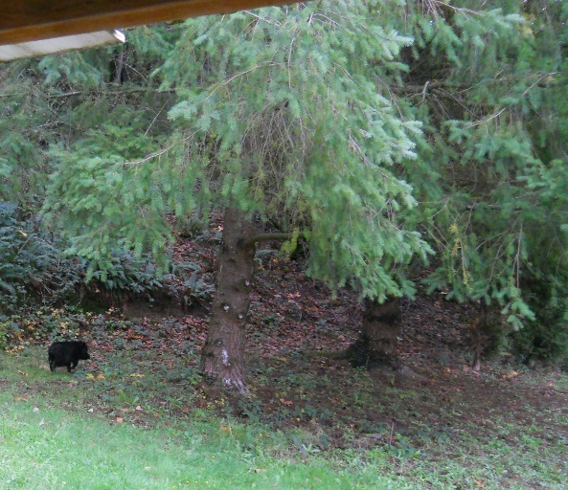

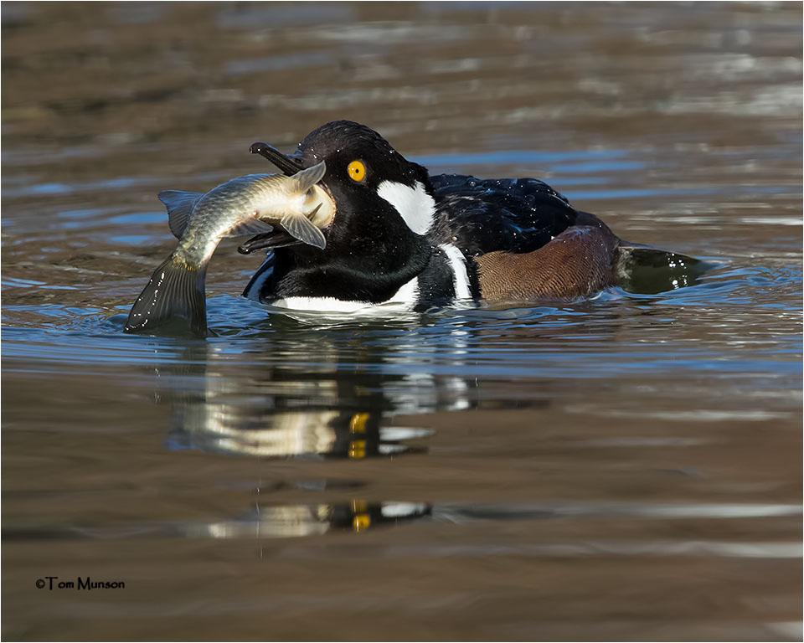
See it? Report it!

Slide 3
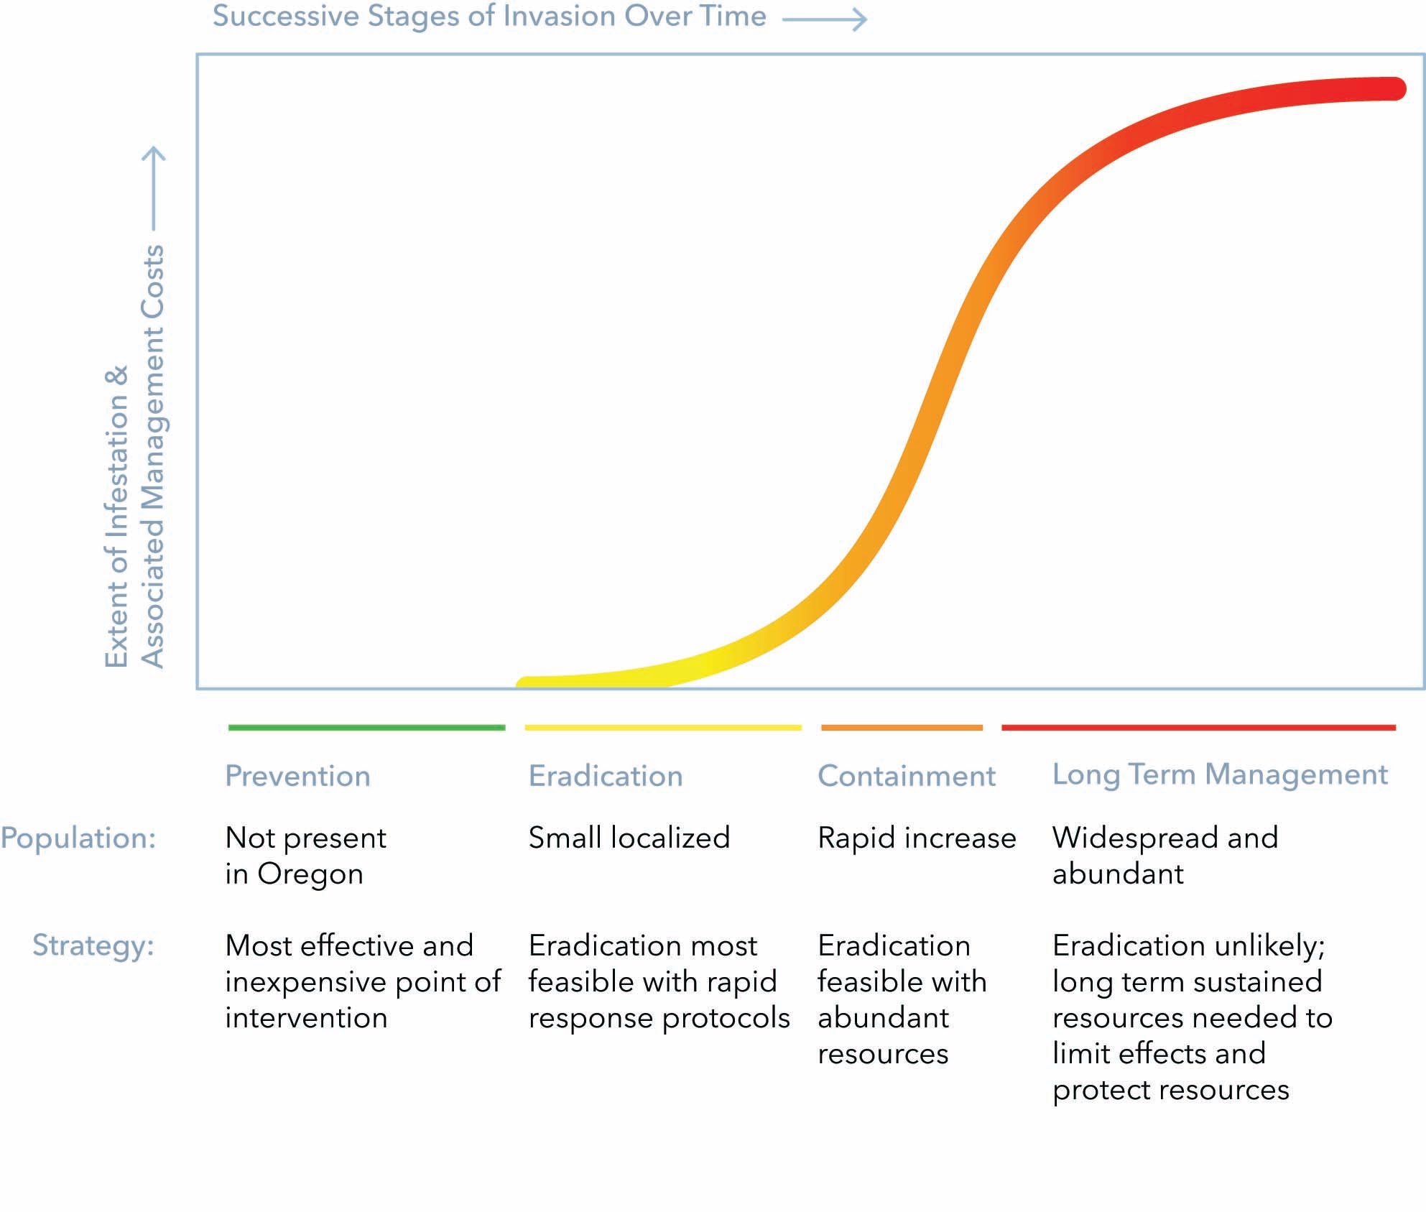
Our Window of Opportunity

Slide 4
Early Detection Rapid Response (EDRR)
After Prevention, our next line of defense is EDRR
Early detection along key pathways
Detector networks: rapid response plans and teams
Surveys and monitoring efforts
You!

Slide 5








Reporting in WA
1) Phone:
  Aquatic Invasive Species Hotline
    1-888-WDFW-AIS (1-888-933-9247)
  WA/OR/ID Squeal on Pigs! Hotline
    1-888-268-9219
2) Mobile app: “WA Invasives”
    iOS
    Android
3) Website form
    invasivespecies.wa.gov/report.shtml

Slide 6
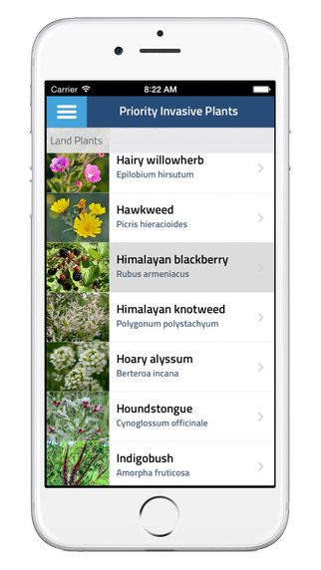
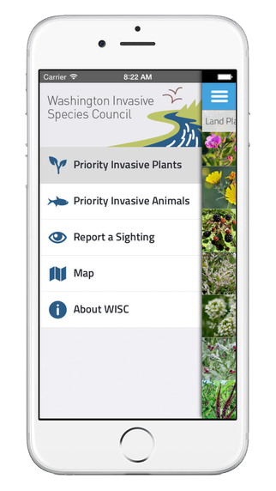


Reporting in WA
2) Mobile app “WA Invasives”
    Seach your app store for “WA Invasives”
    Links at invasivespecies.wa.gov/report.shtml

Slide 7
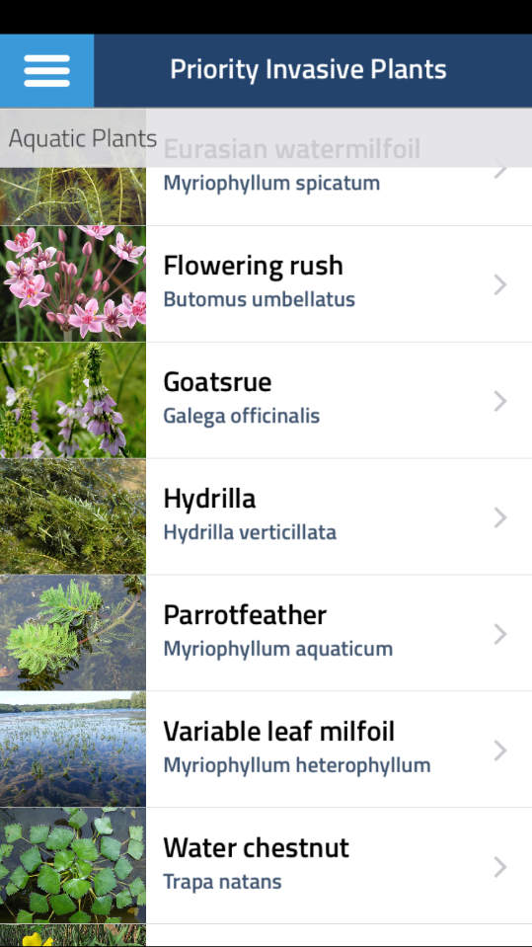
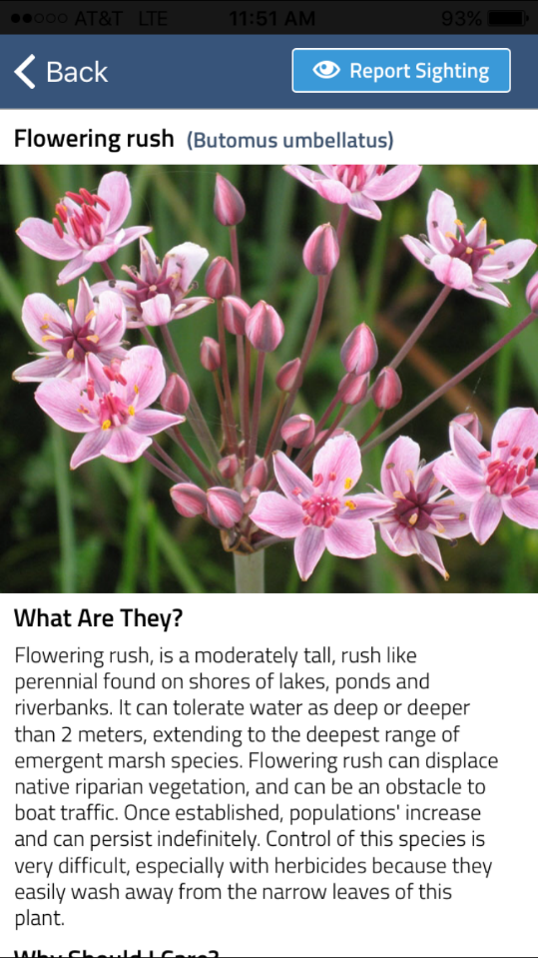
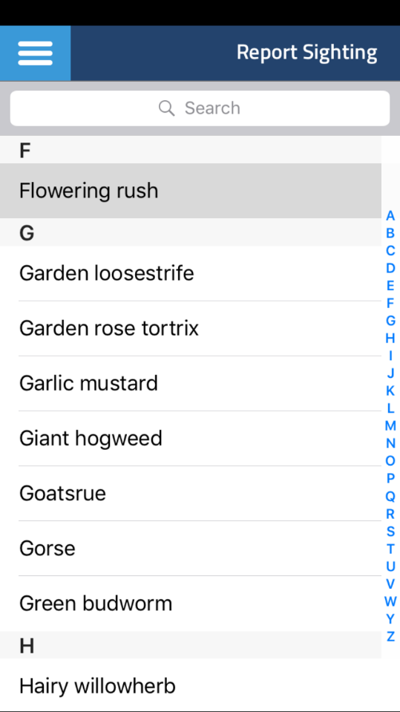
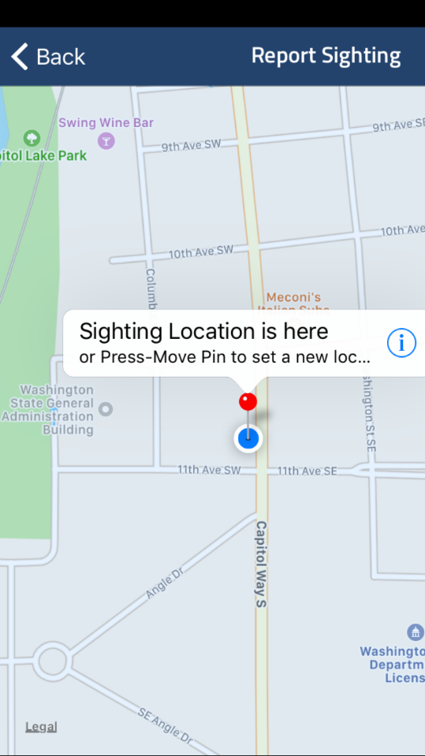
Reporting in WA
2) Mobile app “WA Invasives”

Slide 8
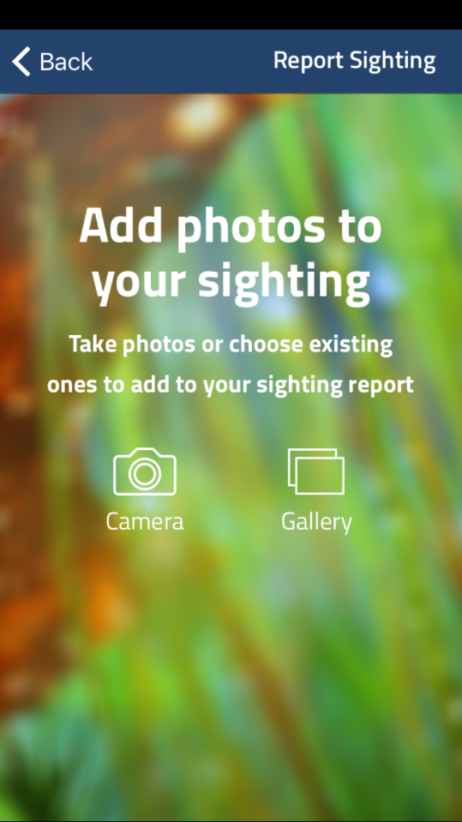
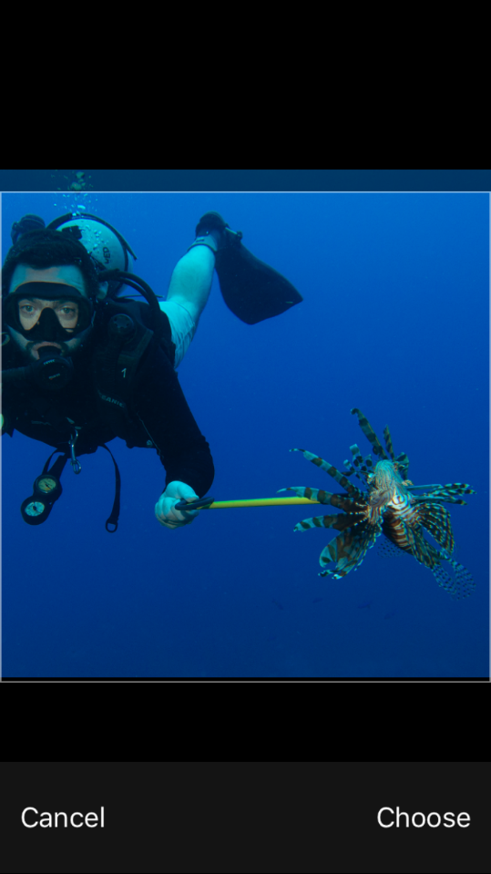
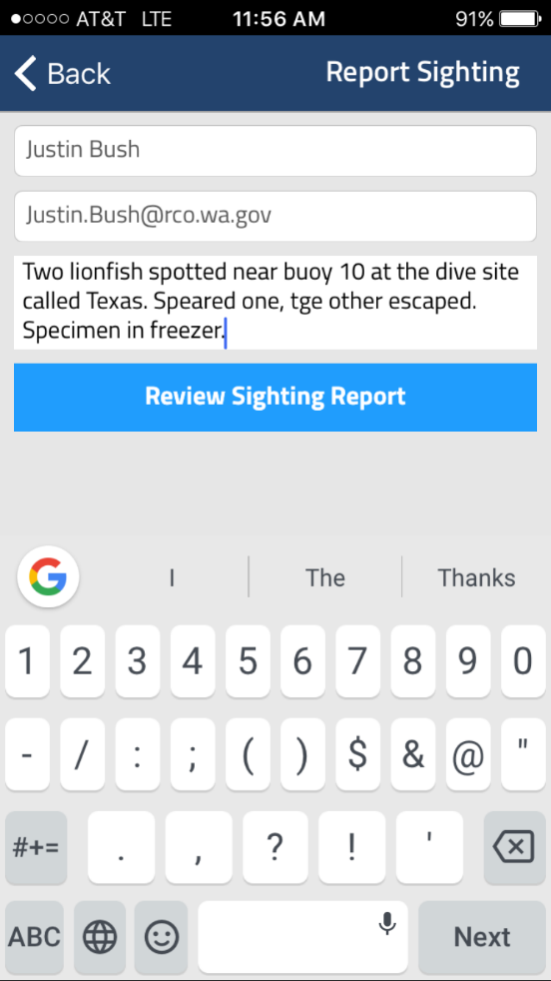
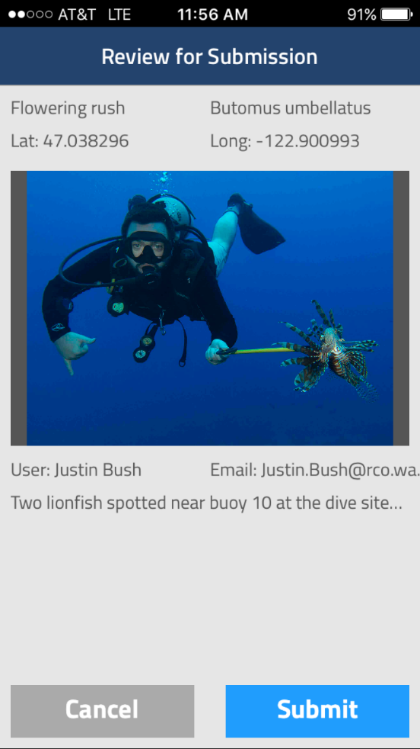
Reporting in WA
2) Mobile app “WA Invasives”

Slide 9
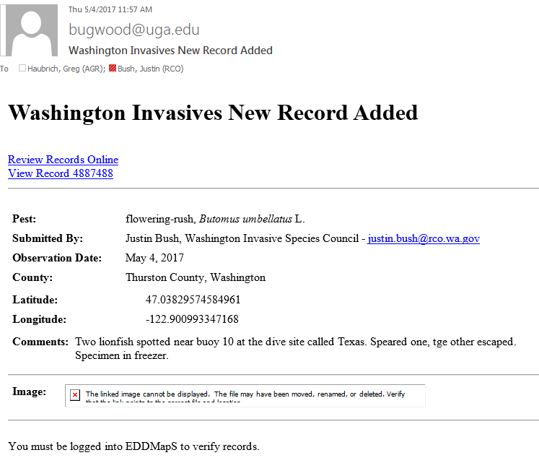
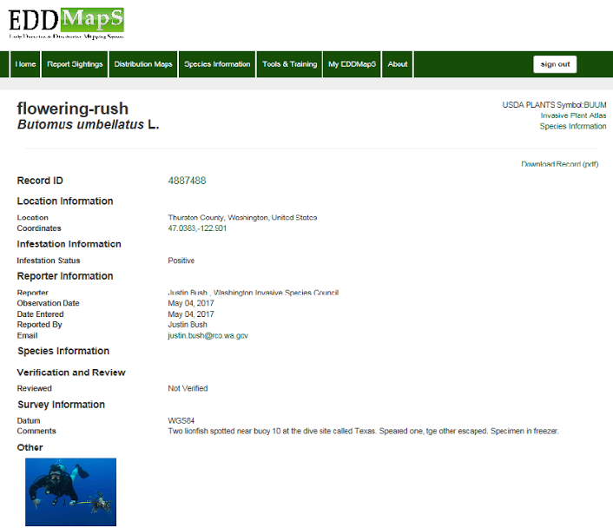
Reporting in WA

Slide 10
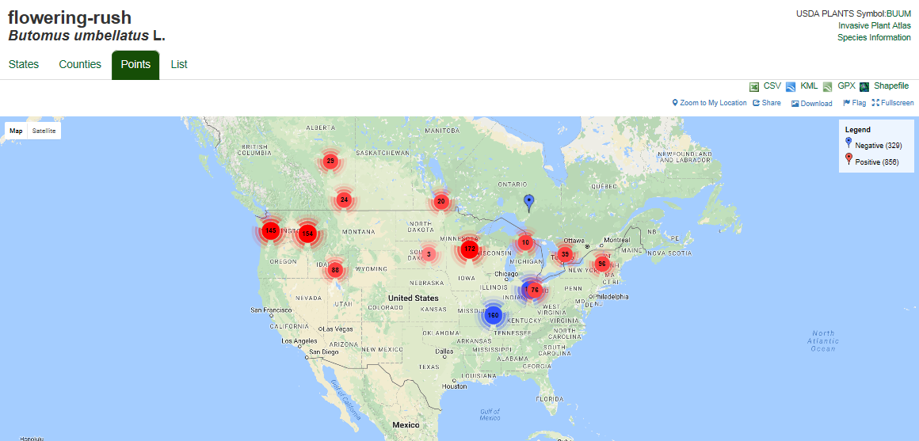
Reporting in WA

Slide 11
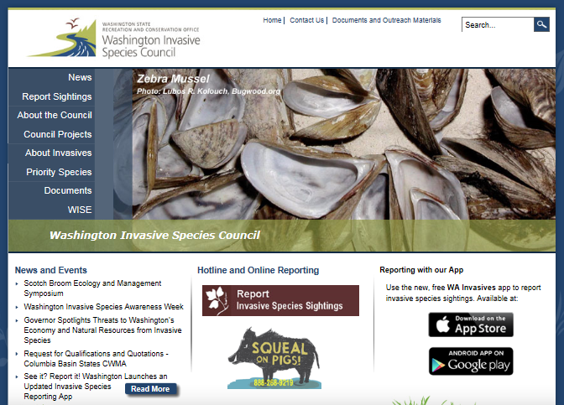
Reporting in WA
3) Website form
    invasivespecies.wa.gov/report.shtml
What did you find?
Where did you find it?
Your contact information
Photo

Slide 12
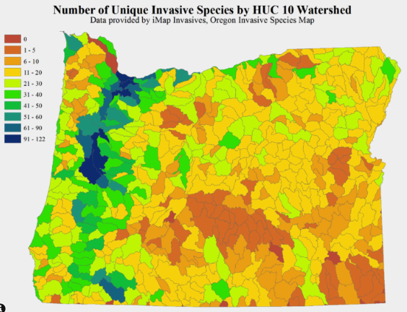
Reporting in Oregon
Learn
Look
Report
OFDW, Oregon Conservation Strategy

Slide 13
Reporting in OR
Learn
Know what to look for & familiarize yourself with the “watch list”
Utilize available resources
  Oregon Invasive Species Council: top invaders
  Western Invasives Network: Invasive species by region
  Oregon Department of Agriculture List: noxious weeds

Slide 14
Reporting in OR
Learn
Download or print off guides to take out in the field
  Western Invasive Plant EDRR Guide
  On the Lookout for Aquatic Invaders
  GardenSmart Oregon
Get trained: Oregon Forest Pest Detectors & Weed Watchers

Slide 15

Reporting in OR
Look
Think Pathways
Think habitat
Think distribution
Document any detections by taking photos, taking detailed notes, and recording the exact location

Slide 16
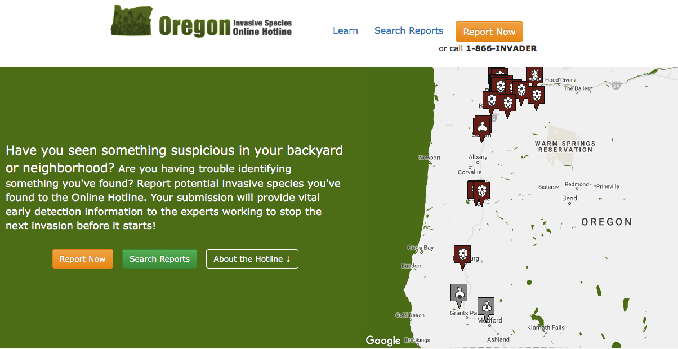
Reporting in OR
Report Online
Consider signs & symptoms
Go to oregoninvasiveshotline.org
Bookmark! Mobile Friendly Fill out reporting form

Slide 17
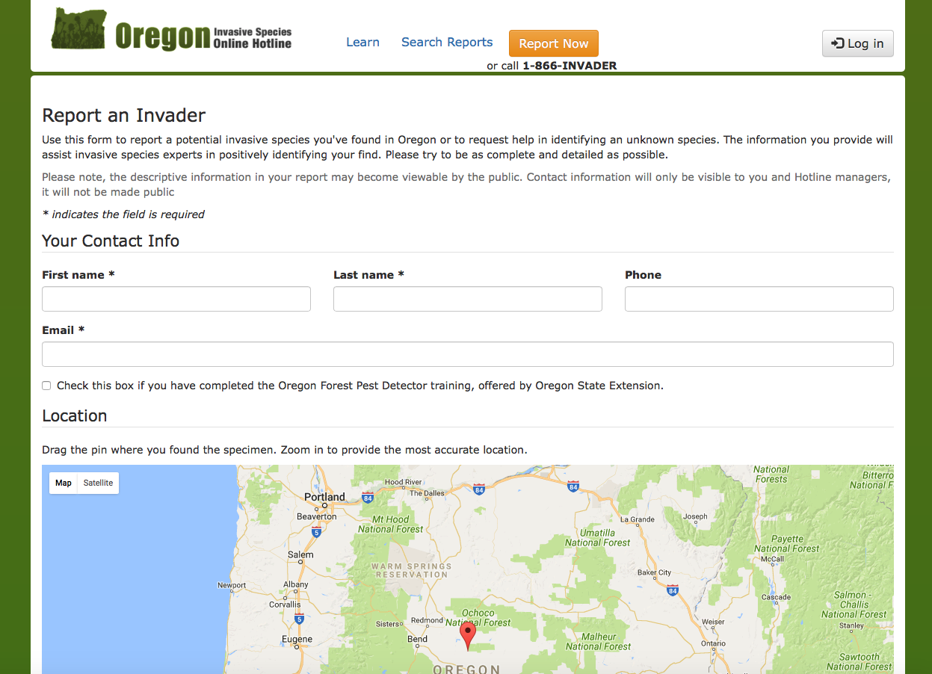
Reporting in OR

Slide 18
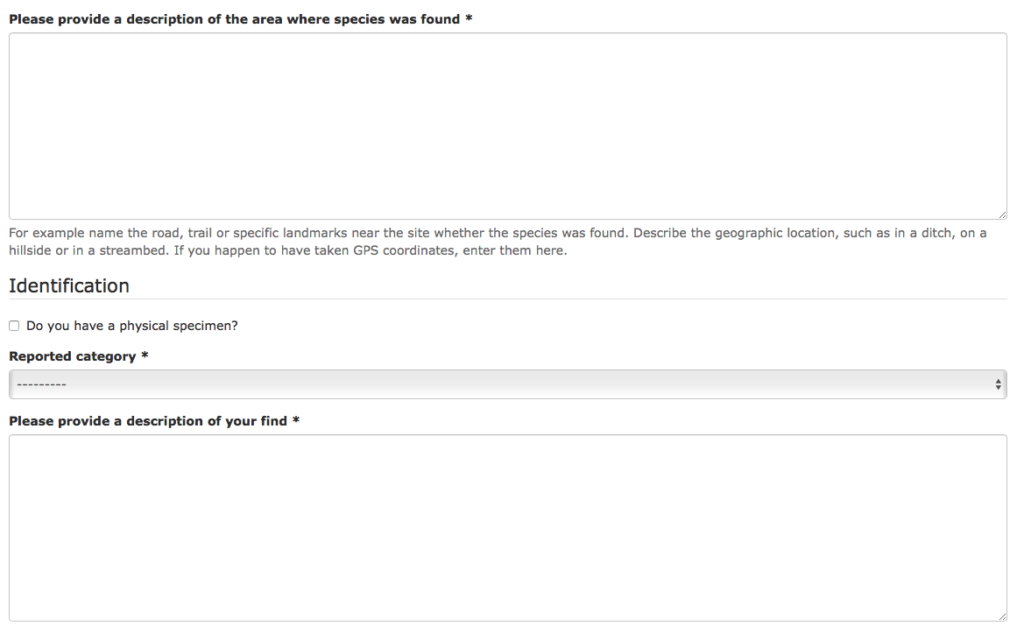
Reporting in OR

Slide 19
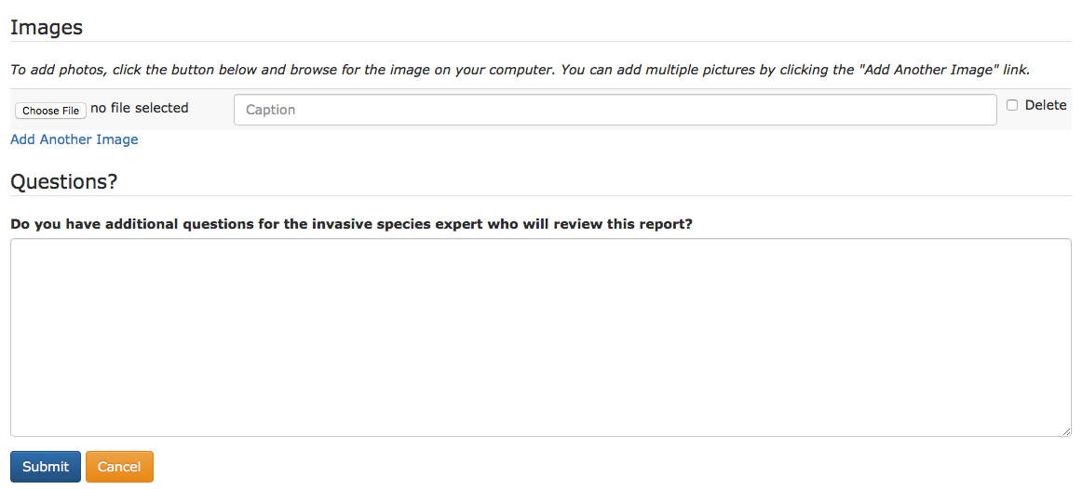
Reporting in OR
You will hear from an expert a few days after submission to follow-up

Slide 20

Reporting in OR
Report Over the Phone
Report sightings to Oregon Invasive Species Hotline: 1-866-INVADER
Report sightings of feral swine to Squeal on Pigs! Hotline: 1-888-268-9219

Slide 21
Everyone has a role in
protecting the northwest
from invasive species
invasivespecies.wa.gov/report.shtml
oregoninvasiveshotline.org

