Slide 1

Trails & Invasive Plants
Protecting our resources while enjoying our trails

Slide 2
What is an invasive plant?
Non-Native Plant
  Any plant not known to historically occur in an area. Only a small percent of non-native plants are invasive.
Weed
  Any plant growing in an undesirable location.
Noxious Weed
  Weeds that have been legally designated as pests by a listing authority. A legal term.
Invasive Plant
  Non-native plants that exhibit aggressive growth that displaces other plants or animals.

Slide 3
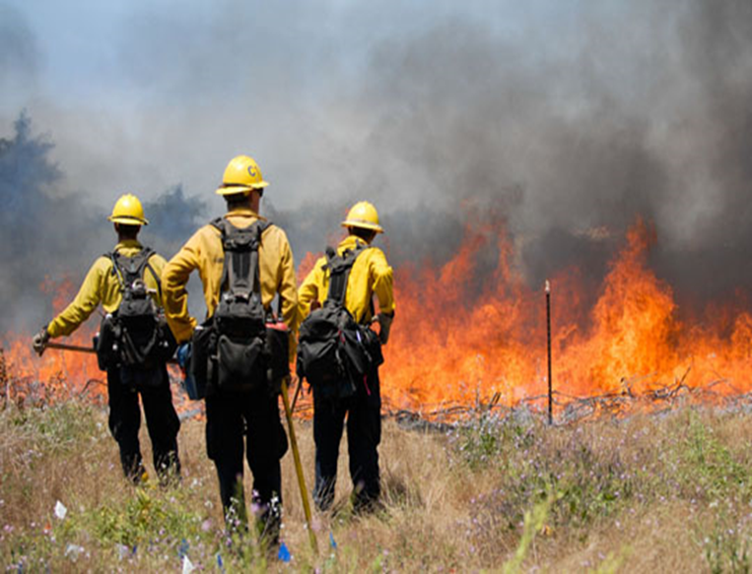
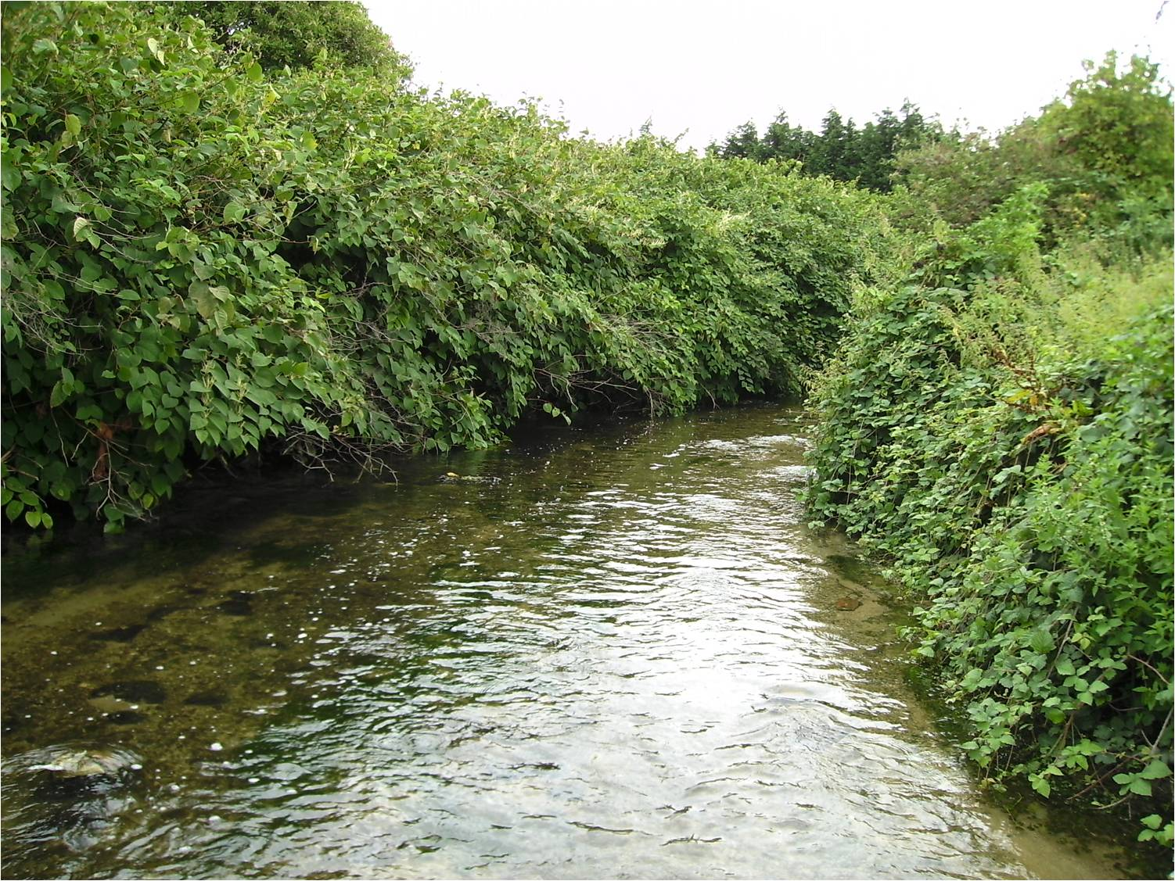
What do weeds impact?
  Plant communities
  Wildlife habitat
  Water resources
  Fisheries
  Recreation
  Natural processes
  Local and State economy

Slide 4
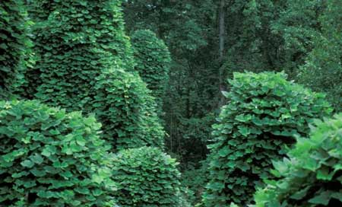
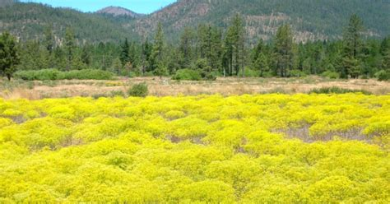
Why is this important?
At home in your yard, you can pull a weed.
In a natural area millions of acres in size, it may not be immediately discovered and pulled, especially if this weed is off a trail deep in a natural area or wilderness.
Many species are not controllable manually, and populations may explode if uncontrolled by other means.
Invasive plants are the second greatest threat to biodiversity after habitat loss.

Slide 5
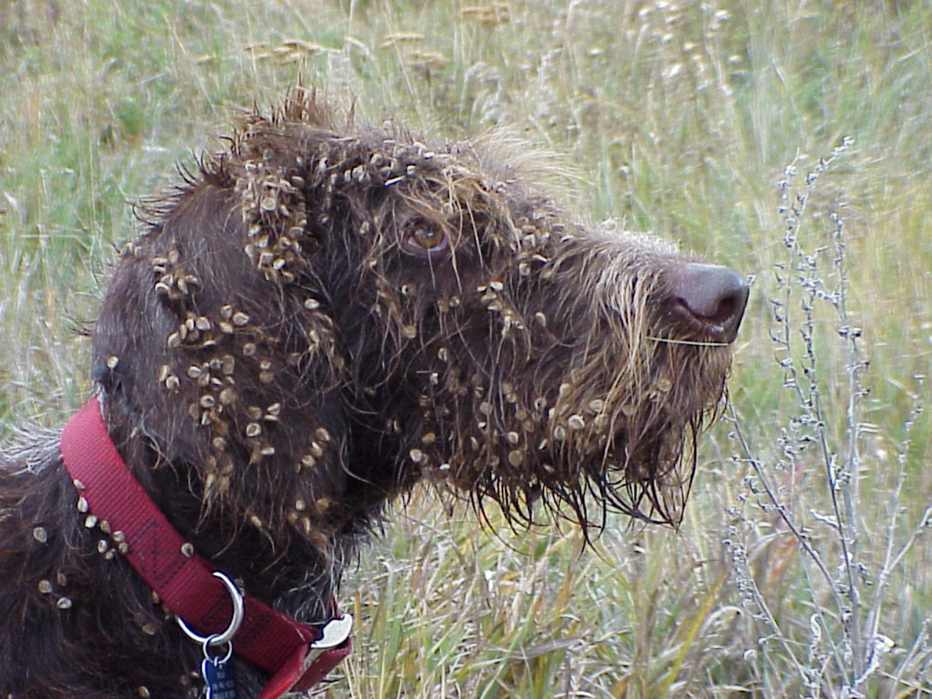
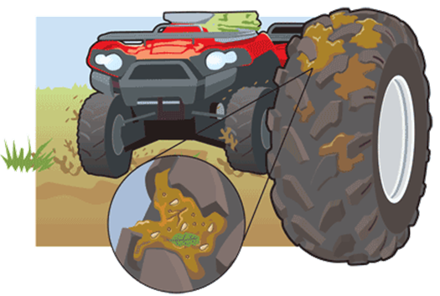
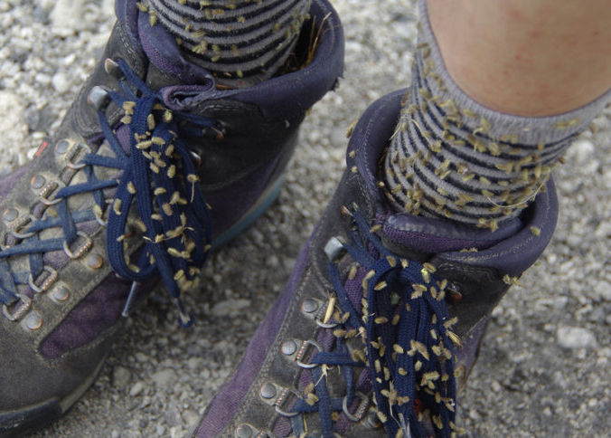
Activities that spread weeds
Motorized travel
  Driving
  Boating
  ORV use
Recreation
  Hiking
  Fishing
  Horseback riding
Disturbance
  Construction
  Wildfire
  Natural events

Slide 6
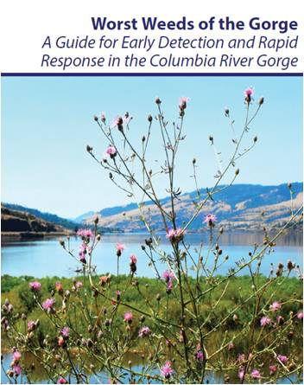
What are our species of concern?
Refer to the Worst Weeds of the Gorge booklet for a reference to the top invasive species of concern in the Columbia River Gorge National Scenic Area, as well as surrounding lands on the Gifford Pinchot National Forest and the Mt. Hood National Forest.

Slide 7
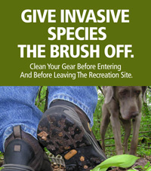

What should you do? Take action!
Be Aware and Prepare
  Clean and check clothing and gear
  Brush animals
  Weed free feed
  Identify invasive plants in the area
Report it!

Slide 8
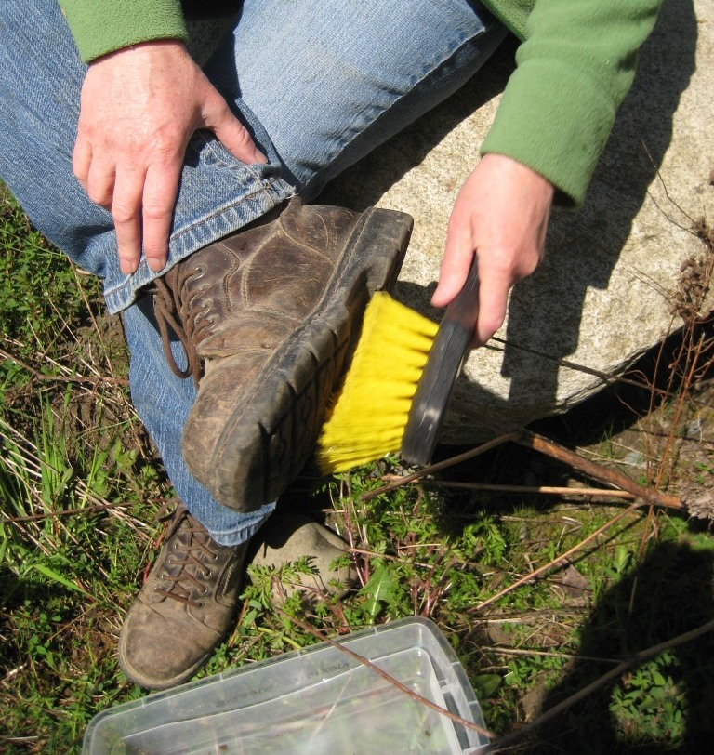
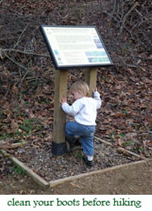
As Trailhead Ambassadors, you will be perfectly placed to alert visitors to the importance of weed prevention. Taking simple steps to clean clothing, gear and animals will dramatically reduce the chance that a visitor will become a weed vector.
Thank you!

